Slide 1


Combination Controls

Slide 2

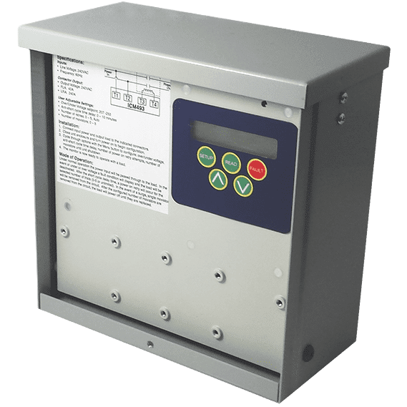
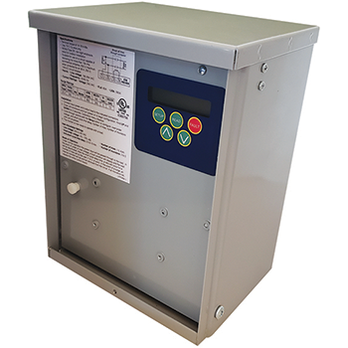

FEATURES:
All- in –one surge protection and voltage monitor
High quality TMOV surge suppression technology
Back lit display for set up or viewing in low light conditions
Rugged 40 Amp contactor to disconnect service voltage to equipment when a fault occurs ( 60Amp model available)
Ideal for mini-splits, heat pumps and inverters
SPECIFICATIONS:
Inputs:
Voltage: 180-264 VAC
Frequency: 50/60 Hz
Output:
Type: Contactor
ICM493 2-Pole contact ratings: 40A FLA, 240A LRA ICM493-60A 2-Pole contact ratings:
60A FLA, 360LRA
ICM493 and ICM493-60A – Single Phase Line Monitor with Surge Protection
Why do I need an ICM493?
It is becoming more common for service voltage to be dirty or fluctuate during the day
This can cause failure of expensive equipment if the service voltage is outside of the limits of the equipment, especially in heat pumps & mini-splits rated for 208/230VAC
The ICM493 not only protects your equipment from irregular voltage but also provides built-in surge protection
Why choose the ICM493 or the ICM493-60A?
Many mini-splits and heat-pumps operate at 208-230 VAC with a maximum allowable voltage of 252 VAC. U.S.A. voltage typically averages 240-246 and can drift above the 252VAC damaging the mini-splits circuit board
The ICM493 incorporates high quality TMOV surge technology
The ICM493 offers an all-in-one solution to both voltage and surge related issues
Easy to use and configurable menu allows for proper setup and protection against voltage and surge related issues.
The display shows how much surge protection is left so the technician knows when to replace the control
Operation
When voltage conditions are outside of the set parameters, the ICM493 will open the internal contactor protecting the load.
When a surge comes down the line connected to the ICM493, the TMOV technology in the ICM493 dissipates the surge to heat to safely protect the protected equipment
APPLIANCE
ELECTRICAL
HVAC/R
MARINE
POOL & SPA
RV

Slide 3
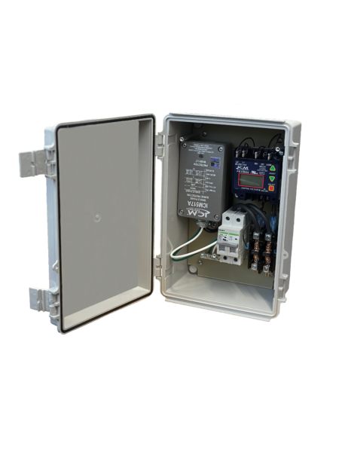
SPECIFICATIONS:
ICM517A Surge Suppressor:
Maximum surge current: 100,000 amps
Robust cast aluminum enclosure for secondary safety
Diagnostics green LED light indicates surge suppression present
Four protection modes: L-L, L-G, L-N, N-G
ICM492D Voltage Monitor User Adjustable settings:
Voltage set point: 18-280 VAC (do not set above 240VAC)
Anti-short cycle time delay: 15-720 seconds
Over/under voltage setting: 5-25% (do not set above 5%)
Inputs:
Line voltage: 208/240 VAC
Frequency: 50/60 Hz
Breaker: 40 amp at 240 VAC
Outputs:
Type: Contactor 2-pole contact ratings: 40A FLA, 240A LRA
SENTRY3N1 – Disconnect with Internal Voltage Monitoring and Surge Protection
Why do I need a SENTRY3N1?
It is becoming more common for service voltage to be dirty or fluctuate during the day.
This can cause failure of expensive equipment if the service voltage is outside of the limits of the equipment
The SENTRY3N1 not only protects your equipment from irregular voltage but also provides built-in surge protection and a 40 amp disconnect switch for ease of installation
With the addition of a contactor for disconnection from service voltage in the case of a fault, the SENTRY3N1 is a best choice for an easy-to-install single-phase protection device
Why choose the SENTRY3N1?
The SENTRY3N1 is ideal for protecting mini-splits or other valuable, 208/240 single-phase equipment and installs easily between the service disconnect and the protected equipment.
All major components are replaceable including the voltage monitor and surge suppressor
Includes a 40 Amp contactor relay to handle inductive loads better than block style relays
Fully wired making it the most cost-effective all-in-one solution for contractors.
Operation
When voltage conditions are outside of the set parameters, the SENTRY3N1 will open the internal contactor protecting the load.
When a surge comes down the line connected to the SENTRY3N1, the TMOV technology in the ICM517A dissipates the surge to safely protect the connected equipment
APPLIANCE
ELECTRICAL
HVAC/R
MARINE
POOL & SPA
RV

Slide 4
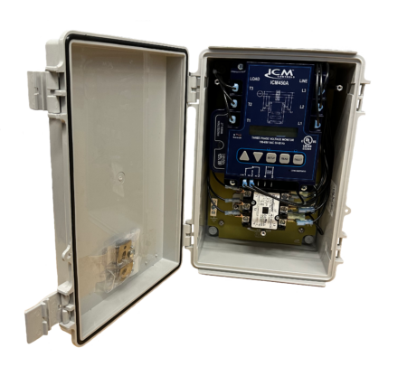
FEATURES:
All components pre-wired for 208/240 volts
Modular design with field replaceable components
Field programmable voltage monitor with backlit LCD display and a large fault history
Protects against over and under voltage, phase loss, phase reversal, phase unbalance and rapid short cycling
Separate 40amp contactor, fully disconnects from the service
Superior TMOV technology provides safe and reliable surge protection, up to 150 kA max surge event
SPECIFICATIONS:
Inputs:
Line voltage: 208/240 VAC
Frequency: 50/60 Hz
Outputs:
Type: Relay, SPDT
2-Pole contact ratings: 40A, 208/240VAC
3VMS – Three-Phase Voltage Monitor and Surge Protector
Why do I need the 3VMS?
Frequently, industrial sites have dirty power or power interruptions that can cause expensive three-phase equipment to fail or become damaged.
Three-phase voltage is unique in that several adverse voltage conditions could lead to equipment failure
Any connected load is susceptible to surges, over/under voltage conditions, phase loss, phase reversal, and phase unbalance.
The 3VMS protects against all these conditions in a simple pre-wired package
Why choose the 3VMS?
The 3VMS combines the benefits of the top selling ICM450A programmable 3-phase line voltage monitor and a high end ICM530 three-phase surge protective device into one easy-to-install solution.
Individual components are easily replaceable and the 3VMS comes prewired for easy installation
Includes a 40-Amp contactor to handle inductive loads better than block style relays
Operation
The 3VMS protects against both power surges and over/ under voltage issues that can cause damage to circuit boards and motors in residential and commercial three-phase 208/240 VAC HVAC/R equipment.
The ICM450A monitors for phase unbalance, over/under voltage, phase loss, and phase reversal.
When these fault conditions are detected, the control opens an internal dry contact relay that can be connected to control voltage or coil voltage to protect the load.
The ICM530 will absorb an incoming surge up to 150kA
APPLIANCE
ELECTRICAL
HVAC/R
MARINE
POOL & SPA
RV

