Slide 1


Electronically Commutated Motor (ECM)

Slide 2

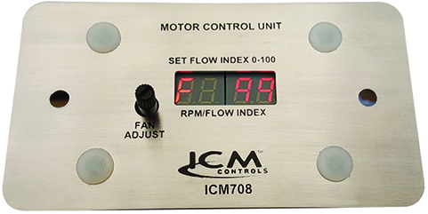
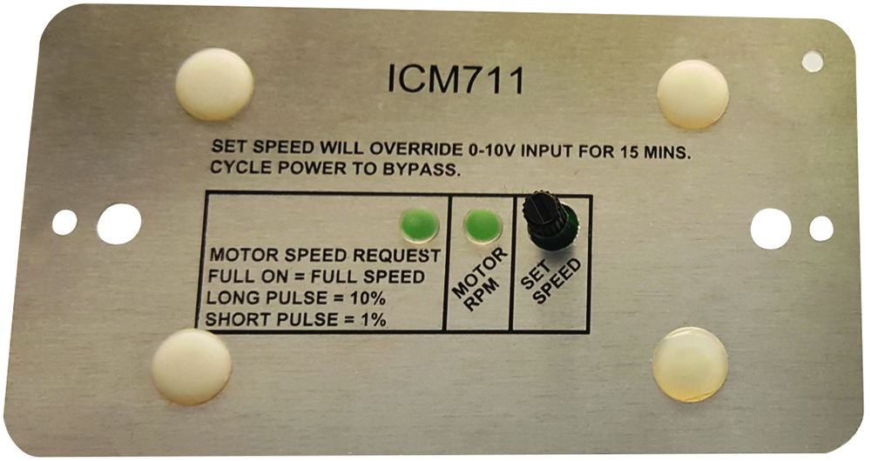
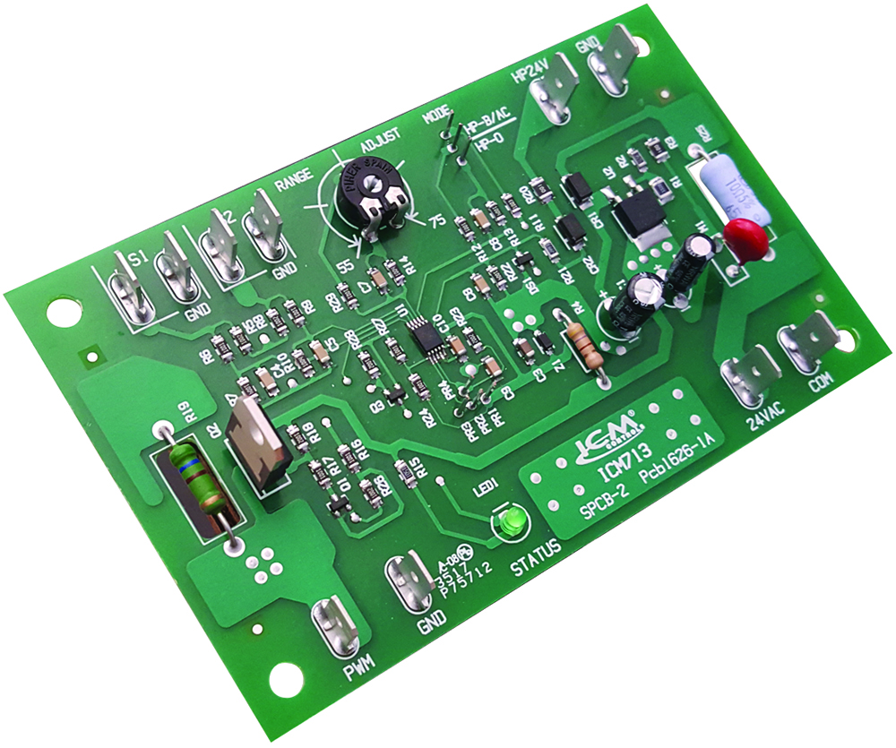

Electronically Commutated Motors (ECM)
REPLACES:
EVO™/ECM-VCU-36-m
EVO™/ECM-ACU+-S1
Hoffman: 800-ECM(10)SSHP
QuickSwapX1 and QuickSwapX3
Why we need Electronically Commutated Motors and their applications?
ECM motors are excellent for efficiency purposes.
The ability to precisely control the speed of the motor allows for varying the airflow and providing an efficient operation of blower fans
Variable speed motors produce less noise, more reliable and provide a comfortable environment
The value of ECM Controls
Form, fit and functional OEM replacements for efficiently controlling a motor’s speed.
Manually or automated control of an ECM is available (model dependent), while monitoring and displaying the RPM, CFM of the motor.
Aftermarket availability allows for contractors to replace OEM parts at a lower cost
Operation
The ICM product will vary the speed of an ECM by providing a pulse width modulated (PWM) signal at an amplitude of 0-10 VDC. Some models will utilize RPM feedback as well.
The ICM713 head pressure control is specifically designed to provide head pressure control to systems incorporating an electronically commutated motor. The ECM motor must be capable of accepting a pulse with modulation (PWM) signal
ICM708
ICM711
ICM713
APPLIANCE
ELECTRICAL
HVAC/R
MARINE
POOL & SPA
RV

Slide 3
SPECIFICATIONS:
Power supply: 18-30 VAC
RPM input: 5 VDC
PWM & ON/OFF outputs:14 VDC (PWM 80Hz)
Dimensions: 4.25” x 2.35” x 1.50”
ICM708 – ECM Control
Features and Benefits:
A low current pulse width modulated signal for controlling the speed of a GE 2.3 ECM based on a user settable potentiometer.
RPM Feedback
On-board LED diagnostics for visual indication of the motor’s status
REPLACES:
EVO™/ECM: -VCU-36-amp
APPLIANCE
ELECTRICAL
HVAC/R
MARINE
POOL & SPA
RV

Slide 4
SPECIFICATIONS:
Power supply: 18-30 VAC, 60Hz
Signal & common: 0-10 VDC – 0-100% PWM request
ECM supplied feedback: 5VDC (motor at rest or not connected)
PWM suppled to ECM: 18VDC (10mA max)
ON/OFF supplied to ECM: 18VDC (10mA max)
RPM & common: 0-10 VDC (5mA max)
– 0-2000 RPM (10 RPM increments)
Dimensions: 4.25” x 2.35” x 1.50”
ICM711 – ECM Control
Features and Benefits:
The ICM711 is used to control the speed of an Electronically Commutated Motor (ECM) by automated control systems via a 0-10 DC input (SIGNAL & COMMON), or manually via potentiometer (SET SPEED).
The ICM711 will also provide motor speed feedback via visual LED indication (MOTOR RPM) as well as a 0-10 VAC output (RPM & COMMON) to supply an automated control system.
REPLACES:
EVO™/ECM – ACU+-S1
APPLIANCE
ELECTRICAL
HVAC/R
MARINE
POOL & SPA
RV

Slide 5
SPECIFICATIONS:
Voltage: 18-30 VAC
Frequency: 50/60 Hz
Output: 13.5 VDC, 10mA max., 80Hz, 0-100%
Operating temperature: -40˚F to 158˚F
Storage temperature: -40˚F to 185˚F
Temperature probes: 10 Kohm (NTC, J-Curve)
Dimensions: 5.00” x 3.25” x 1.50”
ICM713 – Head Pressure Control for ECM
Features and Benefits:
Single or dual temperature inputs
Heat pump bypass circuitry
Low current pulse width modulated output
Lead free design
REPLACES:
Hoffman: 880-ECM(10)SSHP
APPLIANCE
ELECTRICAL
HVAC/R
MARINE
POOL & SPA
RV

