Slide 1


Fan Blower Controls

Slide 2

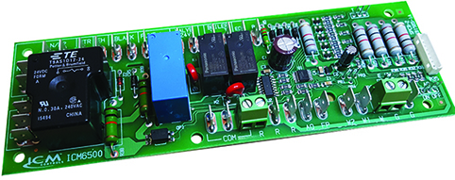

FEATURES:​​
Multi-functional control
Microprocessor controlled
Precision timing
Low-cost solution
SPECIFICATIONS:​​
Voltage: 120VAC or 208-240VAC
Frequency: 50/60Hz​​
Valve output: 24VAC, 50/60Hz, 5A
Blower fan: 120/240VAC, 50/60Hz, 13A/6.5A
Water pump: 120/240VAC, 50/60Hz, 1.5A/1.5A
Boiler: 24VAC, 50/60Hz, 5A
ECM Output: 24VAC, 5A
Dimensions: 2.00” x 7.00” x 1.25”
REPLACES:
Vtronics: R200A
ICM6500-1 – Air Handling Controller
Why we need an Air Handling Controller and their applications?
Air handlers are needed in certain types of heating/cooling systems where the fan is separate from the system
Air handling controllers are the “brains” of the air handler.
The air handler control board controls outputs such as the boiler, water pump, fan motor, water valve and electric heat source in water source heating systems.
The value of choosing ICM controls Air Handling Controller:
ICM6500-1 operates with electric or hot water heating systems
Manufactured and designed in the USA
Replaces more expensive OEM controls
Readily available at HVAC distributors which reduces lead time and adds convenience to both the contractor and homeowner
Operation​
For electric heating systems, the blower fan is turned on with the electric heat. For hot water heating systems, the blower fan, water circulation pump, valve and auxiliary relay are activated by the controller. The blower fan is controlled for cooling cycles.
APPLIANCE
ELECTRICAL
HVAC/R
MARINE
POOL & SPA
RV

Slide 3
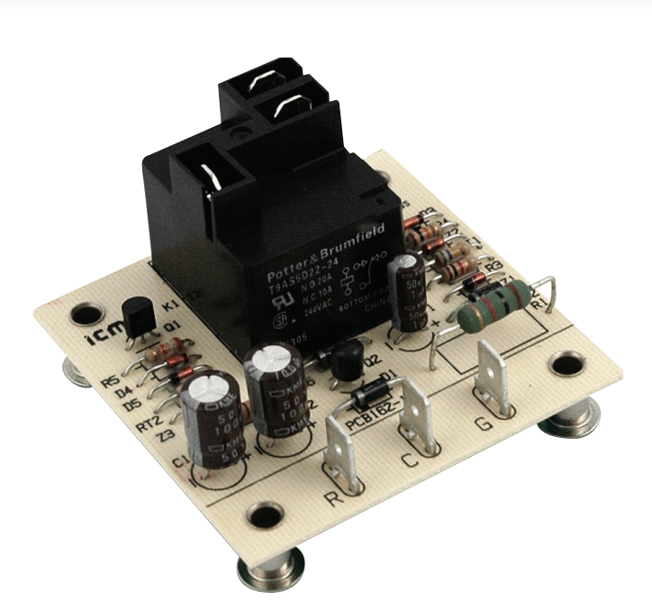
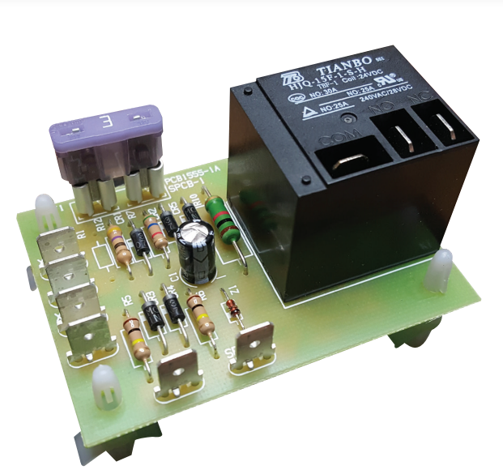
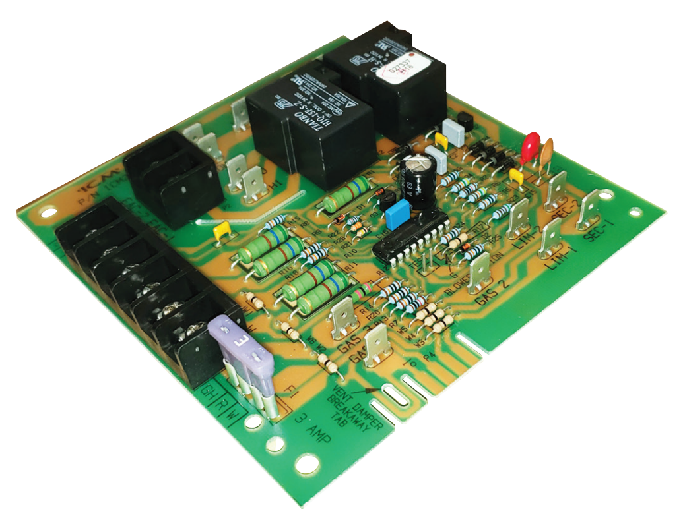
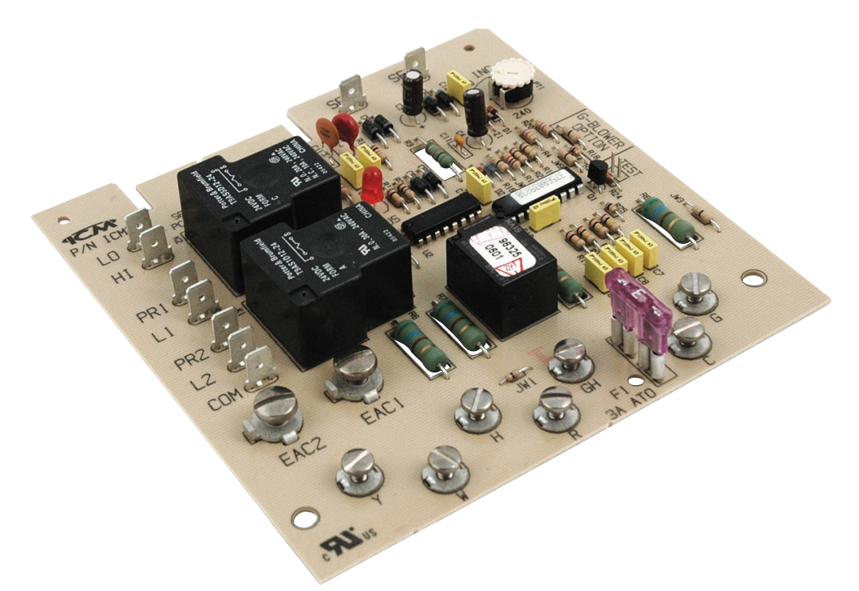
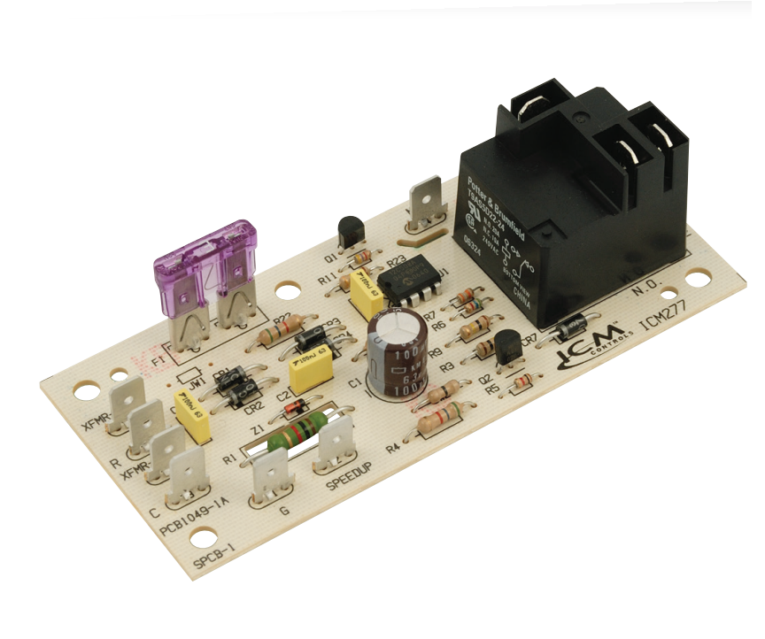
ICM CONTROLS FAN BLOWER CONTROLS CROSS TO MANY POPULAR ORIGINAL EQUIPMENT BRANDS INCLUDING:
Carrier
Robertshaw
Goodman
A-1
Bard
Mars
Rheem
Snyder General / ICP
ICM Controls fan blower controls and their cross references to OEM boards can be found on the ICM Controls website at www.icmcontrols.com
ICM Fan Blower Controls
Why do we need Fan Blower Controls ?
To maintain a stable indoor temperature
Reduces fluctuations in temperature
Timed operation to increase efficiency and lower electrical cost
Extends the life of the blower
The value of the ICM controls Fan Blower Controls
We offer a full line of fan blower controls from OEM replacements to aftermarket replacements
Form, fit, and functional replacement of the original control
Better built boards using double-sided through hole construction and conformal coating for increased reliability
Manufactured in USA
Operation
Fan blower controls will be used in applications where a more precise blower operation is desired. This is achieved by delaying the blower operation from turning on or off.
ICM255
ICM256
ICM271
ICM275
ICM277
APPLIANCE
ELECTRICAL
HVAC/R
MARINE
POOL & SPA
RV

Slide 4
SPECIFICATIONS:​​
Voltage: 18-30 VAC
Dimensions: 2.50” x 2.50” x 1.50”
Time delays fixed:
  ON: 1 seconds
  OFF: 60 seconds
Contact Ratings:
  N.O.: 20amps @ 240VAC
  N.C.: 20amps @ 240VAC
REPLACES:
A1: 5893
Bard: 8201-056
Mars: 32574
Rheem: 42-22515-01, 42-22515-02,
42-22515-03
Snyder General/ICP: 1395336
ICM255 – Fan Blower Control
Features and Benefits:
Low-cost open board design
High power, relay output
Dual function fan delay timer
Controls the circulating fan in heat pump, A/C and forced air systems
OFF delay purges ducts of residual air
APPLIANCE
ELECTRICAL
HVAC/R
MARINE
POOL & SPA
RV

Slide 5
SPECIFICATIONS:​​
Voltage: 18-30 VAC
Dimensions: 2.50” x 2.50” x 1.50”
Time delays fixed:
  ON: 1 seconds
  OFF: 60 seconds
Contact Ratings:
  N.O.: 20amps @ 240VAC
  N.C.: 20amps @ 240VAC
REPLACES:
A1: 5893
Bard: 8201-056
Mars: 32574
Rheem: 42-22515-01, 42-22515-02,
42-22515-03
Snyder General/ICP: 1395336
ICM256 – On Delay on Break Control
Features and Benefits:
Low-cost open board design
High power, relay output
Dual function fan delay timer
Controls the circulating fan in heat pump, A/C and forced air systems
OFF delay purges ducts of residual air
APPLIANCE
ELECTRICAL
HVAC/R
MARINE
POOL & SPA
RV

Slide 6
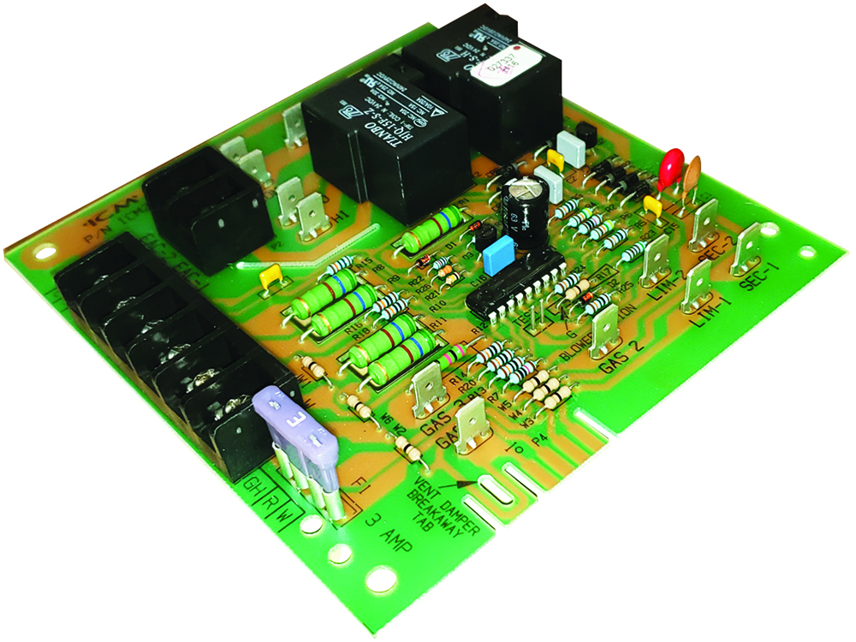
SPECIFICATIONS:​​
Control Voltage: 18-30 VAC
Dimensions: 5.30” x 5.05” x 1.00”
Time delays: Heat ON delay: 75 seconds, Heat OFF delay: 105 seconds, Cool OFF delay: 90 seconds
Contact Ratings:
  N.O.: 20amps
  N.C.: 10amps
REPLACES:
Carrier: 302075-3, CES0110017, CES0110018, HH84AA010, HH84AA011, HH84AA012, HH84AA013, HH84AA020, P771-7002
Robertshaw: 695-100
ICM271 – Fan Blower Control
Features and Benefits:
Reliable solid state fan blower control
Pin selectable blower delays
High power, relay output
Dual function fan delay timer
Controls the circulating fan in HP, A/C and forced air systems
OFF delay purges ducts of residual air
ON delay allows air to reach the proper comfort level prior to energizing the fan
APPLIANCE
ELECTRICAL
HVAC/R
MARINE
POOL & SPA
RV

Slide 7
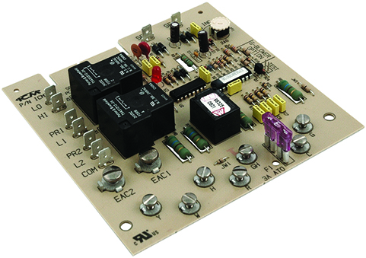
SPECIFICATIONS:​​
Control Voltage: 18-30 VAC
Dimensions: 5.43” x 5.25” x 1.00”
Time delays: Heat ON delay: 60 seconds, Heat OFF delay: 60-240 seconds, Cool OFF delay: 90 seconds
Contact Ratings: High: 20amps @ 240VAC, Low: 10 amps @ 240VAC
REPLACES:
Carrier: CES0110019, HH84AA001, HH84AA003, HH84AA005, HH84AA009, HH84AA014, HH84AA015, HH84AA021
Robertshaw: 695-101
ICM275 – Fan Blower Control
Features and Benefits:
Form, fit and functional OEM replacement control
Heavy duty heat relay
Purges ducts of residual air
Integral short cycle protection
APPLIANCE
ELECTRICAL
HVAC/R
MARINE
POOL & SPA
RV

Slide 8
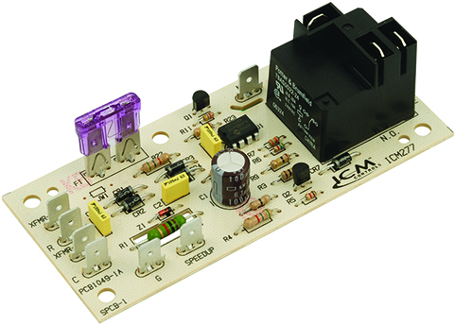
SPECIFICATIONS:​​
Control Voltage: 18-30 VAC
Time delays: Blower ON: 7 seconds, Blower OFF: 65 seconds
Dimensions: 4.50” x 2.00” x 1.25”
Contact Ratings:
  N.O.: 20 amps
  N.C.: 10 amps
REPLACES:
Goodman: B1370735S, PCBFM131S
ICM277 – Fan Blower
Post Purge Time Delay
Features and Benefits:
Microprocessor-based fan blower
For circulating fan in heat pump, A/C and forced air systems
APPLIANCE
ELECTRICAL
HVAC/R
MARINE
POOL & SPA
RV

