Slide 1


Furnace Control Boards

Slide 2

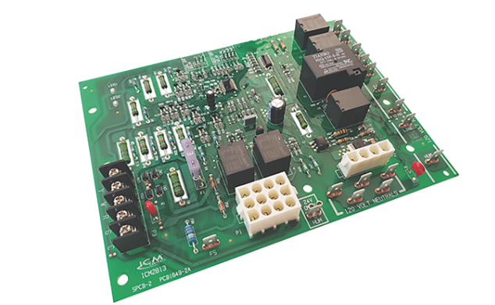
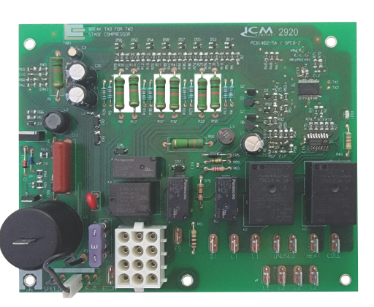

FEATURES:
Controls full operation of the furnace
Microprocessor based precision control and timing
Assembled in USA
Double sided plated through hole construction for durability
Conformal coated for protection
SPECIFICATIONS:
Line Voltage: 120VAC or 120/240VAC (depends on model)
Control voltage: 18-30VAC
Output: Relay (amperage depends on model)
REPLACES:
Many popular OEM brands like Goodman, Rheem, Lennox, Trane, Carrier...etc.
ICM Controls Drop In Furnace Control Board Replacements
Why we need options for furnace board replacements and their applications?
When your furnace breaks down you need a solution fast
The original manufacturer's board may not readily be available
The manufacturer board is likely to be far more expensive
The value of using ICM controls furnace boards:
ICM controls has a full line of both Hot Surface Ignition (HSI) and Direct Spark Ignition (DSI) furnace boards
Many popular OEM brands like Goodman, Rheem, Lennox, Trane, Carrier...etc.
Readily available either online or at a local HVAC distributor
Drop-in, form, fit, and functional boards for easy replacement
Less time for installation saves the customer money
Operation:
ICM Controls automated gas ignition control boards monitor the ignition sequence including the inducer, pressure switch, ignition, gas valve, flame sense, and circulating blower while maintaining full safety circuit monitoring. Onboard diagnostics will indicate when a fault condition exists.
HSI
DSI
APPLIANCE
ELECTRICAL
HVAC/R
MARINE
POOL & SPA
RV

Slide 3
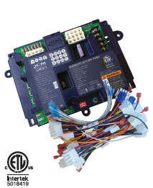
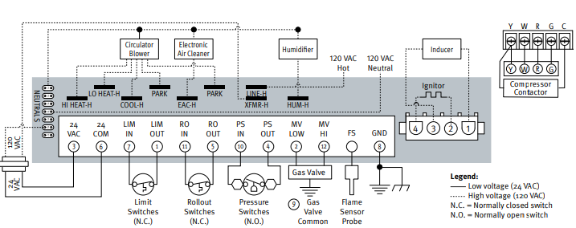
FEATURES:​​
Redundant gas valve safety design​​
Double sided plated through hole board construction​
Fault memory​​
​Agency certified​
Hot surface ignition​
Compatible with over 200 crosses​
SPECIFICATIONS:​​
Input:​​ • Line Voltage: 120 VAC​​ • Control Voltage: 18 – 30 VAC​​
Output:​​ • Type: Relay​ • Blower motor: 9.5 FLA @​ 120VAC
REPLACES:
White Rogers 50M26U-843U and over 200 popular furnace boards including Carrier, Rheem, Nordyne, Goodman, Trane etc.
ICM2812-KIT Universal Hot Surface Ignition Furnace Control board
Why Universal furnace control boards are the way to go?
Reduces truck stock inventory
Eliminates trips back and forth to distributors
Reduces inaccurate crosses by offering a single affordable solution to OEM boards
The value of choosing ICM controls Furnace Boards
Proudly assembled in USA
Meets stringent agency requirements for safety
Durable circuit board design and construction ensures strong connections increasing reliability
Complete with all the required cables to easily fit over 200 furnace boards
U.S. based live technical support with real technicians instead of artificial intelligence
Operation
The board controls all functions of the furnace including timing, trial for ignition, gas valve, system safety switches, flame sensing and provides 100% lockout safety
APPLIANCE
ELECTRICAL
HVAC/R
MARINE
POOL & SPA
RV

Slide 4
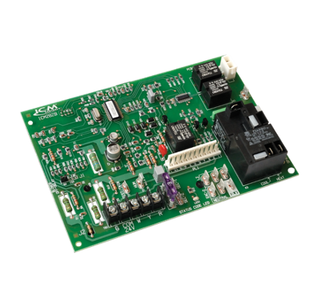
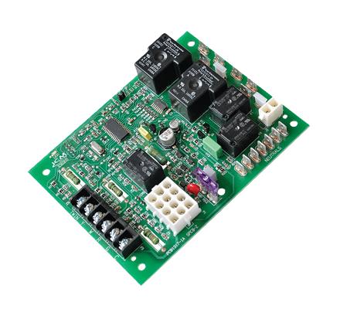
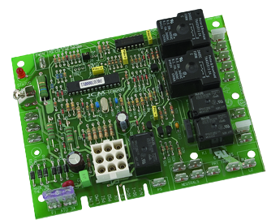
ICM CONTROLS HOT SURFACE IGNITION BOARDS CROSS TO MANY POPULAR ORIGINAL EQUIPMENT BRANDS INCLUDING:
Carrier
White Rodgers
Lennox
Goodman
Trane
UTEC
ICP
Rheem
Nordyne
Texas Instruments
ICM Controls Hot Surface Ignition furnace boards and their cross references to OEM boards can be found on the ICM Controls website at www.icmcontrols.com
Hot Surface Ignition Furnace Boards
Hot surface Ignition (HSI)
Use a high resistance element which glows red hot to provide the means to ignite natural gas in a natural gas furnace
The value of choosing ICM controls HSI Furnace Boards
Proudly assembled & engineered in USA
Meets stringent agency requirements for safety
Durable circuit board design and construction ensures strong connections and increased reliability
U.S. based technical support with real technicians instead of artificial intelligence
Operation
The board controls all functions of the furnace including timing, trial for ignition, gas valve, system safety switches, flame sensing and provides 100% lockout safety
ICM282B
ICM280
ICM2910
APPLIANCE
ELECTRICAL
HVAC/R
MARINE
POOL & SPA
RV

Slide 5
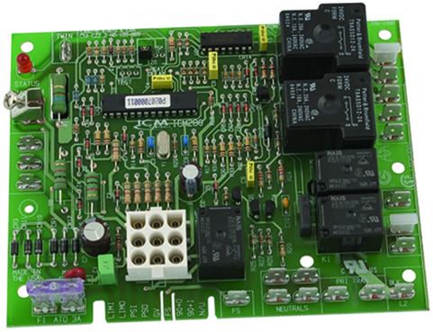
SPECIFICATIONS:
Line voltage: 120 VAC @ 60 Hz
Control voltage: 24 VAC
Fan: 2 HP @ 240 VAC
Inducer motor: 7 amps @ 250 VAC
Gas valve: 1 amp @ 24 VAC
Ignitor: 5 amps @ 120 VAC
Dimensions: 5.80” x 4.50” x 1.00”
ICM280 – Furnace Control
Controls gas valve, ignitor, blower motor, inducer
Microprocessor-based
Status LED for fault codes
Twinning compatible with another ICM280 board
REPLACES:
Goodman: B180999-06, B180999-08, B180999-10, B180999-13, B180999-13S
UTEC: 1012-933D
Texas Instruments: 41F-5
White-Rodgers: 50T35-730, 50T35-743
APPLIANCE
ELECTRICAL
HVAC/R
MARINE
POOL & SPA
RV

Slide 6
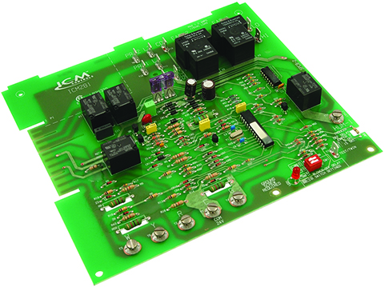
SPECIFICATIONS:
Line voltage: 120 VAC @ 60 Hz
Control voltage: 24 VAC
Operating temp.: -40°F to 176°F (-40°C to 75°C)
Ignitor: 5A @ 120 VAC
Cool blower: 30A, 2HP, 240 VAC
Heat: 5A, 1/2 HP, 240 VAC
Inducer motor: 4A, FLA-8.0 LRA @ 120 VAC
Gas valve: 1.5A @ 30 VAC
Dimensions: 8.50” x 7.50” x 1.00”
ICM281 – Furnace Control
Control gas valve, ignitor, blower motor, inducer, humidifier and air cleaner
Microprocessor-based
Designed for 100% gas shutoff in case of ignition failure
Model selection of 80+ and 90+ furnace operation
Reverse polarity protection
Secondary brownout voltage protection
Heating and cooling fan functions in response to standard thermostat
Provides diagnostic LEDs to aid in troubleshooting
Twinning compatible with another ICM281 board
REPLACES:
Carrier: CES0110020, CES0110048, CES0110057-00, CES0110057-01, CES0110057-02, HH84AA016
APPLIANCE
ELECTRICAL
HVAC/R
MARINE
POOL & SPA
RV

Slide 7
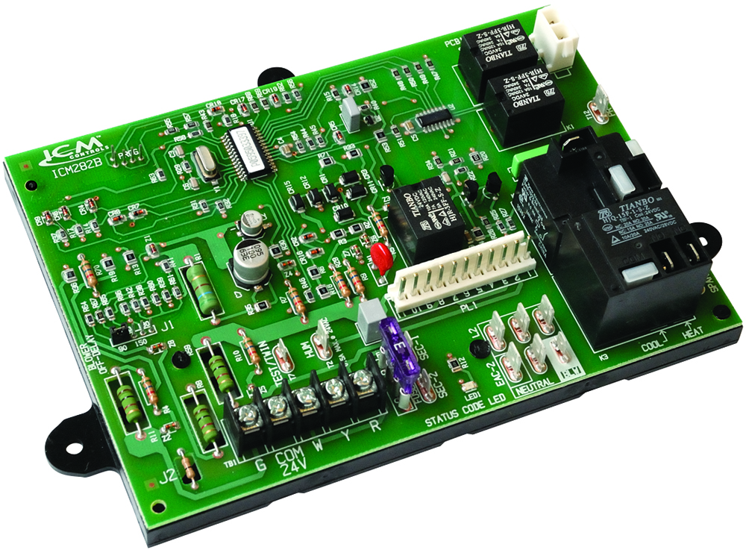
SPECIFICATIONS:
Line voltage: 120 VAC @ 60 Hz
Control voltage: 24 VAC
Operating temp.: -40°F to 176°F (-40°C to 75°C)
Ignitor: 5A @ 120 VAC
Cool blower: 30A, 2HP, 240 VAC
Heat: 5A, 1/2 HP, 240 VAC
Inducer motor: 4A, FLA-8.0 LRA @ 120 VAC
Gas valve: 1.5A @ 30 VAC
Dimensions: 8.25” x 5.50” x 1.50”
ICM282B – Furnace Control
Control gas valve, ignitor, blower motor, inducer, humidifier and air cleaner
Microprocessor-based
Designed for 100% gas shutoff in case of ignition failure
Reverse polarity protection
Secondary brownout voltage protection
Heating and cooling fan functions in response to standard thermostat
Provides diagnostic LEDs to aid in troubleshooting
Includes adapter harness (not shown)
Twinning compatible with another ICM282B board
REPLACES:
Carrier: HK42FZ004, HK42FZ007, HK42FZ008, HK42FZ009, HK42FZ011, HK42FZ013, HK42FZ016, HK42FZ034, 325878-751
ICP: 1176943
APPLIANCE
ELECTRICAL
HVAC/R
MARINE
POOL & SPA
RV

Slide 8
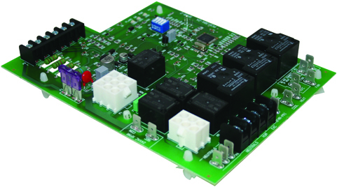
SPECIFICATIONS:
Line voltage: 120 VAC @ 60 Hz
Control voltage: 24 VAC
Ignitor: 5A, 120 VAC
Cool blower: 10A, 2HP, 240 VAC
Heat: 5A, ½ HP, 250 VAC
Inducer blower: 4A, 120 VAC
Gas valve: 1A, 24 VAC
Humidifier motor: 0.5A, 24 VAC
Electronic air cleaner: 1A, 120 VAC
Dimensions: 7.50” x 5.75” x 1.50”
ICM288 – Furnace Control
Microprocessor-based precision
Monitors pressure, roll-out and limit switches
Controls gas valve, inducer draft motor, circulating blower and hot surface ignitor
Reverse polarity detection
Twinning compatible with another ICM288 board
Diagnostic LEDs to aid in testing/troubleshooting
REPLACES:
Rheem: 62-24084-82
APPLIANCE
ELECTRICAL
HVAC/R
MARINE
POOL & SPA
RV

Slide 9
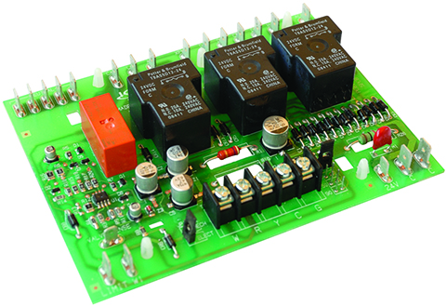
SPECIFICATIONS:
Line voltage: 120 VAC @ 60 Hz
Control voltage: 24 VAC
Cool blower: 20A @ 120 VAC
Heat blower: 20A @ 120 VAC
Inducer motor: 5A @ 120 VAC
Cool blower ON delay: 1 second
Cool blower OFF delay: 1 second
Heat blower ON delay: 45 seconds
Heat blower OFF delay: 90, 150, 210 or 270 secs
Dimensions: 5.60” x 4.25” x 1.50”
ICM289 – Furnace Control
Controls inducer fan motor, blower fan and monitors limit switches
Microprocessor based design
Functions with all 24 VAC thermostats
REPLACES:
Lennox: Replaces all BCC1, BCC2 and BCC3 circuit boards, including 48K98 and 45K48.
APPLIANCE
ELECTRICAL
HVAC/R
MARINE
POOL & SPA
RV

Slide 10
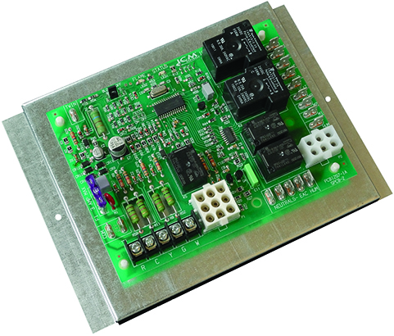
SPECIFICATIONS:
• Line voltage: 120 VAC @ 60 Hz
• Control voltage: 24 VAC
• Ignitor: 5A, 120 VAC
• Cool blower: 10A, 2HP, 240 VAC
• Heat: 5A, ½ HP, 250 VAC
• Inducer blower: 4A, 120 VAC
• Gas valve: 1A, 24 VAC
• Humidifier motor: 0.5A, 24 VAC
• Electronic air cleaner: 1A, 120 VAC
• Dimensions: 6.00” x 4.50” x 1.50”
ICM2805A – Furnace Control
Controls gas valve, inducer draft motor, circulating blower and hot surface ignitor
Monitors timing, trial for ignition, flame sensing, lockout, plus pressure, roll out and limit switches
Microprocessor-based precision
Twinning compatible with another ICM2805A furnace control
Diagnostic LEDs aid in testing and troubleshooting
REPLACES:
• Nordyne: 624631/624631B
APPLIANCE
ELECTRICAL
HVAC/R
MARINE
POOL & SPA
RV

Slide 11
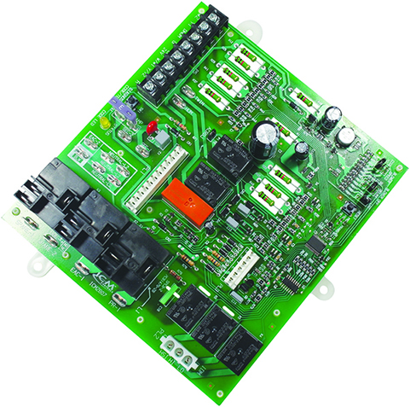
SPECIFICATIONS:
• Line voltage: 120 VAC @ 60 Hz
• Control voltage: 24 VAC
• Ambient temperature:
• Operating: -40ºF to 176ºF • Storage: -40ºF to 185ºF
• Ignitor: 5A @ 120 VAC
• Humidity: 5% to 95% R.H. (non-condensing) @ 131°F
• Cool blower: 10 HP, 120 VAC
• Low heat: 5A, 1/2 HP, 120 VAC
• High heat: 10A, 1 HP, 120 VAC
• Inducer motor: 4A, FLA-8.0 LRA @ 120 VAC
• Gas valve: 1.5A @ 30 VAC
• EAC: 1A@120 VAC
• Humidifier: 0.5A & 24 VAC
• Dimensions: 7.00” x 6.50” x 1.50”
ICM2807 – Furnace Control
Controls gas valve, ignitor, blower motor, inducer, humidifier and air cleaner
Microprocessor-based precision
Designed for 100% gas shutoff in case of ignition failure
Twinning compatible with another ICM2807 control
Reverse polarity protection
Secondary brownout voltage protection
Compatible with 24 VAC standard thermostats
Continuous blower speed jumper
Provides diagnostic LEDs to aid in troubleshooting
REPLACES:
• Carrier: HK42FZ017
APPLIANCE
ELECTRICAL
HVAC/R
MARINE
POOL & SPA
RV

Slide 12
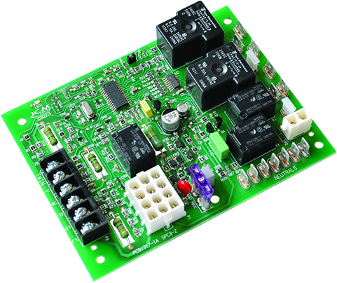
SPECIFICATIONS:
• Line voltage: 120 VAC @ 60 Hz
• Control voltage: 24 VAC
• Blower: 10 FLA, 25 LRA @ 120 VAC
• Inducer motor: 2.8 FLA, 3.5 LRA @ 120 VAC
• Ignitor: 1.2A @ 120 VAC
• Dimensions: 6.00” x 4.50” x 1.00”
ICM2810 – Furnace Control
Microprocessor-based precision
Controls inducer and blower fan motor, hot surface ignitor, and gas valve
Monitors timing, trial for ignition, flame sensing, pressure and limit switches, and lockout
Designed for 100% gas shutoff in case of ignition failure
Twinning compatible with another ICM2810
Compatible with LP or natural gas
Diagnostic LED to aid in testing/troubleshooting
REPLACES:
• Goodman: PCBBF-136, PCBBF140
APPLIANCE
ELECTRICAL
HVAC/R
MARINE
POOL & SPA
RV

Slide 13
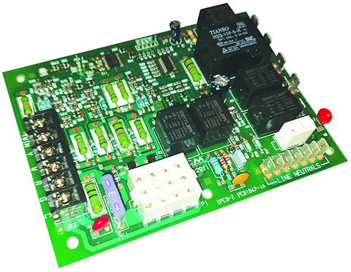
SPECIFICATIONS:
• Line voltage: 120 VAC @ 60 Hz
• Control voltage: 18-30 VAC
• Frequency: 60 Hz
• Igniter current: 6.0 amp @ 120 VAC 60 Hz (resistive)
• Inducer relay: 2.2 FLA–3.5 LRA @ 120 VAC
• Blower relay: 14.5 FLA–25.0 LRA @ 120 VAC (2spd–H/C)
• Gas valve relay: 1.5 amp @ 25 VAC 60 Hz 0.6 pf
• Operating temperature: -40˚F to 176˚F (-40˚C to 80˚C)
• Humidity range: 5 to 95% RH (non-condensing)
• Dimensions: 5.75” x 4.50” x 1.25”
ICM2811 – Furnace Control
Controls the gas valve, inducer draft motor, circulating blower and hot surface ignitor
Monitors system pressure and limit switches
Microprocessor based precision
Twinning compatible with another ICM2811 control board
Diagnostic LEDs aid in testing and troubleshooting
REPLACES:
• Goodman: PCBBF110/S, CBBF123/S, PCBBF123S, 0130F00005/S, PCBBF112/S, B18099-26/S
• ICM: ICM286
• White-Rodgers: 50A55-743, 50A55-289, 50T55-289
APPLIANCE
ELECTRICAL
HVAC/R
MARINE
POOL & SPA
RV

Slide 14
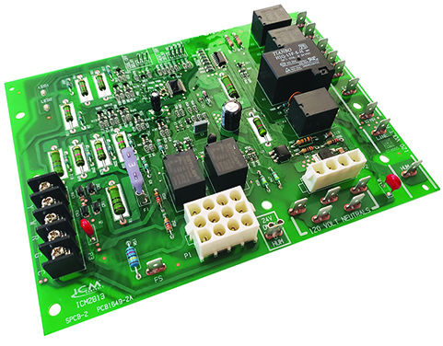
SPECIFICATIONS:
• Control voltage: 18-30 VAC
• Line voltage: 120 VAC @ 60 Hz
• Frequency: 60 Hz
• Igniter current: 2.0 amp @ 80 VAC 60 Hz (resistive)
• Inducer relay: 2.2 FLA–3.5 LRA @ 120 VAC
• Blower relay: 14.5 FLA–25.0 LRA @ 120 VAC (2spd–H/C)
• Gas valve relay: 1.5 amp @ 25 VAC 60 Hz 0.6 pf
• Operating temperature: -40˚F to 176˚F (-40˚C to 80˚C)
• Humidity range: 5 to 95% RH (non-condensing)
• Dimensions: 5.75” x 7.50” x 1.25”
ICM2813 – Furnace Control
Controls the gas valve, inducer draft motor, circulating blower and hot surface ignitor
Monitors system pressure and limit switches
Microprocessor based precision
Diagnostic LEDs aid in testing and trouble shooting
REPLACES:
• Lennox: 10M9301, 12L6901, 32M8801, 56L8401, 24L8501, 63K8901, 97L4801, 100925-01, 100925-03, 17W9201, 23W5101, 30W2501, 69M0801, 69M1501, 83M00
• White-Rodgers: 21D83M-843, 50A65-120, 50A65-121, 50A62-120, 50A62-121, 50A62-820, 50A66-122, 50A66-123
APPLIANCE
ELECTRICAL
HVAC/R
MARINE
POOL & SPA
RV

Slide 15
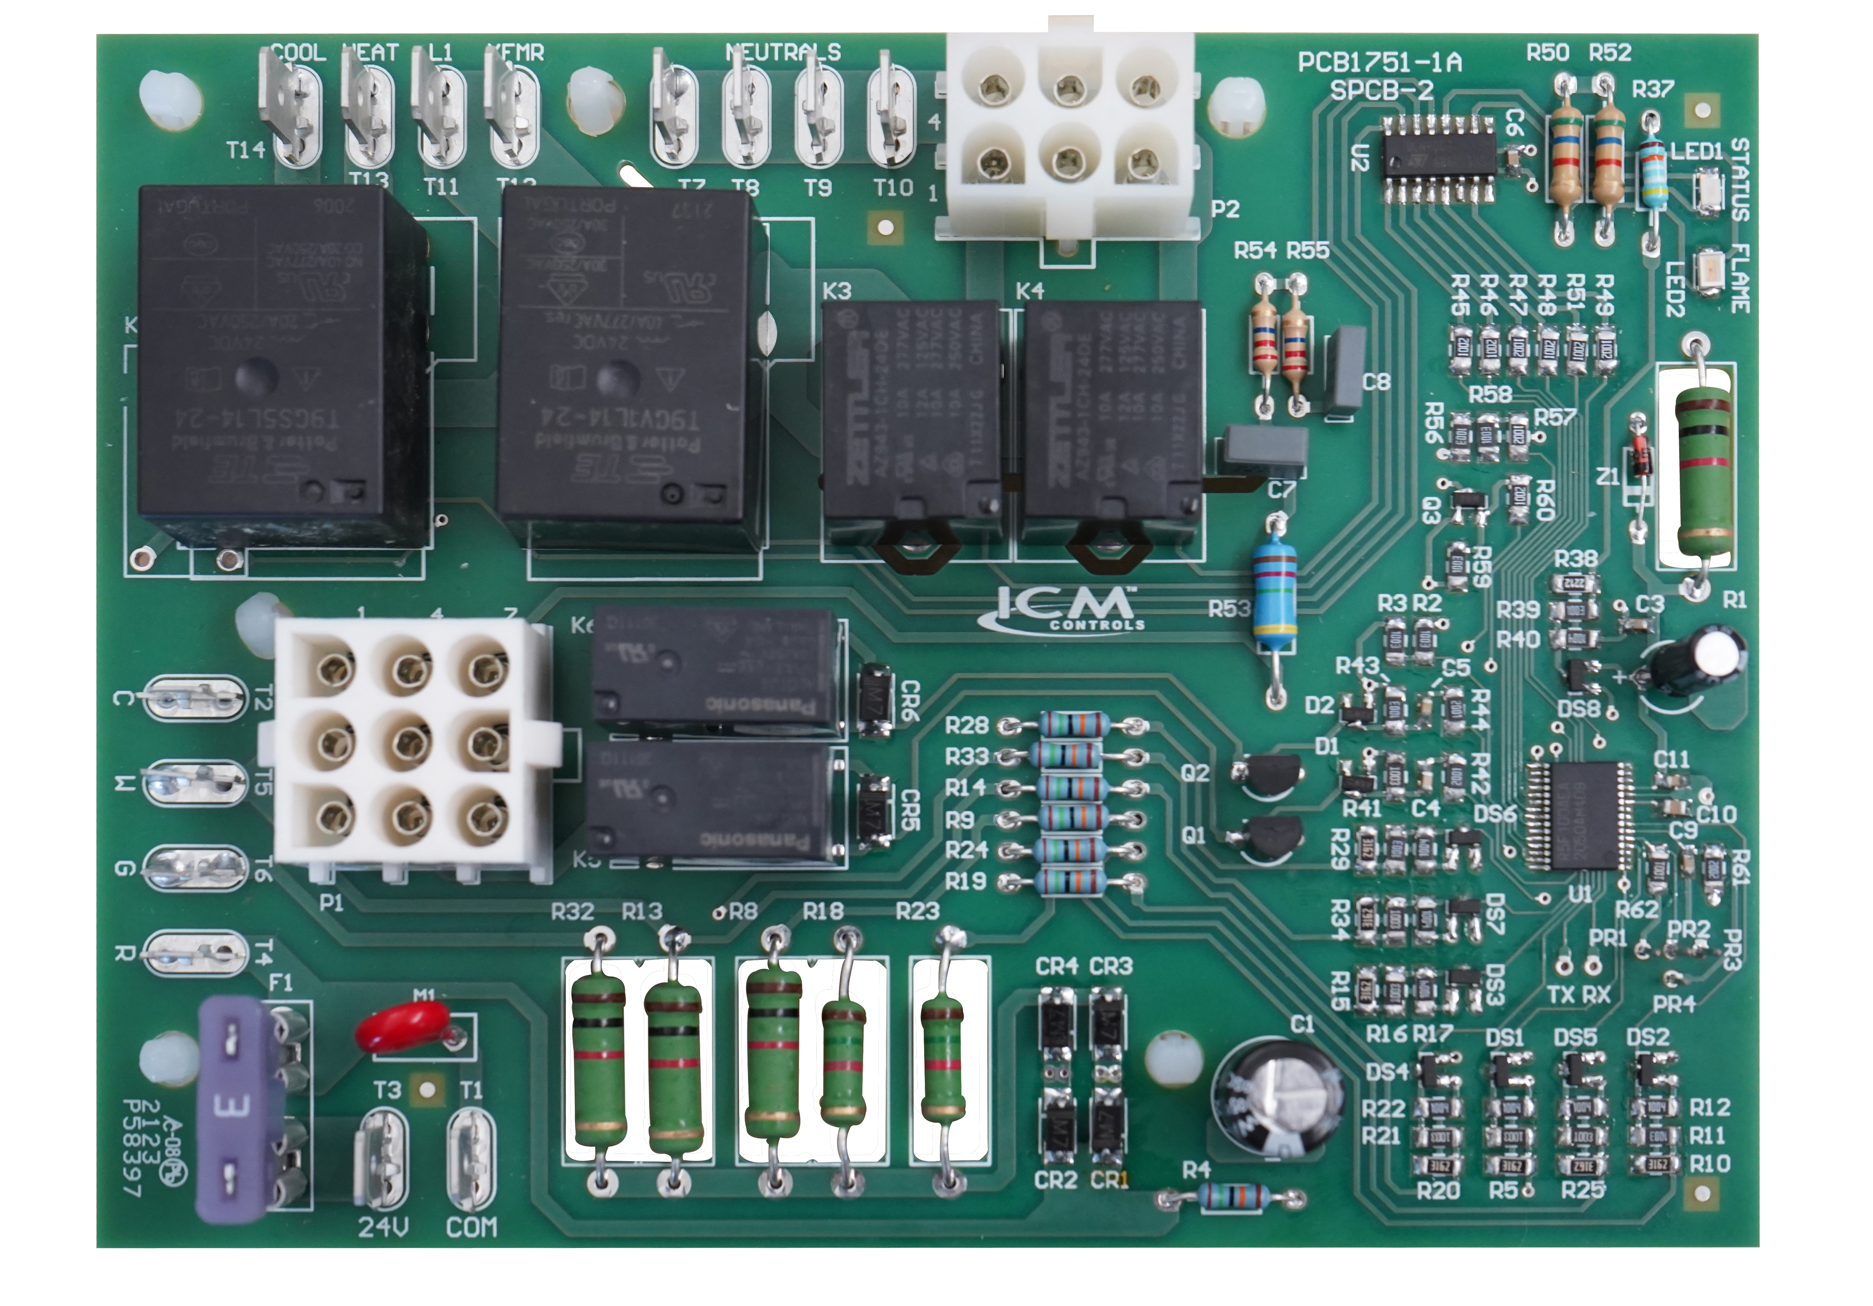
SPECIFICATIONS:
• Input: 120 VAC, 60 Hz
• Control Voltage: 18-30 VAC
• Blower Motor: (M1MA): 1/5 HP (or 1/8),
120 VAC
3-Ton (M1MB): 1/4 HP, 120 VAC
4-Ton (M1MC): 1/2 HP, 120 VAC
5-Ton (M1MD): 3/4 HP, 120 VAC
• Inducer: 1/100HP (0.69A) @ 120V, 60 Hz
• HSI: 6.0A @ 120 VAC, 50/60 Hz (resistive)
• Gas Valve: 0.5A @ 24 VAC, 50/60 Hz (resistive)
ICM2818 – Furnace Control
Controls furnace operation including the function of the induced draft blower, circulating blower, ignition sequence, gas valve, and flame sense.
Monitors system safeties to properly lock out operation when there is a safety fault
Detects and communicates faults using diagnostic LED to aid troubleshooting.
Form, fit, and functional replacement for the OEM boards listed as a cross.
REPLACES:
• Nordyne: 903429, 624602, 624640,
1012-93-9581A, 1012-012-958A, 233089
APPLIANCE
ELECTRICAL
HVAC/R
MARINE
POOL & SPA
RV

Slide 16
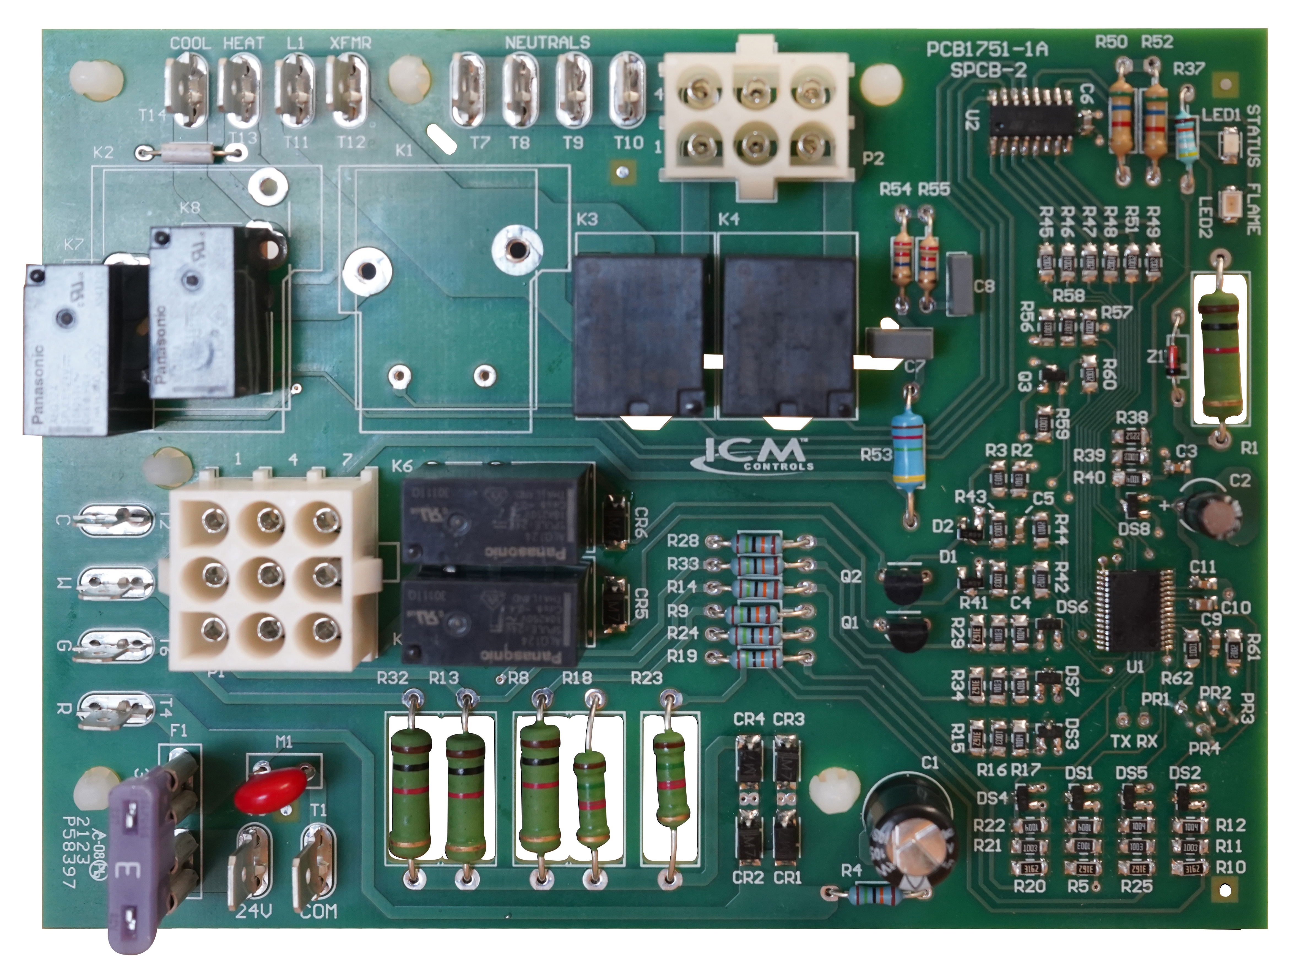
SPECIFICATIONS:
• Input: 120 VAC, 60 Hz
• Control Voltage: 18-30 VAC
• Inducer: 1/100HP (0.69A) @ 120V, 60 Hz
• HSI: 6.0A @ 120 VAC, 50/60 Hz (resistive)
• Gas Valve: 0.5A
ICM2820 – Furnace Control
Controls furnace operation including the function of the induced draft blower, circulating blower, ignition sequence, gas valve, and flame sense.
Monitors system safeties to properly lock out operation when there is a safety fault
Detects and communicates faults using diagnostic LED to aid troubleshooting.
Form, fit, and functional replacement for the OEM boards listed as a cross.
REPLACES:
• Nordyne: 1021575R
APPLIANCE
ELECTRICAL
HVAC/R
MARINE
POOL & SPA
RV

Slide 17
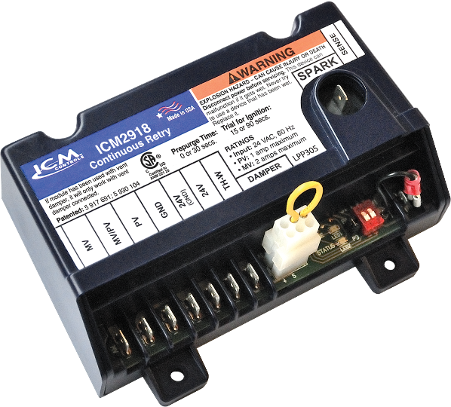
ICM CONTROLS HOT SURFACE IGNITION BOARDS CROSS TO MANY POPULAR ORIGINAL EQUIPMENT BRANDS INCLUDING:
Carrier
White Rodgers
Lennox
Goodman
Trane
UTEC
ICP
Rheem
Nordyne
Texas Instruments
ICM Controls Hot Surface Ignition furnace boards and their cross references to OEM boards can be found on the ICM Controls website at www.icmcontrols.com
ICM2918 Universal Intermittent Pilot Ignition Control
Why use a Universal Pilot Ignition control
Universal function saves the distributor from stocking multiple SKU's
Great for truck stock for contractors
Replaces the very popular Honeywell S8610U universal pilot ignition control.
The value of choosing ICM controls HSI Furnace Boards
Proudly assembled & engineered in USA
Meets stringent agency requirements for safety
Durable circuit board design and construction ensures strong connections and increased reliability
U.S. based technical support with real technicians instead of artificial intelligence
Operation
The ICM2918 Universal Intermittent Pilot Gas spark Ignition Control Module initiates and monitors pilot flame, trial for ignition, vent damper and the gas valve operation while incorporating a flame sensing circuit which will safely go into 100% lockout if flame sense is lost.
APPLIANCE
ELECTRICAL
HVAC/R
MARINE
POOL & SPA
RV

Slide 18
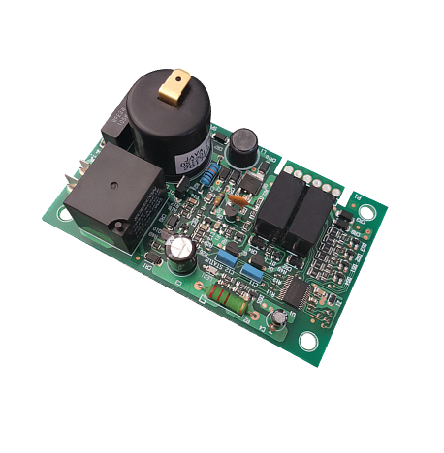
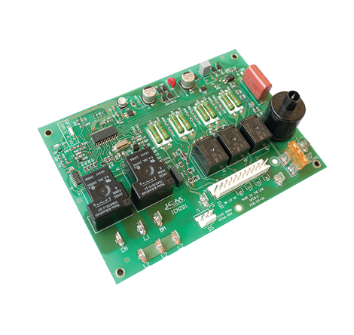
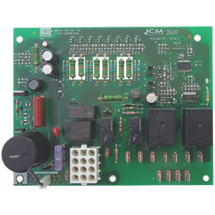
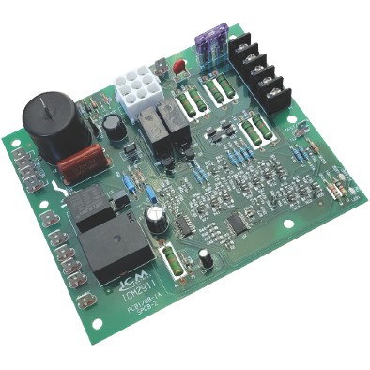
ICM CONTROLS HOT SURFACE IGNITION BOARDS CROSS TO MANY POPULAR ORIGINAL EQUIPMENT BRANDS INCLUDING:
White Rodgers
Lennox
Goodman
Trane
UTEC
ICP
Rheem
Nordyne
Texas Instruments
ICM Controls Direct Spark Ignition furnace boards and their cross references to OEM boards can be found on the ICM Controls website at www.icmcontrols.com
Direct Spark Ignition Furnace Boards
Direct Spark Ignition (DSI)
Uses a spark coil to emit a high voltage spark across a gap to a ground rod to provide the means to ignite natural gas or propane in a gas fired furnace
The value of choosing ICM controls DSI Furnace Boards
Proudly assembled & engineered in USA
Meets stringent agency requirements for safety
Durable circuit board design and construction ensures strong connections and increased reliability
U.S. based technical support with real technicians instead of artificial intelligence
Operation
The board controls all functions of the furnace including timing, trial for ignition, gas valve, system safety switches, flame sensing and provides 100% lockout safety
ICM6700
ICM2920
ICM291
ICM2911
APPLIANCE
ELECTRICAL
HVAC/R
MARINE
POOL & SPA
RV

