Slide 1


Head Pressure Controls

Slide 2

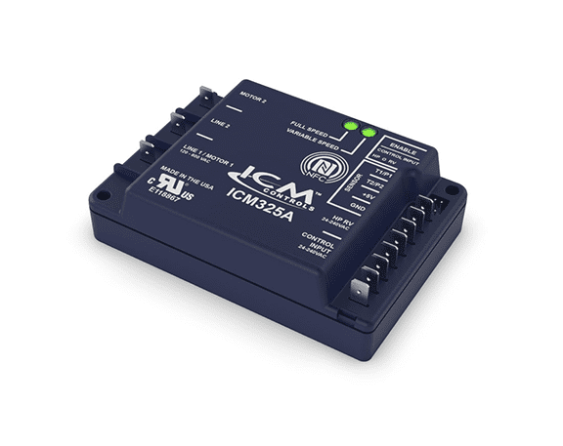

FEATURES:
Near field communication via the ICM Omni App
2 senor inputs
Universal control and input voltage
SPECIFICATIONS:
Input: • Voltage Range: Universal 120 – 600 VAC • Control Voltage: 24 – 240 VAC (jumper enabled)
Output: • Motor 2: 10A maximum
ICM325A – Single-Phase Universal Head Pressure Control
Why we need Head Pressure Controls and their applications ?
Supermarkets, grow houses and computer rooms still require air conditioning and refrigeration during low-ambient conditions.
To prevent the loss of perishable goods and damage to sensitive equipment
Prevents issues like liquid slugging and evaporator freeze-ups.
Helps regulate the system pressure.
The value of the ICM’s Head Pressure Controls
Universal input voltage 120-600VAC
NFC technology allows for easy programming and setup without the need for external power by using the power of your mobile device and the ICM OMNI App!
NFC does not require internet connection and is more reliable than Bluetooth
More reliable and accurate than setting with basic potentiometers
Universal operation reduces truck stock and multiple SKU’s making it a great choice for both stocking distributors and contractor alike
Operation
The ICM325A will control the head pressure on a heat pump or HVAC unit by adjusting the condenser fan speed thus allowing the heat pump or air conditioner to operate in low ambient conditions.
REPLACES:
ACT: FM2000
Hoffman: 800, 800A, 800AA, 814-50, 816-10
Ranco: E31Series
Johnson Controls: P66AAB/P66AAD
ICM: All Single-Phase Head Pressure Controls Models; ICM325H, ICM325HNV, ICM326HN, ICM327HN, ICM333
APPLIANCE
ELECTRICAL
HVAC/R
MARINE
POOL & SPA
RV

Slide 3
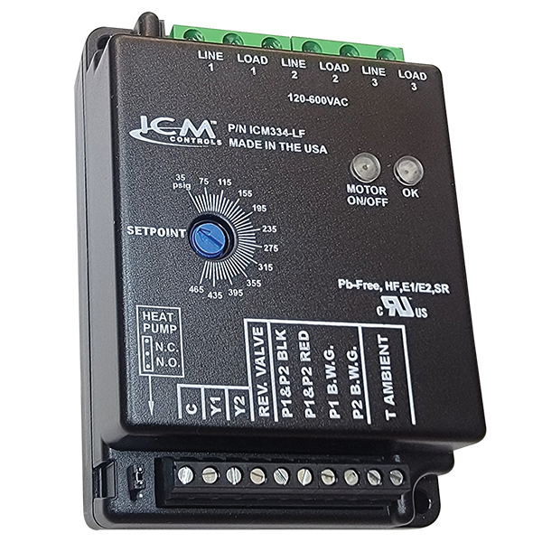
FEATURES:
3-phase ON/OFF control
Heat pump bypass
10-amp load carrying capability
SPECIFICATIONS:
Input: • Voltage Range: 120 – 600 VAC • Control Voltage: 18 – 30 VAC
Output: • Type: Relay, SPDT • Voltage Range: 277 VAC @ 10A maximum
ICM334 – Three-Phase
Head Pressure Control
Why do we need 3-Phase Head Pressure Controls?
Commercial and Industrial sites still require AC in low ambient conditions
3-phase head pressure controls are needed to operate large scale cooling applications year–round such as large walk-in freezers, industrial manufacturing buildings etc.
Temperature sensitive 3-phase equipment may be damaged by excessive heat without cooling
The value of the ICM’s 3-Phase Head Pressure Controls
Low-cost alternative to expensive VFD’s
Built in a vertically integrated state-of-the-art facility in North America supporting local economy
Allows for a solution when other three phase head pressure controls are not available or not an option
Operation​
Using a temperature sensor and up to two pressure sensors; the ICM334 will monitor the ambient temperature and system pressure. The ICM334 will be energized when there is a Y call. When the ambient temperature is above 50°F (10°C), the motor will be energized continuously. When the ambient temperature is below 50°F, the pressure sensor is used to determine whether the motor is on or off. When the pressure is 15 psi below the pressure setting the motor will be turned off. When the pressure is 15 psi above the setting, the motor will be turned on
APPLIANCE
ELECTRICAL
HVAC/R
MARINE
POOL & SPA
RV

