Slide 1


Motor Starters

Slide 2

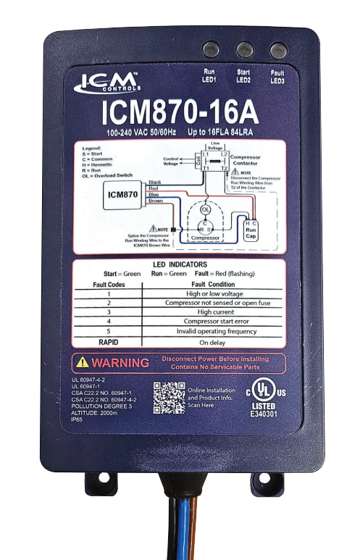

FEATURES:​​
LED fault indicators
​Over/under voltage monitoring
Over-current protection
Built-in self-learning algorithm
✓ Built-in start capacitor
SPECIFICATIONS:​​
Input:​​ • Line Voltage: 120/240 VAC​​
Output:​​ • Type: Solid State/Relay ​ • Current: Max. nominal
ICM870-9A: 9FLA
ICM870-16A: 16FLA
ICM870-32A: 32FLA
REPLACES:
Dometic: SmartStart
Hyper Engineering: Sure-Start
Micro-Air: EasyStart
Network RV: SoftStartRV
Carlo Gavazzi: SmoothStarter
ICM870 Series - Soft Starts
Why we need Soft Starts and their applications?
The ICM870 reduces the current required to start a motor allowing other power sources like generators or inverters to start a heavy load.
Ideal in areas where storms knock out power and you must run your AC off a generator
Reduces the need for load shedding
Reduces loud startup noises, light flickering, and breaker trips
The value of choosing ICM controls Soft Starts
Reduces in-rush current by up to 70%.
Automatic – self learning Algorithm
Prolongs the life of the A/C by reducing excessive torque
Installation hardware is included.
The ICM870 can be used in Residential, Commercial, RV and Marine applications.
Operation​
The ICM870 integrates compressor in-rush current over startup time, thus reducing peak current demand on the power supply source. The ICM870 will monitor system health including voltage, current, compressor startup and self-integrity. Upon a fault condition, the ICM870 will halt operation and initiate a 4-minute delay while providing diagnostic fault information by means of an LED indicator.
APPLIANCE
ELECTRICAL
HVAC/R
MARINE
POOL & SPA
RV

Slide 3
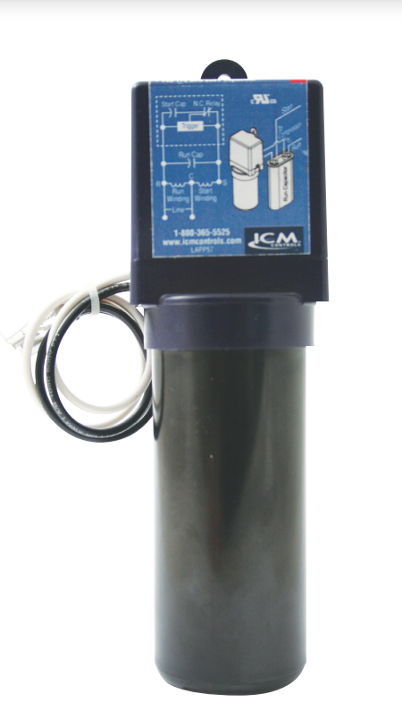
FEATURES:​​
Patented circuitry with differential voltage sensing technology
Self-adjusting to changes in voltages ​
Simple, two-wire installation
​ Multi-voltage operation for 115 or 230 VAC motors ​
SPECIFICATIONS:​​
Input:​​
Line Voltage: 90-240 VAC​​
Recommended range: 1/12 to 5 HP
Capacitor: 145-175 Mfd. 330 V
REPLACES:
5-2-1: CSR-U1, CSR-U2, CSR-U3
DiversiTech: DST-5, DST-6
Kickstart: KS1-KS5 & KS8
Mars: 32708, SS1, SS5, 32703, 32704, 32701, 32702
Supco: SPP5, SPP6, SPP5E, SPP6E, SPP7E, SPP8E, SPP9E, SPP10E, RCO810, RCO410, RCO210
Watsco: WSX1
ICM866U- Hard Start
Why we need Hard Starts and their applications?
To provide older motors the necessary torque to start quickly.
To reduce strain on the system
To prolong the life of older motors which struggle to start on their own
Reduces breaker tripping on long line sets or where there are tight compressors
The value of using ICM Hard Starts.
Precisely engages and disengages the start cap using patented differential voltage sensing circuit
Not affected by ambient temperature
Instant recycling far better than PTCR types
Universal application eliminates guesswork on which hard start you need
No positional requirement
Operation​
ICM866U’s differential voltage sensing employs a patented circuitry which monitors differential compressor auxiliary voltage, determines the state of the motor and precisely engages and disengages the start capacitor. A timed safety circuit is provided in the event the motor fails to start within 2 seconds.​
APPLIANCE
ELECTRICAL
HVAC/R
MARINE
POOL & SPA
RV

Slide 4
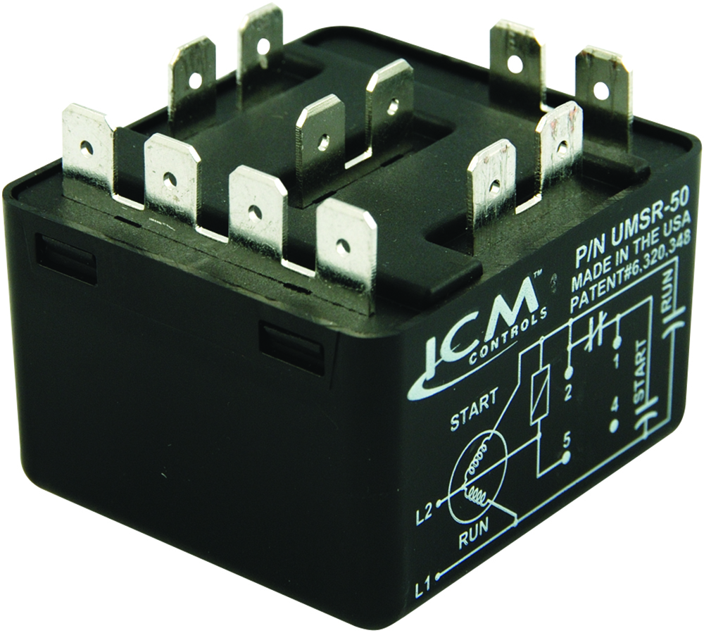
FEATURES:​​
Replacement for all standard potential relays
Patented differential voltage sensing
No user-adjustments required
Non-positional mounting configuration
50A switching capabilities
Universal mounting bracket for easy installation
SPECIFICATIONS:​​
Voltage rating: 110-270VAC, single phase
Max. voltage contact rating: 502 VAC (absolute)
Motor power rating: Up to 10 HP
Operating position: Non-positional
Safety time out: Approximately 1-second per 100 microfarads
Consumption: 5 VA maximum
Contact rating: 50A (break only)
Dimensions: 2.00” x 2.00” x 1.75”
REPLACES:
All standard potential relays
Supco: APR5, SUPR
UMSR-50- Universal Motor Starting Relays
Why we need Motor Starting Relays and their applications?
Capacitor start motors require a potential relay to dropout the start capacitor after the motor has started
There is a need to replace older style potential relays which have a pick-up and dropout rating requiring contractors to stock a large inventory of relays for different motor types
The value of using ICM’s Motor Starting Relay
ICM solved this issue by designing a universal motor starting relay incorporating a patented differential sensing circuit which removed the need for multiple relays
One universal function potential relay reduces truck stock and distributor inventory
Non-positional configuration offers a convenient mounting option
Ideal for A/C, commercial refrigeration, heat pump or any single-phase motor application up to 10 HP.
Operation​
Uses a differential voltage sensing circuit to monitor the back EMF of a motor and precisely disconnect the start circuit including the start capacitor at the exact moment the motor is started.
APPLIANCE
ELECTRICAL
HVAC/R
MARINE
POOL & SPA
RV

Slide 5
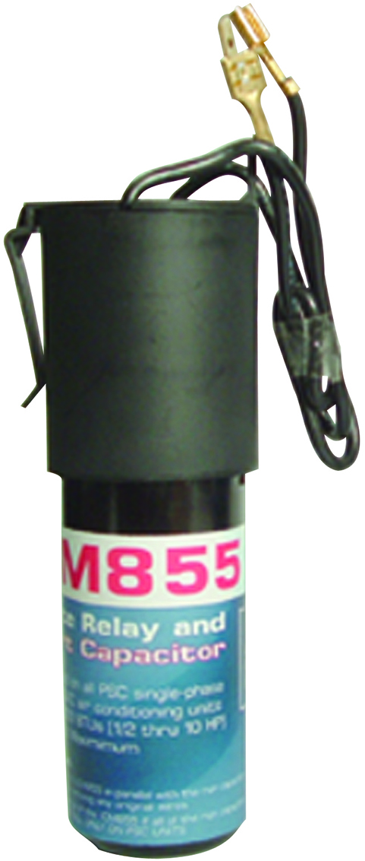
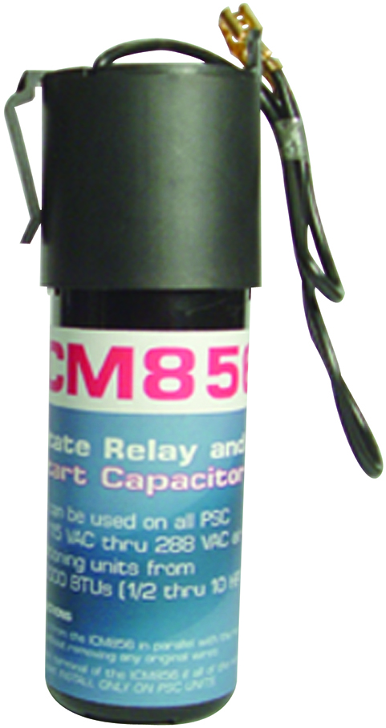
FEATURES:​​
Positive Temperature Coefficient (PTC) technology
Easy to install
Low-cost motor starting device
ICM855
Increase torque up to 300%
ICM856
Increase torque up to 500%
SPECIFICATIONS:​​
Voltage : 115-288VAC
Range: ½ to 10 HP
ICM855
Capacitor: 43-52 MdF, 330V
Dimensions: 2.50” x 1.75” x 6.25”
ICM856
Capacitor: 130-156 MdF, 330V
Dimensions: 2.00” x 2.00” x 6.50”
REPLACES:
ICM855
A-1: WX-5, MARS: 32701, 35701
Supco: SPP-5, Wagner/DiversiTech: DT-5
ICM856
A-1: WXS-6, MARS: 32702, 35702
Supco: SPP-6, Wagner/DiversiTech: DST-6
Hard Start Capacitors: ICM855 & ICM856
Why we need a Hard Start Capacitor and their applications?
Hard-start capacitors are required to start a motor when they have a difficult time starting due to long line sets, poor power distribution, tight bearings or weak windings.
The capacitor and potential relay give the additional starting torque required to overcome the back EMF needed to start the motor
The value of using ICM’s PTCR Hard Start Capacitor:
Low-cost competitive product to other PTCR style hard starts
Uses a simple design to drop out the start winding when the motor has started
Easy 2-wire installation
Operation​
Uses a normally closed bi-metal switch which stays closed until the motor has started. As current is drawn during start-up the bi-metal switch heats up and will open to break the start circuit within an appropriate time needed to start the motor.
APPLIANCE
ELECTRICAL
HVAC/R
MARINE
POOL & SPA
RV

