Slide 1


Oil Burner Primaries

Slide 2

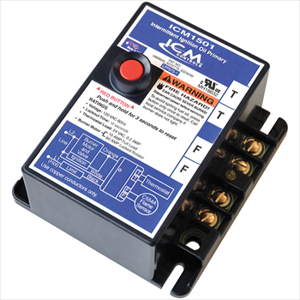

ICM CONTROLS Oil Primary Controls replace popular Honeywell models
Replaces:
Honeywell R8184G4066, R8184G1161, R8184G1294
ICM Oil Burner Primary Control
ICM1501/ICM1502/ ICM1503
Why do we need Oil Primary Controls
The northeastern United states as well as some northern mid-west states still use oil burners for heating which requires a need for oil primary controls.
The ICM Controls offering provides for a simple control and far less expensive than high end digital versions
Great for older applications where expensive modules may not be required or desired
The value of choosing ICM controls Oil Primaries
Proudly assembled & engineered in USA
Meets stringent agency requirements for safety
Incorporates ICM patented energy transfer technology ensures fuel valve and pump will only be energized if the control is properly functioning
Form Fit and functional replacement to popular Honeywell Oil Primary Controls
Durable circuit board design and construction ensures strong connections and increased reliability
U.S. based technical support with real technicians instead of artificial intelligence
Operation
Controls oil burner, oil valve (if required) and the ignition transformer in response to a call for heat.
LED aids in testing and troubleshooting
Enclosed safety switch with external reset button
APPLIANCE
ELECTRICAL
HVAC/R
MARINE
POOL & SPA
RV

Slide 3
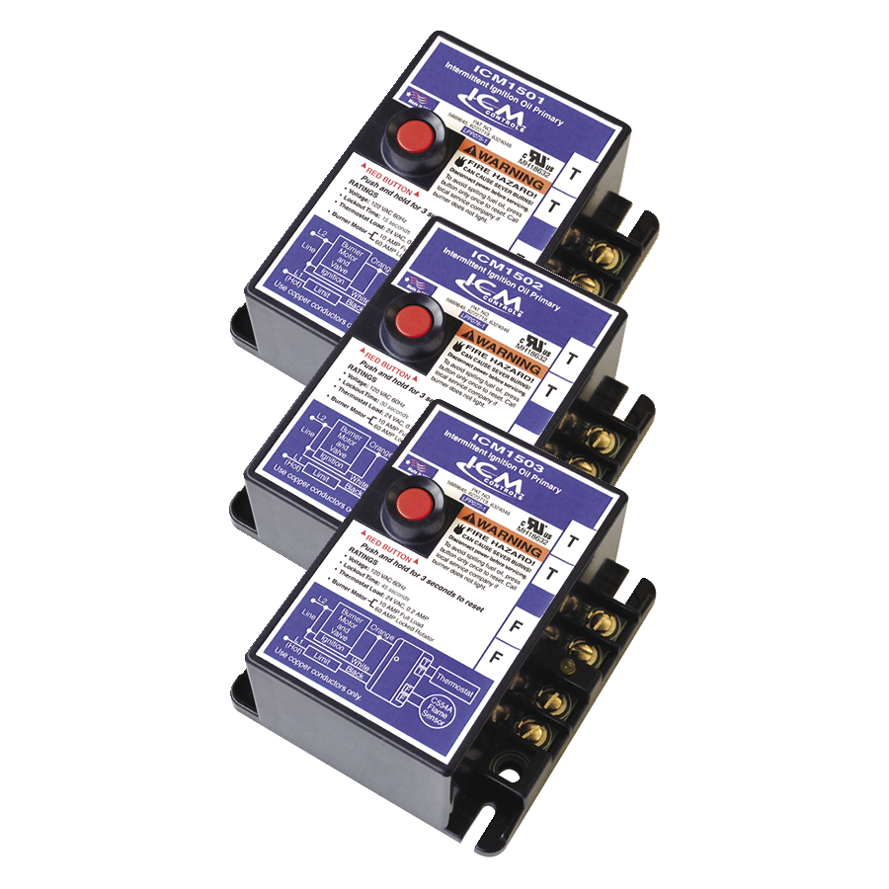
SPECIFICATIONS:
Ignition Type: Intermittent
Time, safety switch: 15,30 or 45 seconds
Mounting Bracket: For mounting on a standard 4” x 4” junction box or direct mounting on burner housing
Temperature range: -30F to +130F
Approvals: Underwriters Laboratories Inc.
Dimensions: 4.10” x 2.36” x 4.40”
ICM1500 Series:
ICM1501, ICM1502 & ICM1503
Features: and Benefits:
Controls oil burner, oil valve (if desired) and the ignition transformer in response to a call for heat
Solid state flame sensing circuit
LED on terminal strip indicates system lockout
Enclosed safety switch with external reset button
C554A Cadmium Sulfide flame detector button
Form, fit and functional replacement for popular competitive models
ICM P/N | Safety Timing | Replaces
ICM1501 | 15 seconds | Honeywell: R8184G4066, R8184G1161, R8184G1294
ICM1502 | 30 Seconds | Honeywell: R8184G4074, R8184G1179, R8184G1302, R8184G4033
ICM1503 | 45 Seconds | Carlin: 48245 Honeywell: R8184G4074, R8184G1138, R8184G1427, R8184G4025 Tempstar/Heil: 1147017 White Rodgers: 668-401
APPLIANCE
ELECTRICAL
HVAC/R
MARINE
POOL & SPA
RV

