Slide 1


Product Overview

Slide 2

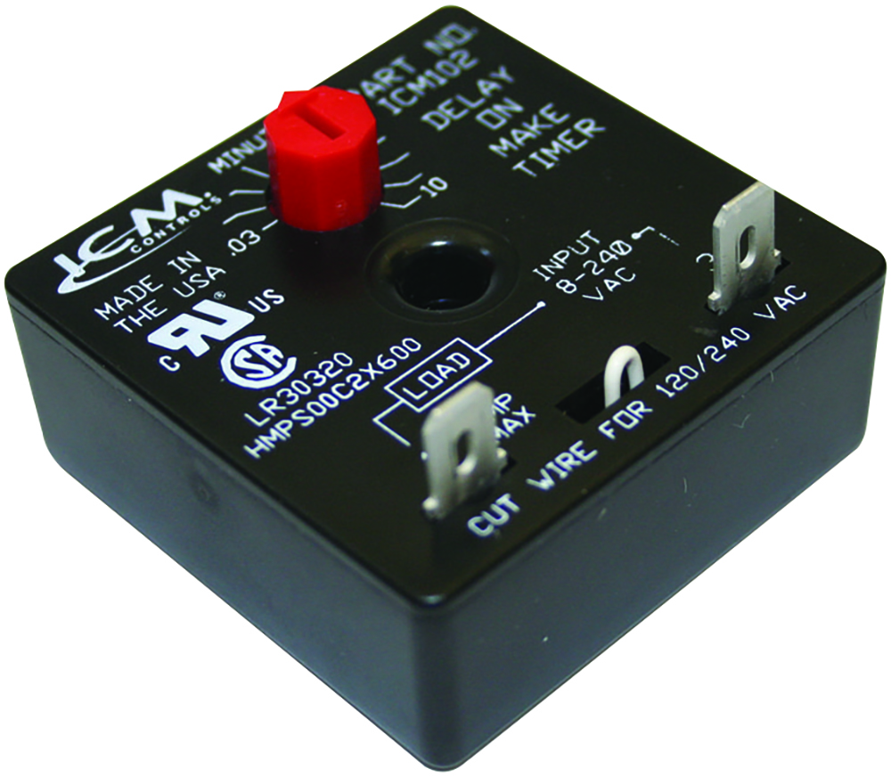
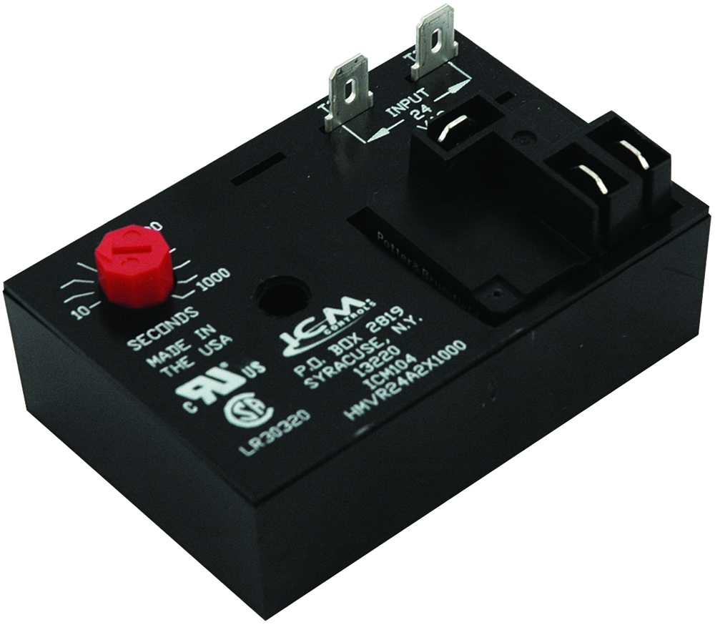
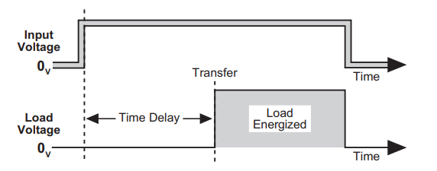

FEATURES:
Universal voltage operation
Knob-adjustable time delays
Works with anticipator-type thermostats
One model replaces many in field
Ideal for compressor staging
Simple 2-wire hookup
SPECIFICATIONS:
Voltage: 18-240 VAC,
Output: Solid State:1.5 amps, 40 mA holding current
Adjustable delay: .03-10 minutes (1.8-600 seconds)
Delay on Make Timers
Why we need Time Delays and their applications?
Used in many applications where the power to a device needs to be delayed for a given period
The HVAC industry for example requires the need to run multiple AC units on a single power source which could create an overload condition.
ICM controls has the solution with our Delay On Make timers which allows you to stagger start multiple loads like a compressor!
The value of ICM controls Delay On Make Timers
High quality circuit board construction and solid-state design means no mechanical relay thus increasing reliability
Ultra low-cost alternative to more expensive devices
Two wire design for ease of installation and wide application range
Universal voltage range makes it an all-In-one solution
Operation
The ICM102 will delay the load from turning on based on the ICM102 dial setting
Setting the delay different for each load allows you to stagger start multiple loads preventing the potential overload condition
REPLACES:
Airotronics, Little Fuse , EAC, and other similar delay on make timers
Timing Diagram
APPLIANCE
ELECTRICAL
HVAC/R
MARINE
POOL & SPA
RV

Slide 3
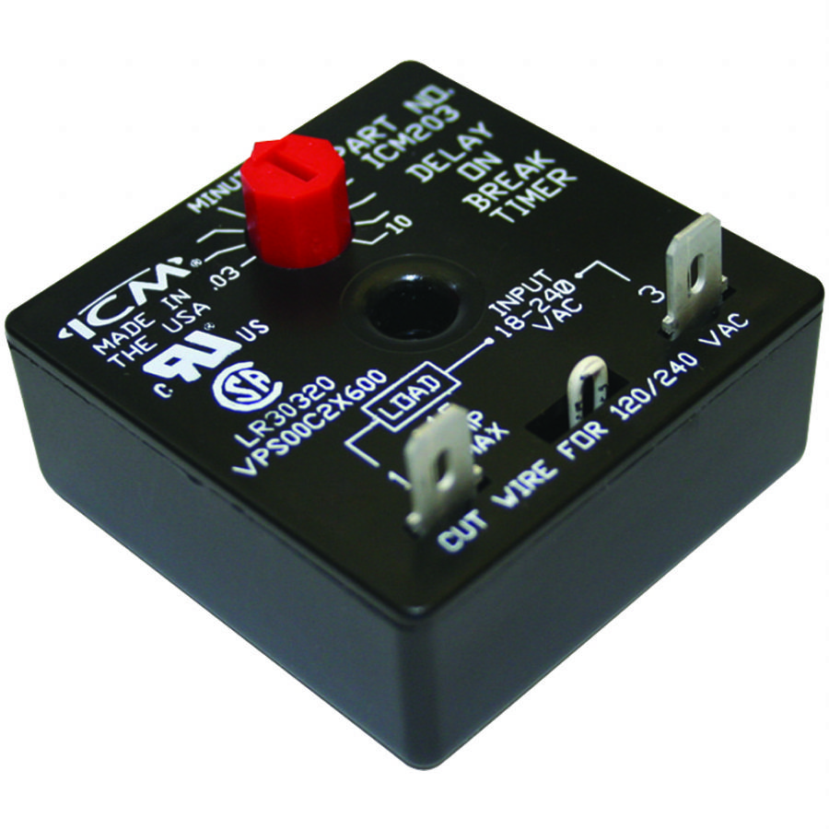
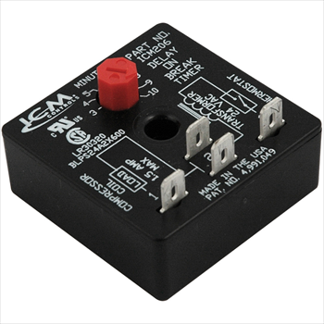
ICM203 SPECIFICATIONS:​​
Voltage: 18-240 VAC, 1.5 amps, 15A inrush, 40 mA holding current
Frequency: 50/60 Hz
Adjustable delay: .03-10 minutes (1.8-600 seconds)
Voltage drop: 4.5 V max @ 1.5 amps
REPLACES:
A-1: EAC-501-ADJ, Diversified: AC-503, MARS: 32001, 32387, 32392, Robertshaw: 3310-072, Supco: TD72, TD73, Wagner/DiversiTech: ADB-1
ICM206 SPECIFICATIONS:​​
Voltage: 18-30 VAC, 1.5A, 15A inrush, 40mA holding current
Frequency: 50/60 Hz
Adjustable delay: 3-10 minutes
REPLACES:
• A-1: EAC-426-ADJ , Supco: TD74
ICM Delay on Break Timers
Why do we need Delay on Break Timers?
Delay on Break timers will help to protect equipment from damage which can be caused by rapid short cycling.
The value of ICM Delay on Break Timers
High quality circuit board construction and solid-state design means increased reliability
Ultra low-cost alternative to more expensive devices
Operation
Upon application of power, the load is energized. When the there is a loss of power, the load is de-energized and the delay period begins.
The load will not start during the delay period. Restart occurs after the delay period has elapsed.
APPLIANCE
ELECTRICAL
HVAC/R
MARINE
POOL & SPA
RV

Slide 4
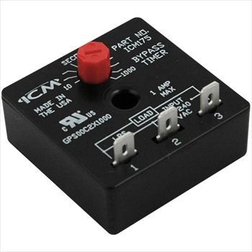
Features:
Designed to bypass a low-pressure switch or other device during startup
Ideal for low ambient startups
Helps to reduce nuisance lockouts
Universal AC voltage operation
ICM175 SPECIFICATIONS:​​
Voltage: 18-240 VAC 40mA min,1A max, 10A inrush
Adjustable delay: 10-1000 seconds
Replaces:
Mars: 32395
Supco: TD32
ICM175 - Bypass Timer
Why we need Bypass timers and their applications?
Bypass timers provide the ability to temporarily bypass a switch function to allow operation under a normally locked out condition when necessary for operation.
Bypass timers allow compressors to start during low ambient conditions when operation would normally be locked out due to low pressures in the system.
The value of ICM controls Bypass timer
Manufactured in the USA to high quality standards
Low-cost option to more expensive custom designs
Universal operating voltage makes it a versatile choice
Key component for “winter start” kits
Operation
With power applied to the input, the load energizes immediately and remains energized for the length of the time delay, regardless of the state of the switch being bypassed. At the end of the time delay, the condition of the load is determined by the state of the switch.
APPLIANCE
ELECTRICAL
HVAC/R
MARINE
POOL & SPA
RV

Slide 5
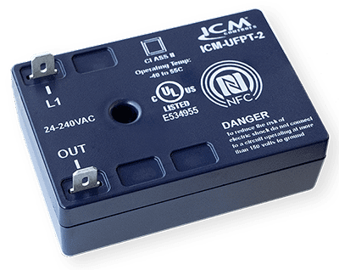
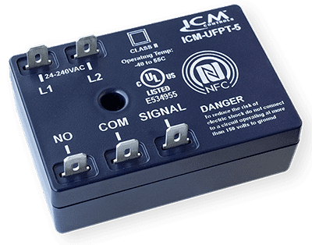
ICM-UFPT-2 SPECIFICATIONS:​​
Voltage: 24-240 VAC
40mA minimum-0.5A max
ICM-UFPT-5 SPECIFICATIONS:​​
Voltage: 24-240 VAC
1A @ 240VAC (pilot duty)
4FLA/4LRA @ 277VAC (AC motor)
5A @ 277VAC (general use)
8.75A @ 240VAC (resistive)
ICM-UFPT Timing Modes:​​
On delay
Interval
Anti-short cycle
Repeat cycle
Off delay (5-wire model only)
Single shot (5-wire model only)
Universal Time Delay Relays
Why we need a universal time delay relay and their applications?
One stop shop for all your timing needs
Replacement option for obsolete legacy timers
Universal application saves cost for the distributor and the technician by reducing the number of timers needed for stock
Great option for unique timing applications
The value of ICM controls universal time delay relays
Universal function replaces over 85 ICM legacy timers and hundreds of competitor models.
The convenience to stock one control for all timer applications.
State-of-the-art NFC technology allows accurate programming of all functionalities using a smart phone.
Installation instructions, wiring diagrams, and timing diagrams are conveniently displayed on the App.
Operation
Uses near field communication and the ICM OMNI app to program 6 different timing functions
APPLIANCE
ELECTRICAL
HVAC/R
MARINE
POOL & SPA
RV

Slide 6
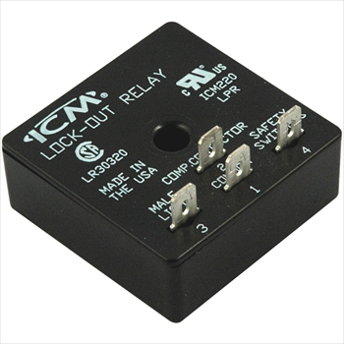
FEATURES:
UL 873 recognized as a
compressor controller
Low-cost lockout relay
Ideal for use with safety/ interlock switches
SPECIFICATIONS:
Voltage: 18-30 VAC
Output : Relay: 2 amps max. @ 30 VAC
ICM220 – Lockout Relay
Why we need Lockout Relays and their applications?
For older systems which do not have controls to monitor safety switches and protect the system.
To protect the compressor or other sensitive equipment from damage caused by rapid short cycling when safety switches open and close.
The value of ICM controls Lockout Relays
Monitors various switch inputs to help protect the compressor.
Helps eliminate nuisance lockouts.
Protects the compressor by locking out operation until power is recycled, and switches are closed.
Replaces impedance relay series 84 and 93
Low-cost alternative to more expensive LPR’s
Operation
Upon application of power with the safety switches closed, the load will energize. If any of the safety switches are open longer than 600ms; the ICM220 will energize the fault output, and lockout compressor operation. Power must be removed for 100ms, and the safety switches must be closed to clear the lockout.
REPLACES:
Impedance Relays: 83 and 93
APPLIANCE
ELECTRICAL
HVAC/R
MARINE
POOL & SPA
RV

Slide 7
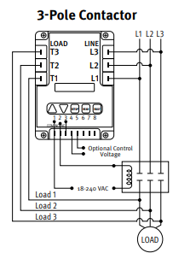
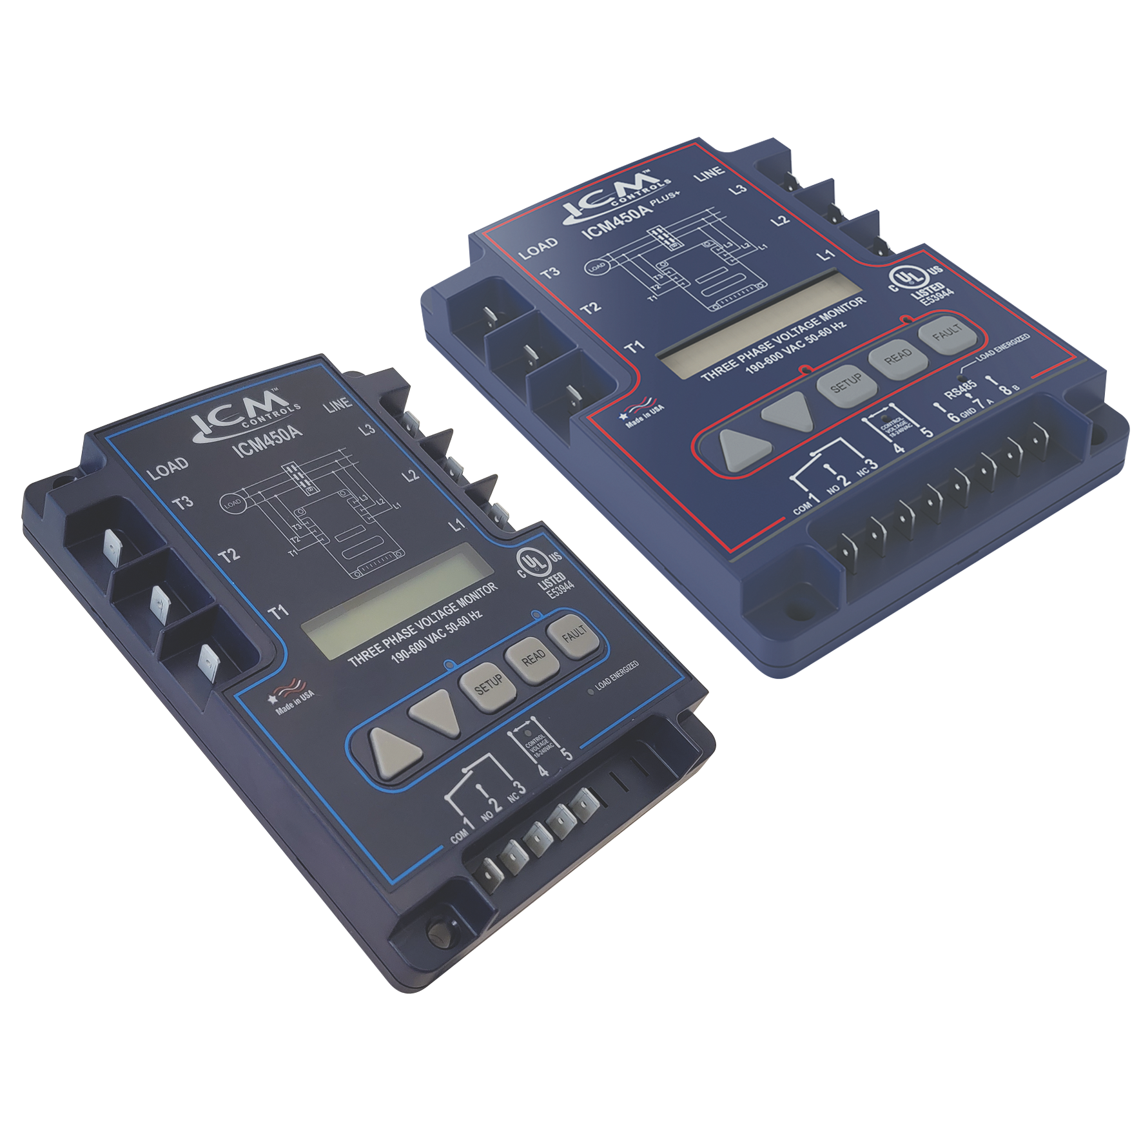
FEATURES:
Simultaneous 3-phase true
RMS voltage monitoring
Factory calibrated
Large Fault memory
Date and time stamp available ICM450A plus+
English or Spanish menu options
SPECIFICATIONS:
Input:
• Voltage Range: Universal 190 – 600 VAC
• Control Voltage: 18 – 240 VAC
Output:
• Type: Relay, SPDT
• Voltage Range: 277 VAC @ 10A maximum
ICM450A and ICM450A+ - Three Phase Voltage Monitor
Why do we need Three Phase Voltage Monitors?
Frequently, industrial sites have dirty power or power interruptions that can cause expensive three phase equipment to fail or become damaged.
Often with three phase, the cause of these failures is not determinable.
ICM controls has the solution with our Three Phase Voltage Monitor!
The value of the ICM controls Three Phase Monitor
User-friendly layout with customizable parameters
Backlit display makes for easy adjustments in low light conditions
¼" quick connects allow for a safe and easy connection
ICM450A+ offers date and time stamp capability for troubleshooting fault occurrences
Modbus RS485 communications port for applications with building management systems
Operation
The ICM450A monitors for phase unbalance, over/under voltage, phase loss, and phase reversal.
When these fault conditions are detected, the control opens an internal dry contact relay that can be connected to control voltage or coil voltage to protect the load.
REPLACES:
A-1: EAC-800, EAC-8000, EAC-8002, Copeland: 085-0160-00 , Diversified: AC-2020, AC-301, AC-302 , ICM: ICM450, ICM 450S , Mars: PFM-2000 , Motorsaver: 455 , SSAC: QLM/QLV , Time Mark: 265 , Wagner / DiversiTech: DTP-3, WPC-800
ICM 450A Plus+ Additional Features
Realtime clock for date and time stamp on recorded faults
MODBUS RS-485 communication
APPLIANCE
ELECTRICAL
HVAC/R
MARINE
POOL & SPA
RV

Slide 8
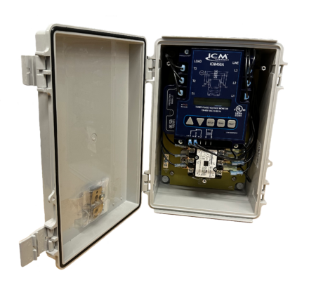
FEATURES:
All components pre-wired for 208/240 volts
Modular design with field replaceable components
Field programmable voltage monitor with backlit LCD display and a large fault history
Protects against over and under voltage, phase loss, phase reversal, phase unbalance and rapid short cycling
Separate 40amp contactor, fully disconnects from the service
Superior TMOV technology provides safe and reliable surge protection, up to 150 kA max surge event
SPECIFICATIONS:
Inputs:
Line voltage: 208/240 VAC
Frequency: 50/60 Hz
Outputs:
Type: Relay, SPDT
2-Pole contact ratings: 40A, 208/240VAC
3VMS – Three-Phase Voltage Monitor and Surge Protector
Why do I need the 3VMS?
Frequently, industrial sites have dirty power or power interruptions that can cause expensive three-phase equipment to fail or become damaged.
Three-phase voltage is unique in that several adverse voltage conditions could lead to equipment failure
Any connected load is susceptible to surges, over/under voltage conditions, phase loss, phase reversal, and phase unbalance.
The 3VMS protects against all these conditions in a simple pre-wired package
Why choose the 3VMS?
The 3VMS combines the benefits of the top selling ICM450A programmable 3-phase line voltage monitor and a high end ICM530 three-phase surge protective device into one easy-to-install solution.
Individual components are easily replaceable and the 3VMS comes prewired for easy installation
Includes a 40-Amp contactor to handle inductive loads better than block style relays
Operation
The 3VMS protects against both power surges and over/ under voltage issues that can cause damage to circuit boards and motors in residential and commercial three-phase 208/240 VAC HVAC/R equipment.
The ICM450A monitors for phase unbalance, over/under voltage, phase loss, and phase reversal.
When these fault conditions are detected, the control opens an internal dry contact relay that can be connected to control voltage or coil voltage to protect the load.
The ICM530 will absorb an incoming surge up to 150kA
APPLIANCE
ELECTRICAL
HVAC/R
MARINE
POOL & SPA
RV

Slide 9
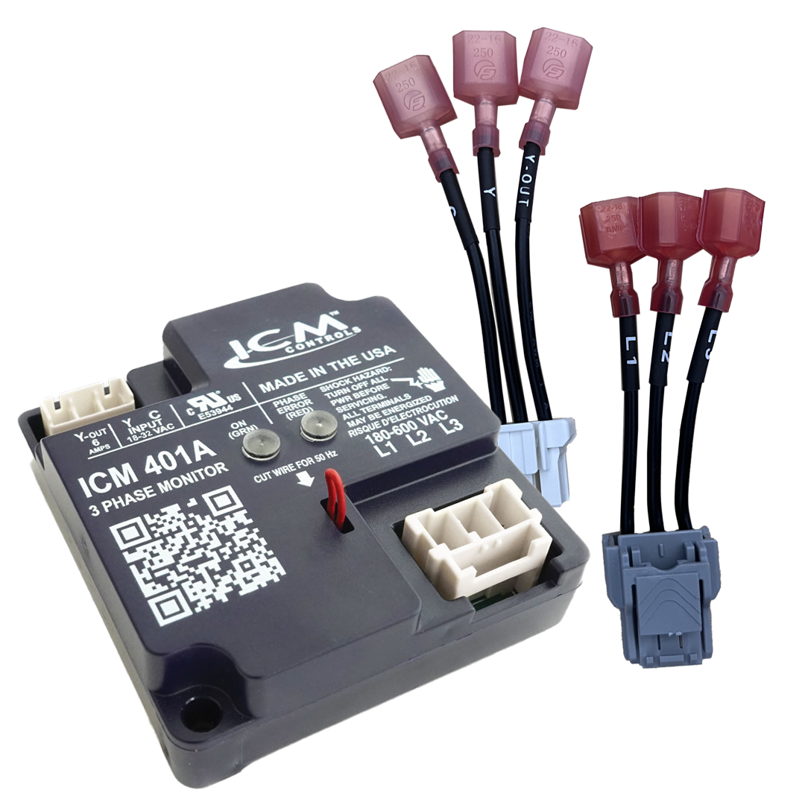
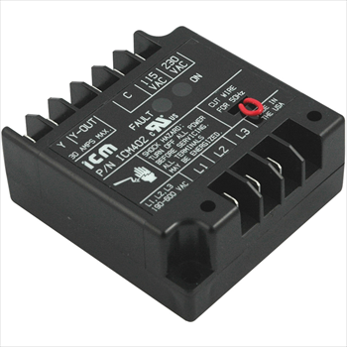
FEATURES:
Bright LED indicators for ON
and FAULT
Convenient wiring plugs included
Universal 3-phase input: 190-600 VAC
Highly reliable passive electronics
Patented: U.S. Patent No. 5,337,206
SPECIFICATIONS:
Voltage: 190-600 VAC
Frequency: 50/60 Hz
ICM402 Control: 115 or 208/230 VAC
ICM401A Control: 18-32 VAC
ICM402 Output Relay: SPST N.O. 30 amps
ICM401A Output Relay: SPST N.O. 6 amps
ICM401A and ICM402 - Three Phase Voltage Monitors
Why do we need Three Phase Voltage Monitors?
Phase loss and phase reversal cause expensive three phase equipment to fail or become damaged
Customers need a low-cost solution to these issues
ICM controls offers the ICM401A/ICM402 as the solution
Why choose the ICM401A and the ICM402?
ICM controls offers an ultra-low-cost solution for basic phase loss and phase reversal conditions in three phase equipment
Small footprint, simple connections and LED indication lights make for stress free installation and use
Ideal for OEM market
Operation
The ICM401A and ICM402 monitor for phase loss and phase reversal conditions
When these fault conditions are detected, the control opens an internal relay that can be connected to control voltage or coil voltage to protect the load.
The ICM401A operates on 24VAC whereas the ICM402 operates on 115 or 208/230 VAC
REPLACES:
ICM401A and ICM402:
Mars: 32536 and Supco: TPMP2
APPLIANCE
ELECTRICAL
HVAC/R
MARINE
POOL & SPA
RV

Slide 10
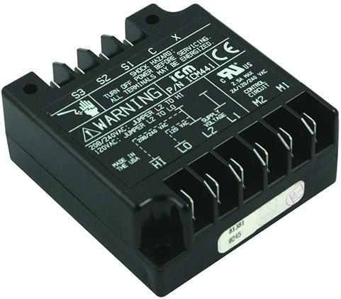
FEATURES:
Control duty, SPST output relay
Voltage & Temperature Monitoring
Anti-short cycle time delay, 4 minutes (nominal)
1-second manual bypass
SPECIFICATIONS:
Voltage: 120 or 208/240 VAC
Output: Relay: SPST
N.O.: 6 amps resistive
ICM441 - Three Phase Motor Protection
Why do we need Three Phase Motor Protection?
Motors can fail for several reasons, winding shorts, over and under voltage conditions, and short cycling
Customers need a way to catch these issues and protect the motor from failure.
The ICM441 monitors each winding of the motor as well as the incoming 3-phase to make sure the motor is protected and working efficiently
Why choose the ICM441?
ICM controls offers a low-cost solution for three phase voltage monitoring
Temperature monitoring in the ICM441 offers a way to catch dangerous unbalance conditions which can damage a motor quickly
Internal relay shuts off the motor before thermal damage occurs
Operation
The ICM441 is designed to individually monitor 3 PTC temperature sensors which are wound into each phase winding of a motor
If any winding or incoming line power is beyond the safe operating range of the motor, the ICM441 will lock the motor out of operation until the inputs fall back into the safe operating range
The ICM441 can sense shorted or open sensors, in addition to providing isolation to each sensor to prevent damage to the monitor in the event a sensor shorts to a winding or case ground
REPLACES:
Bristol: 241680
Copeland: 071-0376-01, 071-0376-02, 071-0397-00, 071-0397-01, 071-0424-00, 071-0424-01, 071-9800-00, 071-9800-01
Mars: 37300, 37302, 37304, 37306, 37322
Texas Instruments: 15AA1600 B, 15AA1600 C, 15AA1603 B, 15AA1603 C, 31AA1600 E, 31AA1606 E
APPLIANCE
ELECTRICAL
HVAC/R
MARINE
POOL & SPA
RV

Slide 11
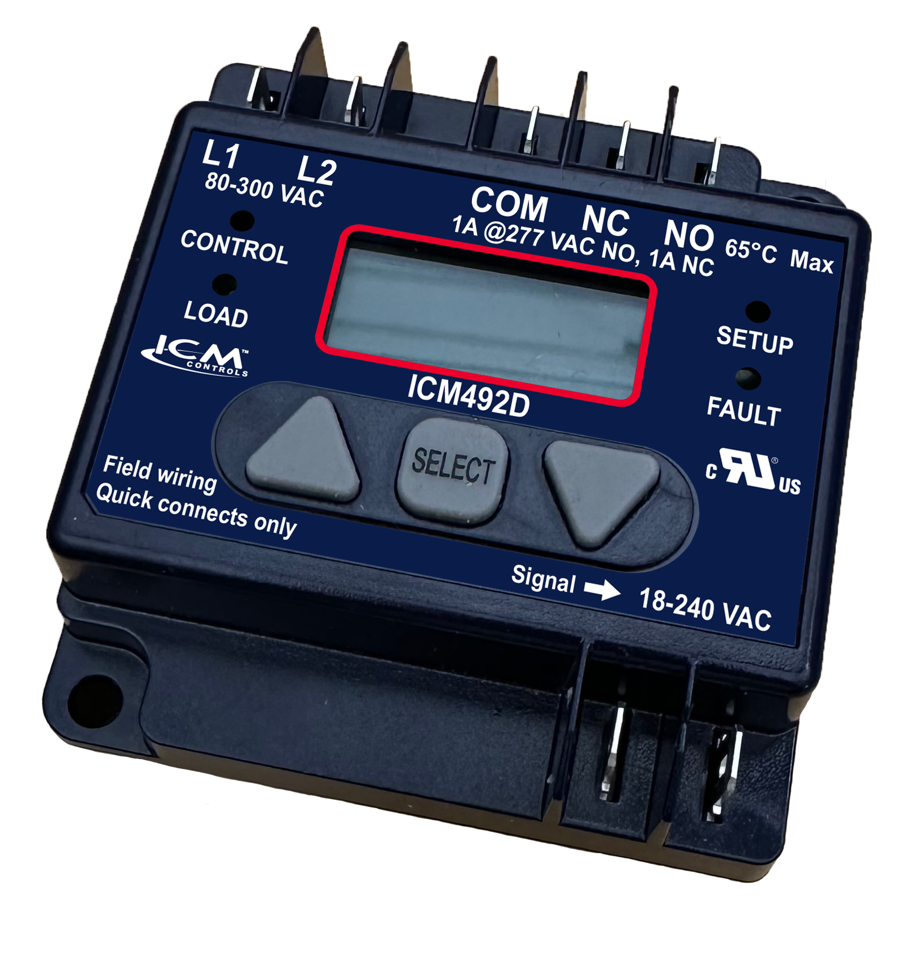
FEATURES:
Easy-view, backlit digital display
Adjustable voltage set point
Calibration feature
Adjustable anti-short cycle time delay
5-fault memory
Heavy duty SPDT relay output
SPECIFICATIONS:
Inputs:
Voltage: 18-280 VAC
Frequency: 50/60 Hz
Over/under voltage setting: 5-25%
Outputs:
Relay contact ratings:
N.C. contacts: 2A resistive @ 277 VAC
N.O. contacts: 1A Pilot Duty @ 240 VAC
Replaces:
Wagner / DiversiTech: DSP-1
ICM492D - Single Phase
Voltage Monitor
Why do we need Single Phase Voltage Monitors?
It is becoming more common for service voltage to be dirty or fluctuate during the day
This can cause failure of expensive equipment if the service voltage is outside of the limits of the equipment
The ICM492D locks out in these harmful conditions and protects your single-phase load
Why choose the ICM492D?
The ICM492D is a new compact design with integral anti short cycle delay
New true RMS read with display calibration feature
New tactile buttons for durability
Simple to use configuration menus and minimal connections makes for simple installation and operation
Operation
The ICM492D continuously monitors incoming line voltage for faults and displays RMS voltage on the digital display.
When incoming line voltage is outside of the user selected parameters a fault occurs and the ICM492D will break the relay contacts and indicate a fault condition by flashing FAULT on display.
An ASC time delay prevents system short cycling caused by transient faults and rapid power interruptions
APPLIANCE
ELECTRICAL
HVAC/R
MARINE
POOL & SPA
RV

Slide 12
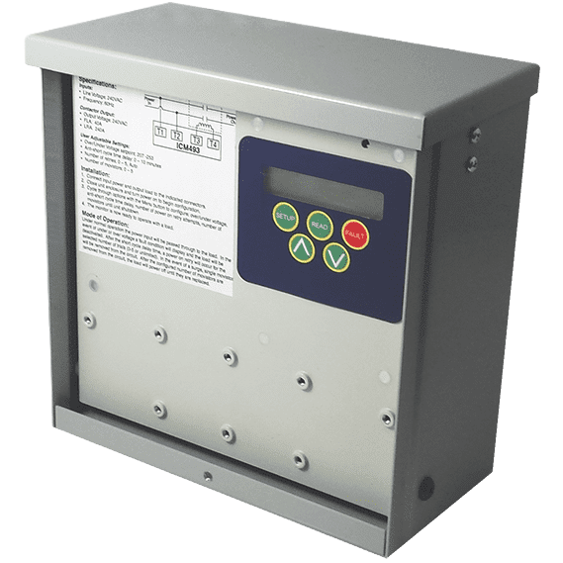
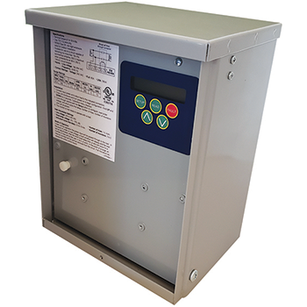
FEATURES:
All- in –one surge protection and voltage monitor
High quality TMOV surge suppression technology
Back lit display for set up or viewing in low light conditions
Rugged 40 Amp contactor to disconnect service voltage to equipment when a fault occurs ( 60Amp model available)
Ideal for mini-splits, heat pumps and inverters
SPECIFICATIONS:
Inputs:
Voltage: 180-264 VAC
Frequency: 50/60 Hz
Output:
Type: Contactor
ICM493 2-Pole contact ratings: 40A FLA, 240A LRA ICM493-60A 2-Pole contact ratings:
60A FLA, 360LRA
ICM493 and ICM493-60A – Single Phase Line Monitor with Surge Protection
Why do I need an ICM493?
It is becoming more common for service voltage to be dirty or fluctuate during the day
This can cause failure of expensive equipment if the service voltage is outside of the limits of the equipment, especially in heat pumps & mini-splits rated for 208/230VAC
The ICM493 not only protects your equipment from irregular voltage but also provides built-in surge protection
Why choose the ICM493 or the ICM493-60A?
Many mini-splits and heat-pumps operate at 208-230 VAC with a maximum allowable voltage of 252 VAC. U.S.A. voltage typically averages 240-246 and can drift above the 252VAC damaging the mini-splits circuit board
The ICM493 incorporates high quality TMOV surge technology
The ICM493 offers an all-in-one solution to both voltage and surge related issues
Easy to use and configurable menu allows for proper setup and protection against voltage and surge related issues.
The display shows how much surge protection is left so the technician knows when to replace the control
Operation
When voltage conditions are outside of the set parameters, the ICM493 will open the internal contactor protecting the load.
When a surge comes down the line connected to the ICM493, the TMOV technology in the ICM493 dissipates the surge to heat to safely protect the protected equipment
APPLIANCE
ELECTRICAL
HVAC/R
MARINE
POOL & SPA
RV

Slide 13
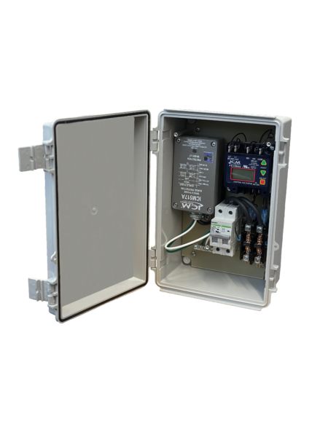
SPECIFICATIONS:
ICM517A Surge Suppressor:
Maximum surge current: 100,000 amps
Robust cast aluminum enclosure for secondary safety
Diagnostics green LED light indicates surge suppression present
Four protection modes: L-L, L-G, L-N, N-G
ICM492D Voltage Monitor User Adjustable settings:
Voltage set point: 18-280 VAC (do not set above 240VAC)
Anti-short cycle time delay: 15-720 seconds
Over/under voltage setting: 5-25% (do not set above 5%)
Inputs:
Line voltage: 208/240 VAC
Frequency: 50/60 Hz
Breaker: 40 amp at 240 VAC
Outputs:
Type: Contactor 2-pole contact ratings: 40A FLA, 240A LRA
SENTRY3N1 – Disconnect with Internal Voltage Monitoring and Surge Protection
Why do I need a SENTRY3N1?
It is becoming more common for service voltage to be dirty or fluctuate during the day.
This can cause failure of expensive equipment if the service voltage is outside of the limits of the equipment
The SENTRY3N1 not only protects your equipment from irregular voltage but also provides built-in surge protection and a 40 amp disconnect switch for ease of installation
With the addition of a contactor for disconnection from service voltage in the case of a fault, the SENTRY3N1 is a best choice for an easy-to-install single-phase protection device
Why choose the SENTRY3N1?
The SENTRY3N1 is ideal for protecting mini-splits or other valuable, 208/240 single-phase equipment and installs easily between the service disconnect and the protected equipment.
All major components are replaceable including the voltage monitor and surge suppressor
Includes a 40 Amp contactor relay to handle inductive loads better than block style relays
Fully wired making it the most cost-effective all-in-one solution for contractors.
Operation
When voltage conditions are outside of the set parameters, the SENTRY3N1 will open the internal contactor protecting the load.
When a surge comes down the line connected to the SENTRY3N1, the TMOV technology in the ICM517A dissipates the surge to safely protect the connected equipment
APPLIANCE
ELECTRICAL
HVAC/R
MARINE
POOL & SPA
RV

Slide 14
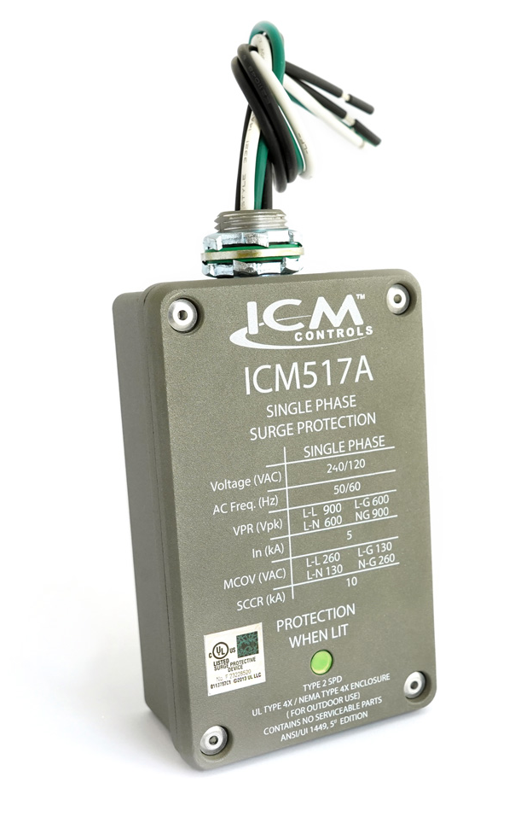
FEATURES:
NEMA Type 4X rated for
indoor/outdoor installation
Withstands effects of prolonged UV exposure better then ABS plastics
Built to withstand the high impact of a
major surge event
Limited lifetime product, up to a 3-year $25,000 connected equipment warranty
Designed and assembled in USA
SPECIFICATIONS:
Service voltage: 120/240 volts, single phase
Maximum surge current: 100,000 amps
Maximum energy dissipation: 1,020 Joules
AC protection modes: L-L, L-N, L-G, N-G
ICM 517A - Single-Phase Surge Protection
Why do we need Surge Protectors?
Single-phase power can have surges caused by lightning strikes, power outages, or an electrical overload
Surges can permanently damage single-phase equipment which can present a major expense to replace
With an ICM517A wired into your system, you can have peace of mind that your equipment is protected
The value of the ICM controls Single Phase Surge Protector
The ICM517A is an upgraded version of the ever-popular ICM517
New robust NEMA 4X rated metal enclosure to contain major surge events better than plastic
Single status LED provides an easy-to-read status of protection
Highly rated at 100,000 Amps max surge protection
Operation:
When a surge occurs, the ICM Surge Protector will absorb the surge up to 100kA for a single event and multiple hits under 100KA
ICM incorporates superior thermally protected metal oxide varistor technology, which allows for safe disabling of the surge elements when a surge exceeds the thermal limits of the device.
REPLACES:
Crosses to comparable Surge Protective Devices from the following companies. Features can vary. ABB, Square D, Eaton, Ditek, Intermatic, Mars, RectorSeal, Supco
APPLIANCE
ELECTRICAL
HVAC/R
MARINE
POOL & SPA
RV

Slide 15
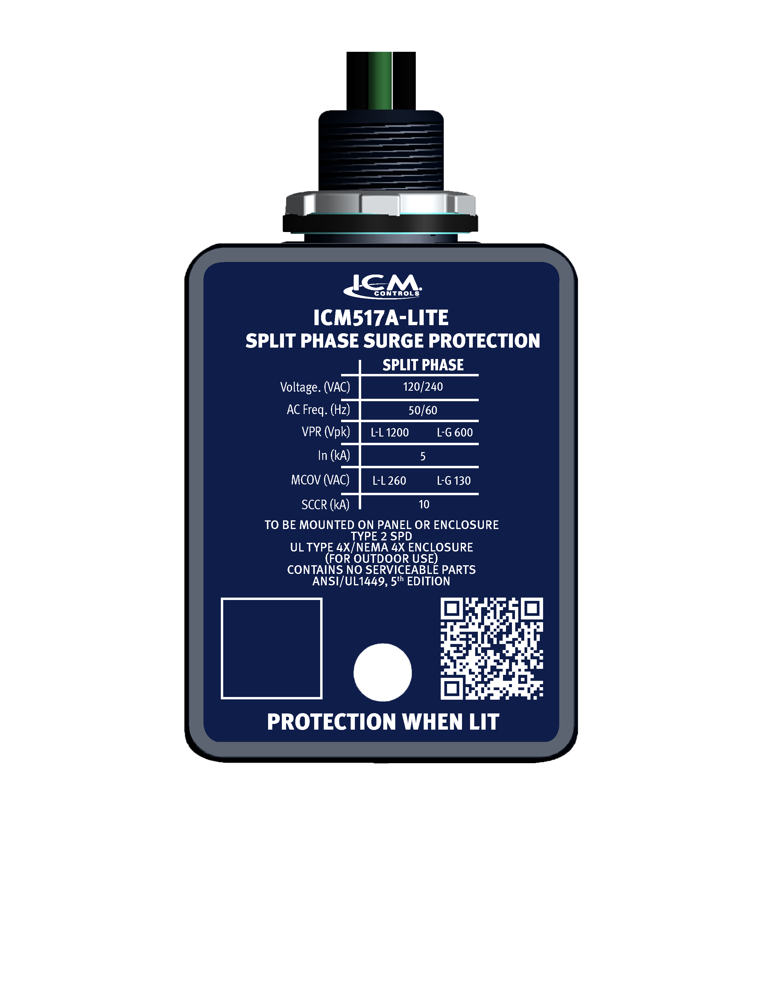
FEATURES:
Superior TMOV technology provides safe and reliable surge protection
Featuring a thinner more compact profile
UL Listed to standard 1449 5th edition
Maximum surge capacity of 60,000 amps
Easy to read status light
Easy 3-wire installation
Designed and assembled in USA
SPECIFICATIONS:
Service voltage: 120/240 volts, single phase
Maximum surge current: 60,000 amps
Maximum energy dissipation: 612 Joules
AC protection modes: L-L, L-G
ICM 517A-LITE – Single-Phase Surge Protection
Why do we need Surge Protectors?
Single-phase power can have surges caused by lightning strikes, power outages, or an electrical overload
The power grid is taxed more than ever by voltage surges, spikes and irregularities caused by increased usage of the grid and changing weather patterns
ICM controls has a low-cost option to these type of issues
The value of the ICM controls Single Phase Surge Protector
ICM provides a USA manufactured option
The ICM517A-Lite is a compact low-cost option to higher cost single phase surge protectors
Provides commercial property owners with peace of mind, contractors with a reliable selling proposition, and wholesalers with a high demand product.
Durable NEMA 4X enclosure for indoor/outdoor installation with easy to see status LED
Reliable surge suppression using TMOV technology which allows for safe disabling of the surge elements when a surge exceeds the thermal limits of the device.
Operation:
When a surge occurs, the ICM517A-Lite absorbs and dissipates the surge up to a maximum surge capacity of 60,000 amps
APPLIANCE
ELECTRICAL
HVAC/R
MARINE
POOL & SPA
RV

Slide 16
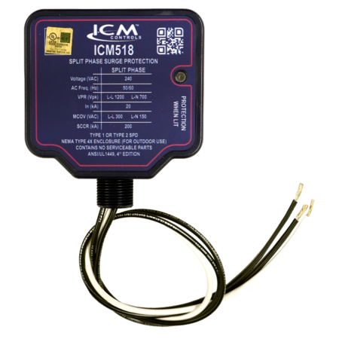
FEATURES:
Easy 3-wire installation
3/4” conduit connection
Green LED indicator tells whether the device is operational
Low cost, high performance
Rugged and reliable
UL Listed Type 1 or Type 2 SPD
SPECIFICATIONS:
Service voltage: Split-phase 240 VAC
Short Circuit Current Rating (SCCR): 200 kA
Maximum Surge Current: 100 kA
Nominal discharge current (In): 20kA
Protection mode: L1-L2, L1-N, L2-N
ICM518 – Three-Phase Surge Protection
Why do we need Surge Protectors?
Three-phase power can have surges caused by lightning strikes, power outages, or an electrical overload
Surges can permanently damage three-phase equipment which can present a major expense to replace
With an ICM518 wired into your system, you can have peace of mind that your equipment is protected
The value of the ICM controls Three-Phase Surge Protector
The ICM518 is a UL Listed Whole-Home Surge Protective Device for 240 VAC three-phase configurations designed to protect a dwellings most valuable assets.
The ICM518 has a NEMA Type 4X waterproof rated enclosure that is suitable for both indoor and outdoor use.
Operation:
When a surge occurs, the ICM Surge Protector will absorb the surge up to the limit of the control
ICM incorporates superior thermally protected metal oxide varistor technology into the three-phase surge suppressors, which allows for safe disabling of the surge elements when a surge exceeds the thermal limits of the device.
REPLACES:
■ ASCO: 420120S ■ Eaton: SP1-240S, SP2-240S ■ ERICO (Critec): TDX50C240 ■ Generac: G0073000 ■ Intermatic: AG2401C3, IG1200RC3, IG1240RC3, IG3240RC3 ■ Leviton: 55240-ASA ■ MARS: 83905 ■ Siemons: TPS3A
APPLIANCE
ELECTRICAL
HVAC/R
MARINE
POOL & SPA
RV

Slide 17
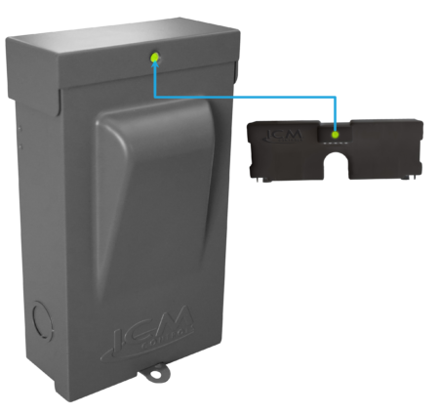
FEATURES:
Maximum Surge Current Rating
of 100kA
Completely factory wired for quick and easy installation
NEMA type 3R rated powder coated metal enclosure for indoor/outdoor use
Fully accessible mounting holes, no disassembling required
SPECIFICATIONS:
Input:
Voltage: Split phase 240 VAC
Frequency: 50/60Hz
Contact ratings:
Voltage: 240 VAC
FLA: 30A/60A (depending on model)
LRA: 360A
REPLACES:
All standard disconnect boxes rated for equal voltage and current configurations
30A – MARS: 83916, RectorSeal: RSH-50 96417
60A – MARS: 83915, RectorSeal: RSH-50 96419
ICM495 – Disconnect with Internal Surge Protection
Why would you need an ICM495?
Disconnect boxes provide safe and easy access to remove power to a circuit when troubleshooting
Oftentimes disconnects do not come with protection devices such as surge protection and they need to be installed separately to properly protect the load
With the ICM495, there is now an all-in-one surge and disconnect solution
Why choose the ICM495?
The ICM495 is a UL Listed Electrical Disconnect with an Internal Surge Protective Device built-in
Highest UL rating for nominal discharge current (In 20kA), for increased longevity & durability of the SPD
Completely assembled and pre-wired for quick and easy installation
Operation
When a surge occurs, the ICM495 will absorb the surge up to the limits of the control
The ICM495 incorporates thermal protection on the surge elements (TMOV’s) which allows for safe disabling of the surge elements when a surge exceeds the thermal limits of the device
The ICM495 has a status light on the control which identifies operational status when illuminated
APPLIANCE
ELECTRICAL
HVAC/R
MARINE
POOL & SPA
RV

Slide 18
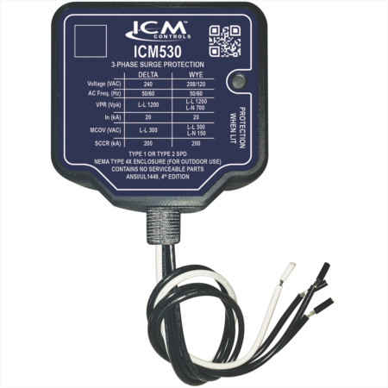
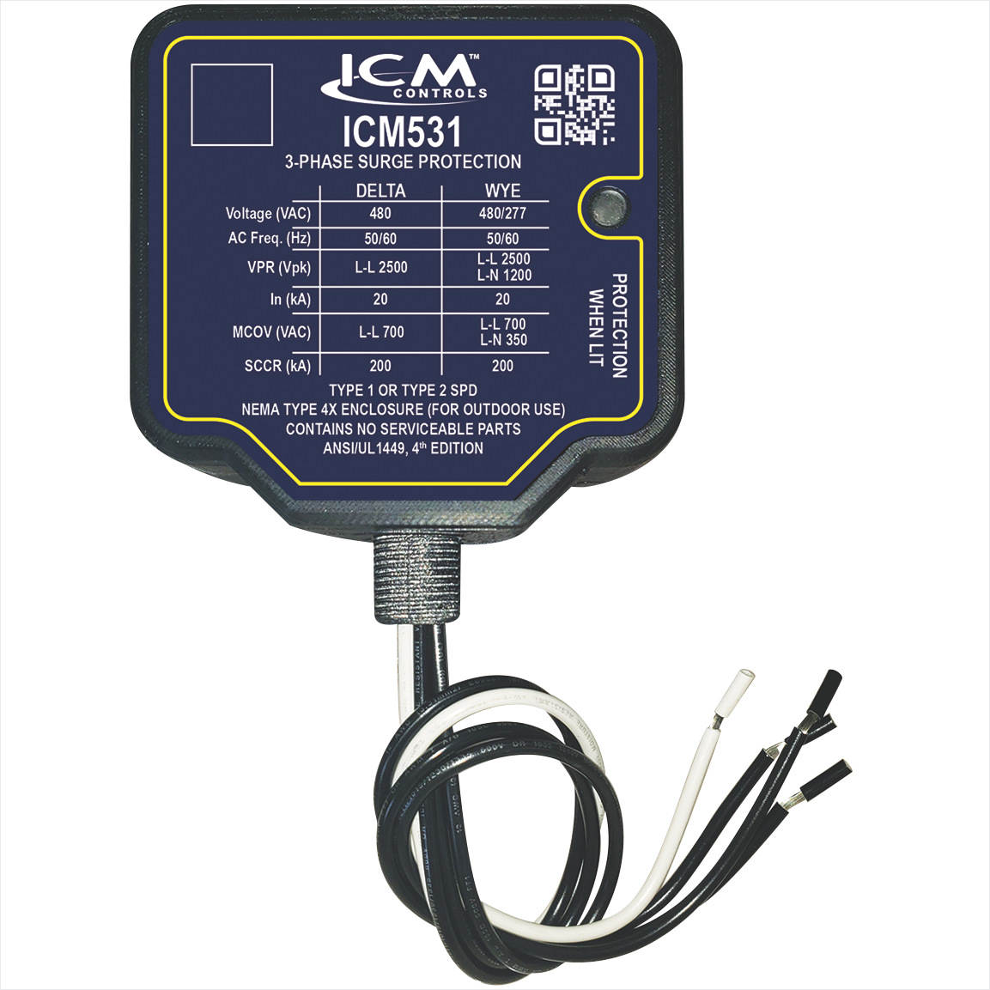
FEATURES:
Delta or Wye configuration
Green LED indicates surge protection present
UL Listed Type 1 or Type 2 SPD
NEMA Type 4X watertight plastic enclosure for outdoor and indoor installation
SPECIFICATIONS:
Short Circuit Current Rating (SCCR): 200 kA
Nominal discharge current (In): 20kA
Surge protection technology: TFMOV
Input power frequency: 50/60 Hz
ICM530 & ICM531 –
Three-Phase Surge Protectors
Why do we need Three Phase Surge Protection?
Frequently, industrial sites have surges caused by lightning strikes, power outages, or an electrical overload
Surges can permanently damage three-phase equipment which can present a major expense to replace
With an ICM surge protector wired into your system, you can have peace of mind that your equipment is protected
The value of the ICM controls Three Phase Surge Protectors
The ICM 3-phase surge protective device can be installed as a Type 1 or Type 2 device for both indoor and outdoor applications
NEMA Type 4X watertight plastic enclosure for outdoor and indoor installation
Easily connects to electrical panel or disconnect for indoor and outdoor applications
Operation
When a surge occurs, the ICM Surge Protector will absorb the surge up to 150kA
ICM incorporates superior thermally protected metal oxide varistor technology into the three-phase surge suppressors, which allows for safe disabling of the surge elements when a surge exceeds the thermal limits of the device.
REPLACES:
ABB: OVRHLDxx-120, ASCO: 420120Y, 420240D, Easton: SP1-208Y, SP1-240D, SP2-208Y, SP2-240D, ERICO (Critec): TDX50C120/208, TDX50C120/240D, Intermatic: AG2083C3, L5F13Y1DG1, Leviton: 55208-ASA, Siemens: TPS3D, TPS3C, Square D: SDSA2040, SDSA2040D
APPLIANCE
ELECTRICAL
HVAC/R
MARINE
POOL & SPA
RV

Slide 19
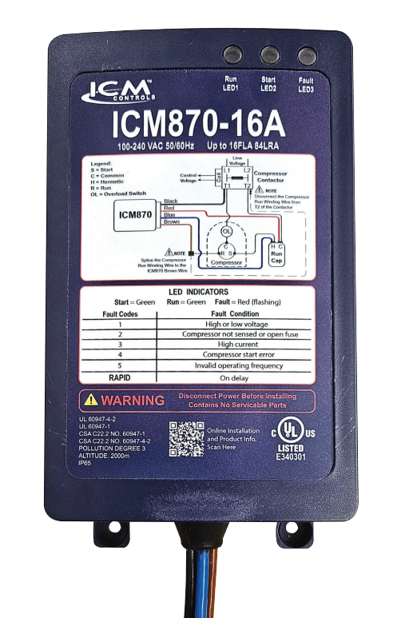
FEATURES:​​
LED fault indicators
​Over/under voltage monitoring
Over-current protection
Built-in self-learning algorithm
✓ Built-in start capacitor
SPECIFICATIONS:​​
Input:​​
• Line Voltage: 120/240 VAC​​
Output:​​
• Type: Solid State/Relay ​
• Current: Max. nominal
  ICM870-9A: 9FLA
  ICM870-16A: 16FLA
  ICM870-32A: 32FLA
REPLACES:
Dometic: SmartStart
Hyper Engineering: Sure-Start
Micro-Air: EasyStart
Network RV: SoftStartRV
Carlo Gavazzi: SmoothStarter
ICM870 Series - Soft Starts
Why we need Soft Starts and their applications?
The ICM870 reduces the current required to start a motor allowing other power sources like generators or inverters to start a heavy load.
Ideal in areas where storms knock out power and you must run your AC off a generator
Reduces the need for load shedding
Reduces loud startup noises, light flickering, and breaker trips
The value of choosing ICM controls Soft Starts
Reduces in-rush current by up to 70%.
Automatic – self learning Algorithm
Prolongs the life of the A/C by reducing excessive torque
Installation hardware is included.
The ICM870 can be used in Residential, Commercial, RV and Marine applications.
Operation​
The ICM870 integrates compressor in-rush current over startup time, thus reducing peak current demand on the power supply source. The ICM870 will monitor system health including voltage, current, compressor startup and self-integrity. Upon a fault condition, the ICM870 will halt operation and initiate a 4-minute delay while providing diagnostic fault information by means of an LED indicator.
APPLIANCE
ELECTRICAL
HVAC/R
MARINE
POOL & SPA
RV

Slide 20
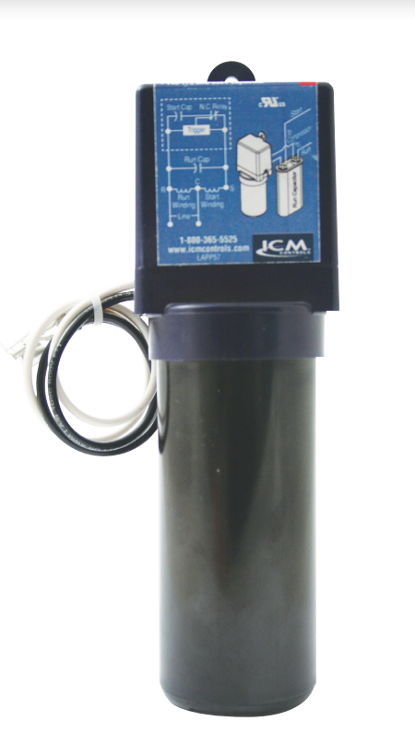
FEATURES:​​
Patented circuitry with differential voltage sensing technology
Self-adjusting to changes in voltages ​
Simple, two-wire installation
​ Multi-voltage operation for 115 or 230 VAC motors ​
SPECIFICATIONS:​​
Input:​​
Line Voltage: 90-240 VAC​​
Recommended range: 1/12 to 5 HP
Capacitor: 145-175 Mfd. 330 V
REPLACES:
5-2-1: CSR-U1, CSR-U2, CSR-U3
DiversiTech: DST-5, DST-6
Kickstart: KS1-KS5 & KS8
Mars: 32708, SS1, SS5, 32703, 32704, 32701, 32702
Supco: SPP5, SPP6, SPP5E, SPP6E, SPP7E, SPP8E, SPP9E, SPP10E, RCO810, RCO410, RCO210
Watsco: WSX1
ICM866U- Hard Start
Why we need Hard Starts and their applications?
To provide older motors the necessary torque to start quickly.
To reduce strain on the system
To prolong the life of older motors which struggle to start on their own
Reduces breaker tripping on long line sets or where there are tight compressors
The value of using ICM Hard Starts.
Precisely engages and disengages the start cap using patented differential voltage sensing circuit
Not affected by ambient temperature
Instant recycling far better than PTCR types
Universal application eliminates guesswork on which hard start you need
No positional requirement
Operation​
ICM866U’s differential voltage sensing employs a patented circuitry which monitors differential compressor auxiliary voltage, determines the state of the motor and precisely engages and disengages the start capacitor. A timed safety circuit is provided in the event the motor fails to start within 2 seconds.​
APPLIANCE
ELECTRICAL
HVAC/R
MARINE
POOL & SPA
RV

Slide 21
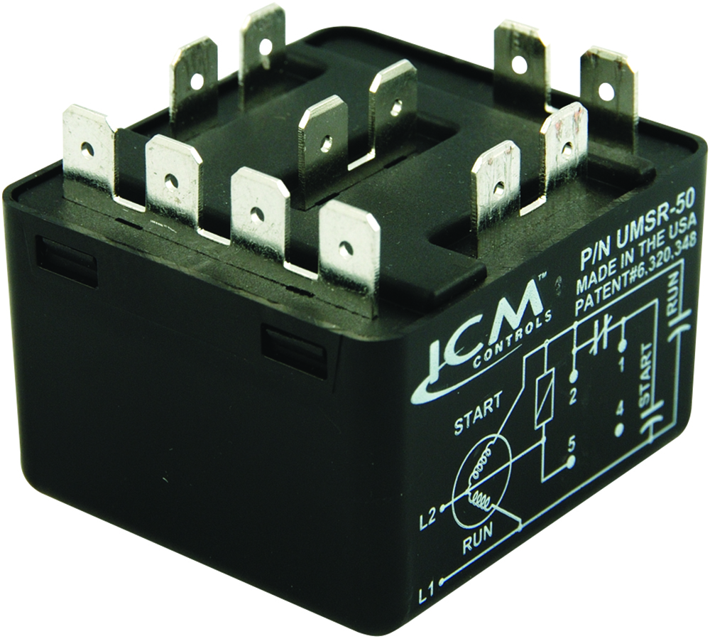
FEATURES:​​
Replacement for all standard potential relays
Patented differential voltage sensing
No user-adjustments required
Non-positional mounting configuration
50A switching capabilities
Universal mounting bracket for easy installation
SPECIFICATIONS:​​
Voltage rating: 110-270VAC, single phase
Max. voltage contact rating: 502 VAC (absolute)
Motor power rating: Up to 10 HP
Operating position: Non-positional
Safety time out: Approximately 1-second per 100 microfarads
Consumption: 5 VA maximum
Contact rating: 50A (break only)
Dimensions: 2.00” x 2.00” x 1.75”
REPLACES:
All standard potential relays
Supco: APR5, SUPR
UMSR-50- Universal Motor Starting Relays
Why we need Motor Starting Relays and their applications?
Capacitor start motors require a potential relay to dropout the start capacitor after the motor has started
There is a need to replace older style potential relays which have a pick-up and dropout rating requiring contractors to stock a large inventory of relays for different motor types
The value of using ICM’s Motor Starting Relay
ICM solved this issue by designing a universal motor starting relay incorporating a patented differential sensing circuit which removed the need for multiple relays
One universal function potential relay reduces truck stock and distributor inventory
Non-positional configuration offers a convenient mounting option
Ideal for A/C, commercial refrigeration, heat pump or any single-phase motor application up to 10 HP.
Operation​
Uses a differential voltage sensing circuit to monitor the back EMF of a motor and precisely disconnect the start circuit including the start capacitor at the exact moment the motor is started.
APPLIANCE
ELECTRICAL
HVAC/R
MARINE
POOL & SPA
RV

Slide 22
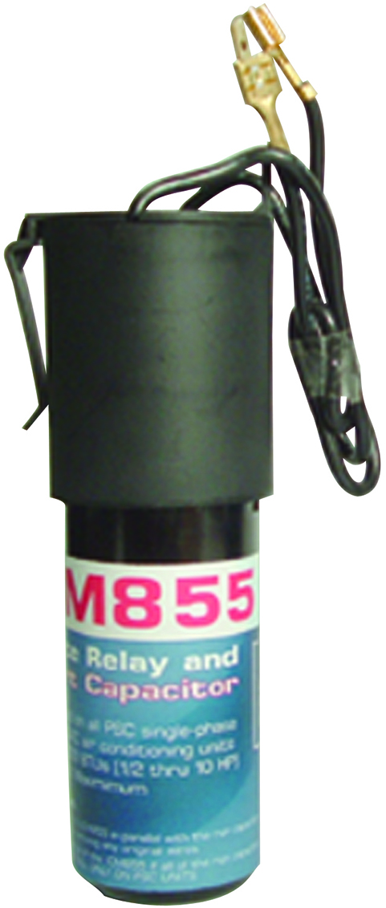
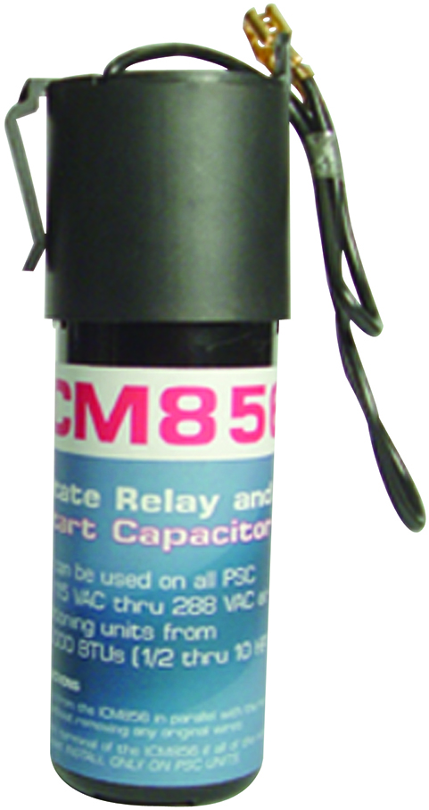
FEATURES:​​
Positive Temperature Coefficient (PTC) technology
Easy to install
Low-cost motor starting device
ICM855
Increase torque up to 300%
ICM856
Increase torque up to 500%
SPECIFICATIONS:​​
Voltage : 115-288VAC
Range: ½ to 10 HP
ICM855
Capacitor: 43-52 MdF, 330V
Dimensions: 2.50” x 1.75” x 6.25”
ICM856
Capacitor: 130-156 MdF, 330V
Dimensions: 2.00” x 2.00” x 6.50”
REPLACES:
ICM855
A-1: WX-5, MARS: 32701, 35701
Supco: SPP-5, Wagner/DiversiTech: DT-5
ICM856
A-1: WXS-6, MARS: 32702, 35702
Supco: SPP-6, Wagner/DiversiTech: DST-6
Hard Start Capacitors: ICM855 & ICM856
Why we need a Hard Start Capacitor and their applications?
Hard-start capacitors are required to start a motor when they have a difficult time starting due to long line sets, poor power distribution, tight bearings or weak windings.
The capacitor and potential relay give the additional starting torque required to overcome the back EMF needed to start the motor
The value of using ICM’s PTCR Hard Start Capacitor:
Low-cost competitive product to other PTCR style hard starts
Uses a simple design to drop out the start winding when the motor has started
Easy 2-wire installation
Operation​
Uses a normally closed bi-metal switch which stays closed until the motor has started. As current is drawn during start-up the bi-metal switch heats up and will open to break the start circuit within an appropriate time period needed to start the motor.
APPLIANCE
ELECTRICAL
HVAC/R
MARINE
POOL & SPA
RV

Slide 23
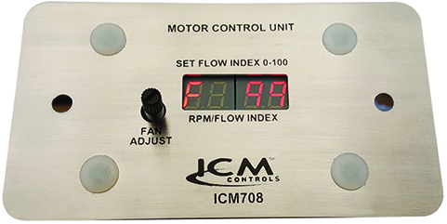
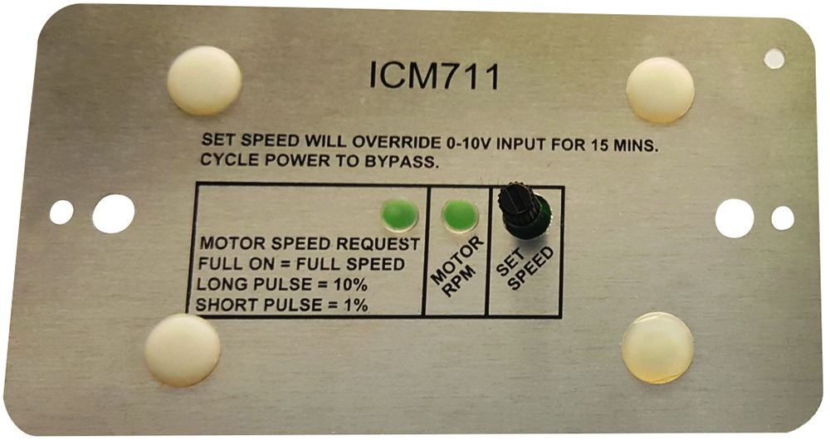
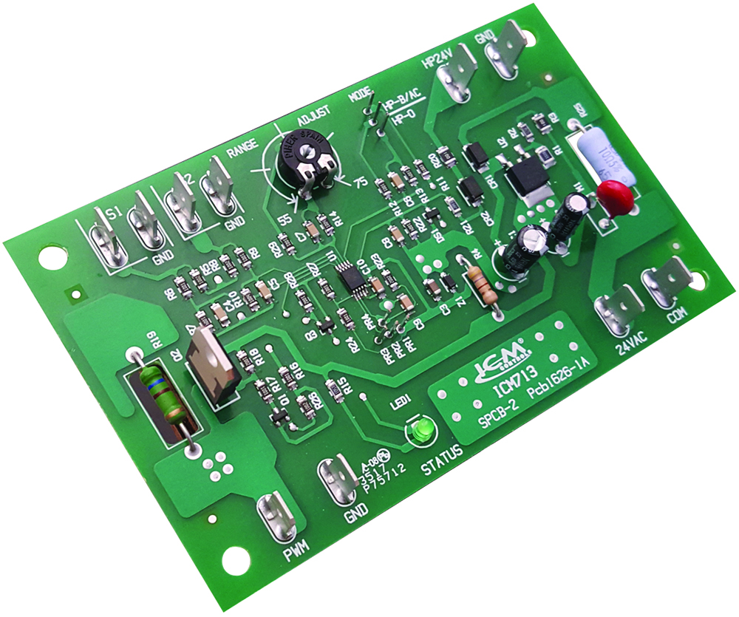
Electronically Commutated Motors (ECM)
REPLACES:
EVO™/ECM-VCU-36-m
EVO™/ECM-ACU+-S1
Hoffman: 800-ECM(10)SSHP
QuickSwapX1 and QuickSwapX3
Why we need Electronically Commutated Motors and their applications?
ECM motors are excellent for efficiency purposes.
The ability to precisely control the speed of the motor allows for varying the airflow and providing an efficient operation of blower fans
Variable speed motors produce less noise, more reliable and provide a comfortable environment
The value of ECM Controls
Form, fit and functional OEM replacements for efficiently controlling a motor’s speed.
Manually or automated control of an ECM is available (model dependent), while monitoring and displaying the RPM, CFM of the motor.
Aftermarket availability allows for contractors to replace OEM parts at a lower cost
Operation
The ICM product will vary the speed of an ECM by providing a pulse width modulated (PWM) signal at an amplitude of 0-10 VDC. Some models will utilize RPM feedback as well.
The ICM713 head pressure control is specifically designed to provide head pressure control to systems incorporating an electronically commutated motor. The ECM motor must be capable of accepting a pulse with modulation (PWM) signal
ICM708
ICM711
ICM713
APPLIANCE
ELECTRICAL
HVAC/R
MARINE
POOL & SPA
RV

Slide 24
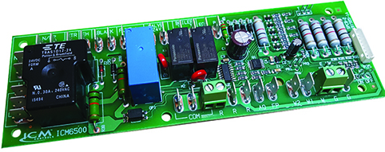
FEATURES:​​
Multi-functional control
Microprocessor controlled
Precision timing
Low-cost solution
SPECIFICATIONS:​​
Voltage: 120VAC or 208-240VAC
Frequency: 50/60Hz​​
Valve output: 24VAC, 50/60Hz, 5A
Blower fan: 120/240VAC, 50/60Hz, 13A/6.5A
Water pump: 120/240VAC, 50/60Hz, 1.5A/1.5A
Boiler: 24VAC, 50/60Hz, 5A
ECM Output: 24VAC, 5A
Dimensions: 2.00” x 7.00” x 1.25”
REPLACES:
Vtronics: R200A
ICM6500-1 – Air Handling Controller
Why we need an Air Handling Controller and their applications?
Air handlers are needed in certain types of heating/cooling systems where the fan is separate from the system
Air handling controllers are the “brains” of the air handler.
The air handler control board controls outputs such as the boiler, water pump, fan motor, water valve and electric heat source in water source heating systems.
The value of choosing ICM controls Air Handling Controller:
ICM6500-1 operates with electric or hot water heating systems
Manufactured and designed in the USA
Replaces more expensive OEM controls
Readily available at HVAC distributors which reduces lead time and adds convenience to both the contractor and homeowner
Operation​
For electric heating systems, the blower fan is turned on with the electric heat. For hot water heating systems, the blower fan, water circulation pump, valve and auxiliary relay are activated by the controller. The blower fan is controlled for cooling cycles.
APPLIANCE
ELECTRICAL
HVAC/R
MARINE
POOL & SPA
RV

Slide 25
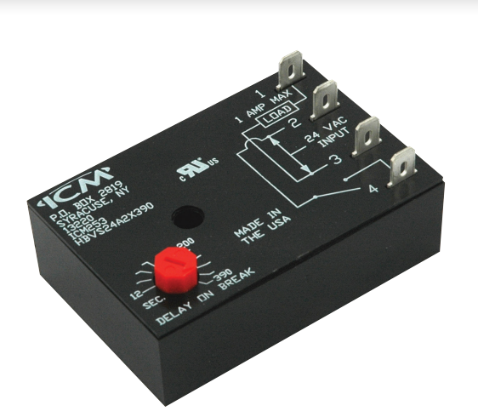
FEATURES:​​
UL 873 recognition for compressor applications
Post-purge fan delay timer
OFF delay purges ducts of residual air at the end of the heating/cooling cycle
Interrogation delay eliminates nuisance trips due to thermostat bounce/tampering
SPECIFICATIONS:​​
Voltage: 18-30 VAC,
Output: 1A max, 40mA, 10A inrush
Adjustable time delay: 12-390 seconds
REPLACES:
Field Controls: 46144700
Gemline: 1C216
Mars: 32393
ICM253 – Post Purge Timer
Why we need post purge timers and their applications?
Increases the efficiency of the heating/cooling system
Removes excess moisture from evaporator coils to prevent condensation and corrosion
Improve indoor air quality
The value of ICM controls post purge timers
Manufactured in the USA
Reliable solid-state circuitry
Low power consumption
Operation
Power must be applied before and during the time delay period. When the initiate contact closes, the load energizes and remains energized as long as the initiate contact is closed. The time delay begins when the initiate contact opens. At the end of the time delay period, the load is turned off. If the initiate contact recloses during the time delay period, the load remains energized, and the time delay is reset to zero. Removal of the input power during the delay turns off the load and resets the time delay to zero. A one-second interrogation delay is provided to avoid nuisance trips due to thermostat bounce or tampering.
APPLIANCE
ELECTRICAL
HVAC/R
MARINE
POOL & SPA
RV

Slide 26
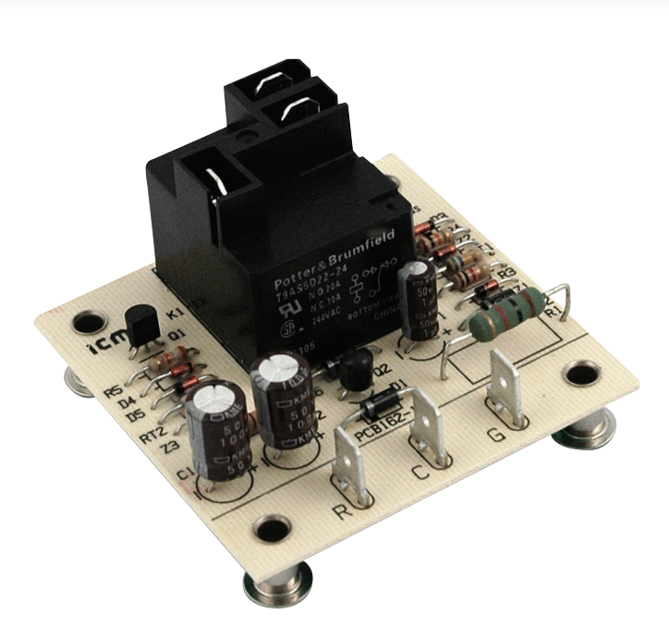
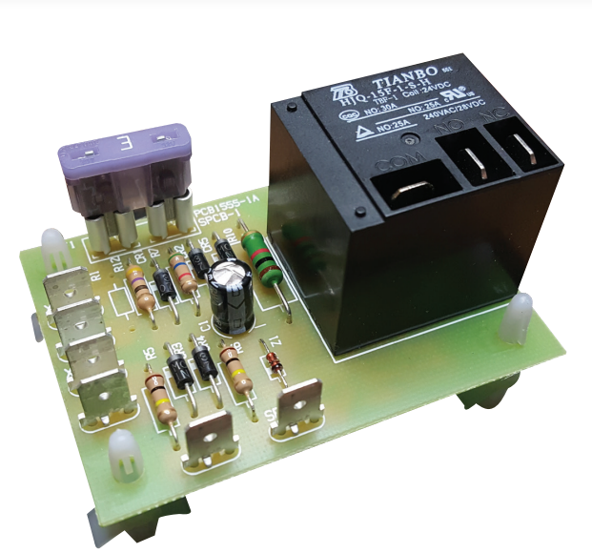
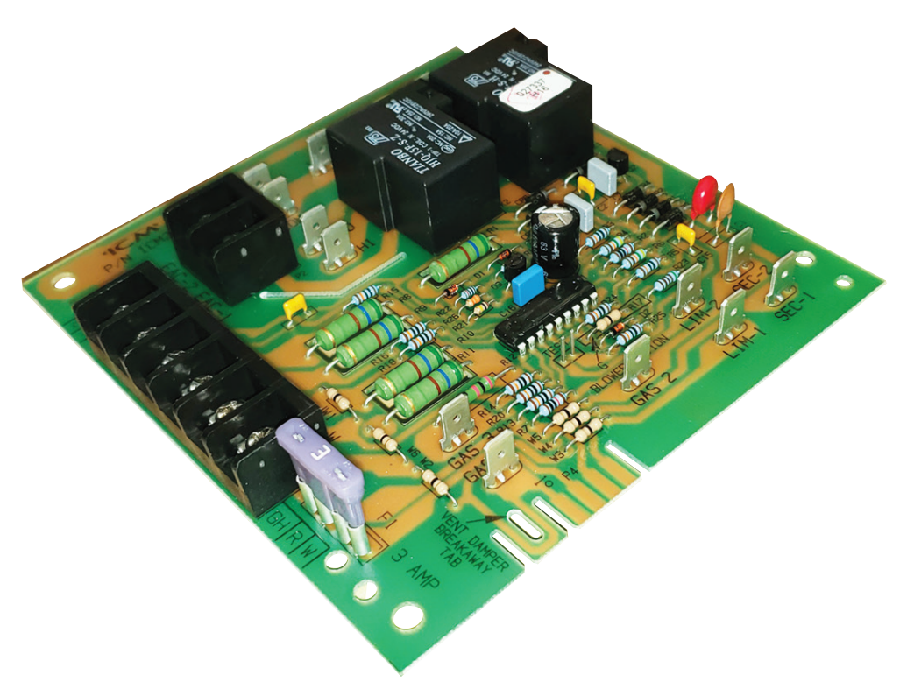
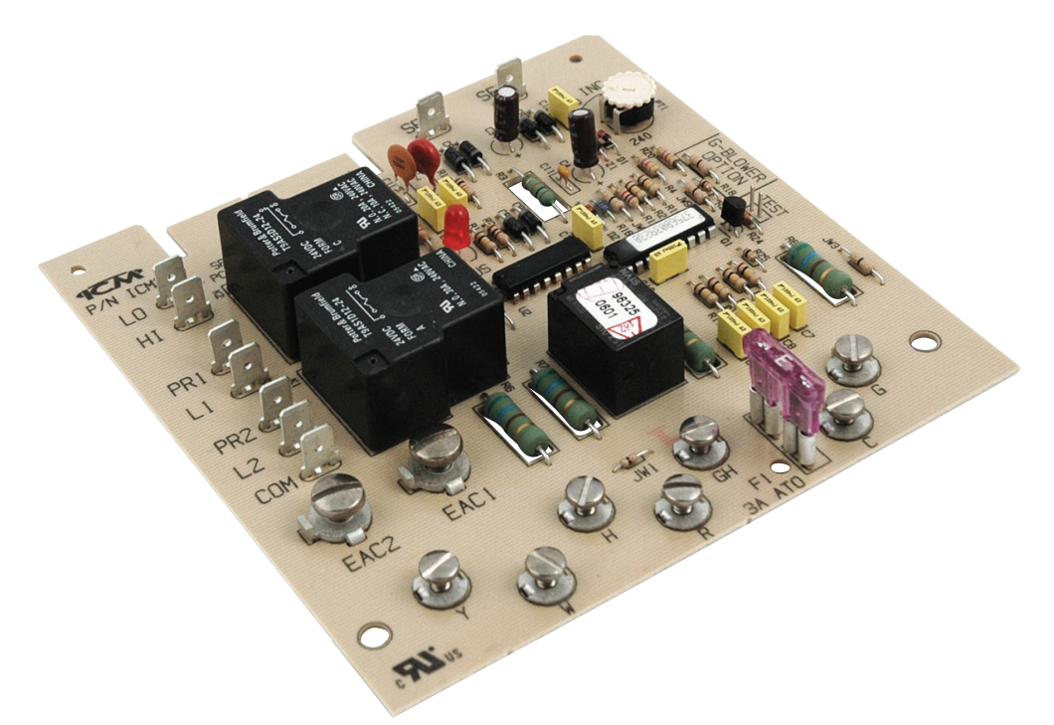
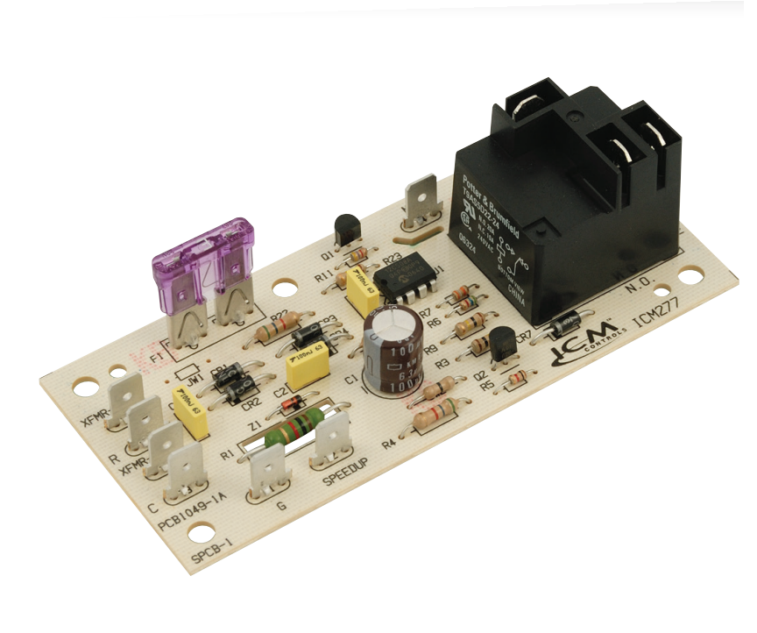
ICM CONTROLS FAN BLOWER CONTROLS CROSS TO MANY POPULAR ORIGINAL EQUIPMENT BRANDS INCLUDING:
Carrier
Robertshaw
Goodman
A-1
Bard
Mars
Rheem
Snyder General / ICP
ICM Controls fan blower controls and their cross references to OEM boards can be found on the ICM Controls website at www.icmcontrols.com
ICM Fan Blower Controls
Why do we need Fan Blower Controls ?
To maintain a stable indoor temperature
Reduces fluctuations in temperature
Timed operation to increase efficiency and lower electrical cost
Extends the life of the blower
The value of the ICM controls Fan Blower Controls
We offer a full line of fan blower controls from OEM replacements to aftermarket replacements
Form, fit, and functional replacement of the original control
Better built boards using double-sided through hole construction and conformal coating for increased reliability
Manufactured in USA
Operation
Fan blower controls will be used in applications where a more precise blower operation is desired. This is achieved by delaying the blower operation from turning on or off.
ICM255
ICM256
ICM271
ICM275
ICM277
APPLIANCE
ELECTRICAL
HVAC/R
MARINE
POOL & SPA
RV

Slide 27
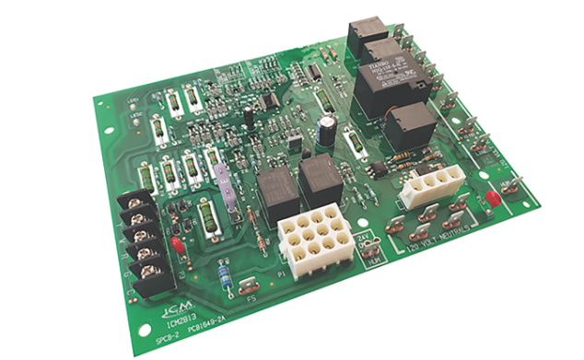
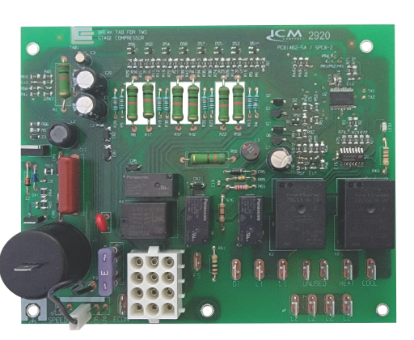
FEATURES:
Controls full operation of the furnace
Microprocessor based precision control and timing
Assembled in USA
Double sided plated through hole construction for durability
Conformal coated for protection
SPECIFICATIONS:
Line Voltage: 120VAC or 120/240VAC (depends on model)
Control voltage: 18-30VAC
Output: Relay (amperage depends on model)
REPLACES:
Many popular OEM brands like Goodman, Rheem, Lennox, Trane, Carrier...etc.
ICM Controls Drop In Furnace Control Board Replacements
Why we need options for furnace board replacements and their applications?
When your furnace breaks down you need a solution fast
The original manufacturer's board may not readily be available
The manufacturer board is likely to be far more expensive
The value of using ICM controls furnace boards:
ICM controls has a full line of both Hot Surface Ignition (HSI) and Direct Spark Ignition (DSI) furnace boards
Many popular OEM brands like Goodman, Rheem, Lennox, Trane, Carrier...etc.
Readily available either online or at a local HVAC distributor
Drop-in, form, fit, and functional boards for easy replacement
Less time for installation saves the customer money
Operation:
ICM Controls automated gas ignition control boards monitor the ignition sequence including the inducer, pressure switch, ignition, gas valve, flame sense, and circulating blower while maintaining full safety circuit monitoring. Onboard diagnostics will indicate when a fault condition exists.
HSI
DSI
APPLIANCE
ELECTRICAL
HVAC/R
MARINE
POOL & SPA
RV

Slide 28
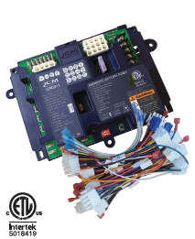
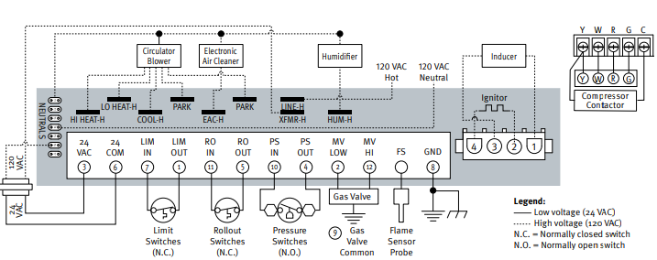
FEATURES:​​
Redundant gas valve safety design​​
Double sided plated through hole board construction​
Fault memory​​
​Agency certified​
Hot surface ignition​
Compatible with over 200 crosses​
SPECIFICATIONS:​​
Input:​​
• Line Voltage: 120 VAC​​
• Control Voltage: 18 – 30 VAC​​
Output:​​
• Type: Relay​
• Blower motor: 9.5 FLA @​ 120VAC
REPLACES:
White Rogers 50M26U-843U and over 200 popular furnace boards including Carrier, Rheem, Nordyne, Goodman, Trane etc.
ICM2812-KIT Universal Hot Surface Ignition Furnace Control board
Why Universal furnace control boards are the way to go?
Reduces truck stock inventory
Eliminates trips back and forth to distributors
Reduces inaccurate crosses by offering a single affordable solution to OEM boards
The value of choosing ICM controls Furnace Boards
Proudly assembled in USA
Meets stringent agency requirements for safety
Durable circuit board design and construction ensures strong connections increasing reliability
Complete with all the required cables to easily fit over 200 furnace boards
U.S. based live technical support with real technicians instead of artificial intelligence
Operation
The board controls all functions of the furnace including timing, trial for ignition, gas valve, system safety switches, flame sensing and provides 100% lockout safety
APPLIANCE
ELECTRICAL
HVAC/R
MARINE
POOL & SPA
RV

Slide 29
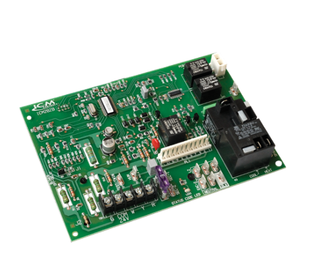
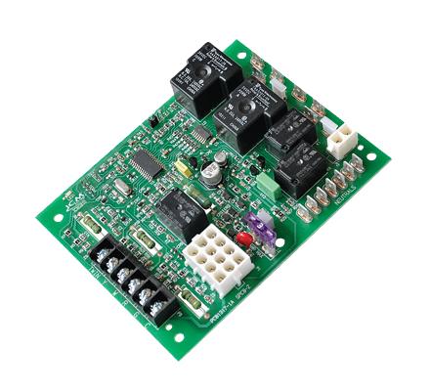
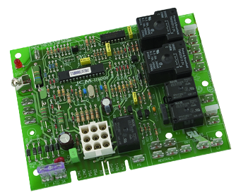
ICM CONTROLS HOT SURFACE IGNITION BOARDS CROSS TO MANY POPULAR ORIGINAL EQUIPMENT BRANDS INCLUDING:
Carrier
White Rodgers
Lennox
Goodman
Trane
UTEC
ICP
Rheem
Nordyne
Texas Instruments
ICM Controls Hot Surface Ignition furnace boards and their cross references to OEM boards can be found on the ICM Controls website at www.icmcontrols.com
Hot Surface Ignition Furnace Boards
Hot surface Ignition (HSI)
Use a high resistance element which glows red hot to provide the means to ignite natural gas in a natural gas furnace
The value of choosing ICM controls HSI Furnace Boards
Proudly assembled & engineered in USA
Meets stringent agency requirements for safety
Durable circuit board design and construction ensures strong connections and increased reliability
U.S. based technical support with real technicians instead of artificial intelligence
Operation
The board controls all functions of the furnace including timing, trial for ignition, gas valve, system safety switches, flame sensing and provides 100% lockout safety
ICM282B
ICM280
ICM2910
APPLIANCE
ELECTRICAL
HVAC/R
MARINE
POOL & SPA
RV

Slide 30
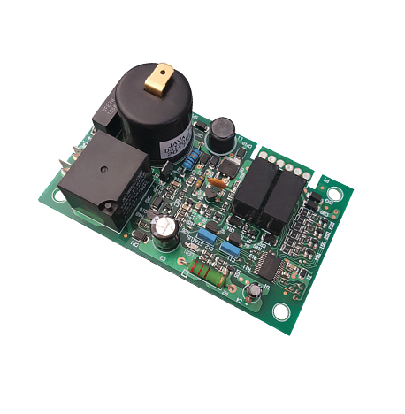
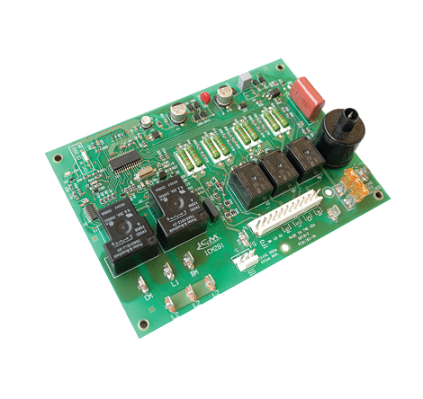
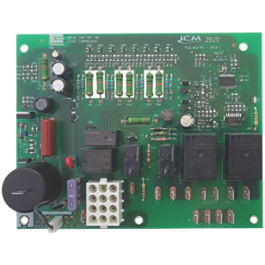

ICM CONTROLS HOT SURFACE IGNITION BOARDS CROSS TO MANY POPULAR ORIGINAL EQUIPMENT BRANDS INCLUDING:
White Rodgers
Lennox
Goodman
Trane
UTEC
ICP
Rheem
Nordyne
Texas Instruments
ICM Controls Direct Spark Ignition furnace boards and their cross references to OEM boards can be found on the ICM Controls website at www.icmcontrols.com
Direct Spark Ignition Furnace Boards
Direct Spark Ignition(DSI)
Uses a spark coil to emit a high voltage spark across a gap to a ground rod to provide the means to ignite natural gas or propane in a gas fired furnace
The value of choosing ICM controls DSI Furnace Boards
Proudly assembled & engineered in USA
Meets stringent agency requirements for safety
Durable circuit board design and construction ensures strong connections and increased reliability
U.S. based technical support with real technicians instead of artificial intelligence
Operation
The board controls all functions of the furnace including timing, trial for ignition, gas valve, system safety switches, flame sensing and provides 100% lockout safety
ICM6700
ICM2920
ICM291
ICM2911
APPLIANCE
ELECTRICAL
HVAC/R
MARINE
POOL & SPA
RV

Slide 31

ICM CONTROLS HOT SURFACE IGNITION BOARDS CROSS TO MANY POPULAR ORIGINAL EQUIPMENT BRANDS INCLUDING:
Carrier
White Rodgers
Lennox
Goodman
Trane
UTEC
ICP
Rheem
Nordyne
Texas Instruments
ICM Controls Hot Surface Ignition furnace boards and their cross references to OEM boards can be found on the ICM Controls website at www.icmcontrols.com
ICM2918 Universal Intermittent Pilot Ignition Control
Why use a Universal Pilot Ignition control
Universal function saves the distributor from stocking multiple SKU's
Great for truck stock for contractors
Replaces the very popular Honeywell S8610U universal pilot ignition control.
The value of choosing ICM controls HSI Furnace Boards
Proudly assembled & engineered in USA
Meets stringent agency requirements for safety
Durable circuit board design and construction ensures strong connections and increased reliability
U.S. based technical support with real technicians instead of artificial intelligence
Operation
The ICM2918 Universal Intermittent Pilot Gas spark Ignition Control Module initiates and monitors pilot flame, trial for ignition, vent damper and the gas valve operation while incorporating a flame sensing circuit which will safely go into 100% lockout if flame sense is lost.
APPLIANCE
ELECTRICAL
HVAC/R
MARINE
POOL & SPA
RV

Slide 32

ICM CONTROLS Oil Primary Controls replace popular Honeywell models
Replaces:
Honeywell R8184G4066, R8184G1161, R8184G1294
ICM Oil Burner Primary Control
ICM1501/ICM1502/ ICM1503
Why do we need Oil Primary Controls
The northeastern United states as well as some northern mid-west states still use oil burners for heating which requires a need for oil primary controls.
The ICM Controls offering provides for a simple control and far less expensive than high end digital versions
Great for older applications where expensive modules may not be required or desired
The value of choosing ICM controls Oil Primaries
Proudly assembled & engineered in USA
Meets stringent agency requirements for safety
Incorporates ICM patented energy transfer technology ensures fuel valve and pump will only be energized if the control is properly functioning
Form Fit and functional replacement to popular Honeywell Oil Primary Controls
Durable circuit board design and construction ensures strong connections and increased reliability
U.S. based technical support with real technicians instead of artificial intelligence
Operation
Controls oil burner, oil valve (if required) and the ignition transformer in response to a call for heat.
LED aids in testing and troubleshooting
Enclosed safety switch with external reset button
APPLIANCE
ELECTRICAL
HVAC/R
MARINE
POOL & SPA
RV

Slide 33

Features:
Universal, time & temperature defrost board for heat pumps
Nine configurable setting with NFC
Field test mode
Brownout protection
LED indicators to aid in troubleshooting
Specifications:
Input:
Power Supply: R,C (24VAC, 50/60Hz)
Thermostat: 24 VAC, 24mA
Field Test Button
Replaces:
The ICM-UDefrost replaces all legacy ICM Controls defrost boards and their associated crosses
ICM-UDefrost- Universal Defrost Control Board
Why we need an ICM-UDefrost and their applications?
With the high cost and limited access to OEM replacement boards, the need for a universal defrost control board with the functions of nearly all time & temperature heat pump defrost controls is a must.
As Heat Pumps have become more efficient, they are being used in much colder climates.
In these colder climates Heat Pumps have the issue of ice building up on the outdoor coil which requires a mechanism for defrost.
The value of ICM-UDefrost, Universal Defrost Control Board:
Manufactured in the USA to high quality standards
Universal to replace almost any traditional Time / Temperature terminate defrost board.
NFC configuration via ICM Omni app allows programming and set up without the need for power or internet connections.
Universal function benefits distributors and contractors by offering a one source solution for their defrost needs
Replaces 200+ competitive part numbers
Operation
The ICM-UDefrost board monitors thermostat calls for Y, O/B and Win inputs. During a heat call, if conditions for defrost are met, the control will perform a time and temperature defrost cycle. During normal operation, the control continuously monitors safeties such as the
low-pressure switch, high-pressure switch, brownout detection, and sensor health while displaying status and fault conditions via onboard LED diagnostics.
APPLIANCE
ELECTRICAL
HVAC/R
MARINE
POOL & SPA
RV

Slide 34


FEATURES:​​
24-hour multi-functional timer
Timed or manual termination
Adjustable 15 minutes to 23 hours 45 minutes defrost cycle
High power relay outputs
100% monitoring of inputs and outputs
Simple to use, drag & drop replacement for popular models
User-friendly time clock
For replacement board only order: ICM550
SPECIFICATIONS:​​
Electrical Rating
Voltage: 120-240VAC
Frequency: 60Hz
OUTPUT:
Type: Relay
Form: SPDT, SPST
Rating:
  [2] & [4]: 30A R, 1HP @ 120VAC, 2HP @240VAC
  [1] & [3]: 40A R, 1HP @120VAC, 2HP @ 240VAC
  [1] & [F]: 30A R, 1HP @ 120VAC, 2HP @240VAC
ICM550/ICM550-ENC: Multi-Functional Timer
Why we need the ICM550 multi-functional timer?
Refrigeration markets require a timer with high power relays to provide defrost operation
Multi-functional timers like the ICM550 can be used to provide cycle timing for many different applications including irrigation for green houses, circulation pump control for pool heaters and a host of other applications which require cycle timing
The value of using ICM’s Multi-functional timer:
Very robust design
User-friendly time click
Heavy duty output relays
Available with NEMA 4X weatherproof enclosure for applications such as water irrigation or pool & spa applications
Drag and drop replacement for popular brands like: Intermatic, Grasslin and Paragon models
Operation​
When mode B is selected and the unit is in the timed cycle (clock dip switches in the on position), the load will be turned on with the back up source. At the end of the timed cycle, the unit will return to normal operation until the next preset interval occurs. Mode A offers opposite operation, where the load is off during the timed cycle.
APPLIANCE
ELECTRICAL
HVAC/R
MARINE
POOL & SPA
RV

Slide 35

FEATURES:
Near field communication via the ICM Omni App
2 senor inputs
Universal control and input voltage
SPECIFICATIONS:
Input:
• Voltage Range: Universal 120 – 600 VAC
• Control Voltage: 24 – 240 VAC (jumper enabled)
Output:
• Motor 2: 10A maximum
ICM325A – Single-Phase Universal Head Pressure Control
Why we need Head Pressure Controls and their applications ?
Supermarkets, grow houses and computer rooms still require air conditioning and refrigeration during low-ambient conditions.
To prevent the loss of perishable goods and damage to sensitive equipment
Prevents issues like liquid slugging and evaporator freeze-ups.
Helps regulate the system pressure.
The value of the ICM’s Head Pressure Controls
Universal input voltage 120-600VAC
NFC technology allows for easy programming and setup without the need for external power by using the power of your mobile device and the ICM OMNI App!
NFC does not require internet connection and is more reliable than Bluetooth
More reliable and accurate than setting with basic potentiometers
Universal operation reduces truck stock and multiple SKU’s making it a great choice for both stocking distributors and contractor alike
Operation
The ICM325A will control the head pressure on a heat pump or HVAC unit by adjusting the condenser fan speed thus allowing the heat pump or air conditioner to operate in low ambient conditions.
REPLACES:
ACT: FM2000
Hoffman: 800, 800A, 800AA, 814-50, 816-10
Ranco: E31Series
Johnson Controls: P66AAB/P66AAD
ICM: All Single-Phase Head Pressure Controls Models; ICM325H, ICM325HNV, ICM326HN, ICM327HN, ICM333
APPLIANCE
ELECTRICAL
HVAC/R
MARINE
POOL & SPA
RV

Slide 36

FEATURES:
3-phase ON/OFF control
Heat pump bypass
10-amp load carrying capability
SPECIFICATIONS:
Input:
• Voltage Range: 120 – 600 VAC
• Control Voltage: 18 – 30 VAC
Output:
• Type: Relay, SPDT
• Voltage Range: 277 VAC @ 10A maximum
ICM334 – Three-Phase
Head Pressure Control
Why do we need 3-Phase Head Pressure Controls?
Commercial and Industrial sites still require AC in low ambient conditions
3-phase head pressure controls are needed to operate large scale cooling applications year–round such as large walk-in freezers, industrial manufacturing buildings etc.
Temperature sensitive 3-phase equipment may be damaged by excessive heat without cooling
The value of the ICM’s 3-Phase Head Pressure Controls
Low-cost alternative to expensive VFD’s
Built in a vertically integrated state-of-the-art facility in North America supporting local economy
Allows for a solution when other three phase head pressure controls are not available or not an option
Operation​
Using a temperature sensor and up to two pressure sensors; the ICM334 will monitor the ambient temperature and system pressure. The ICM334 will be energized when there is a Y call. When the ambient temperature is above 50°F (10°C), the motor will be energized continuously. When the ambient temperature is below 50°F, the pressure sensor is used to determine whether the motor is on or off. When the pressure is 15 psi below the pressure setting the motor will be turned off. When the pressure is 15 psi above the setting, the motor will be turned on
APPLIANCE
ELECTRICAL
HVAC/R
MARINE
POOL & SPA
RV

Slide 37




SIMPLE COMFORT FEATURES:
Large LCD display with backlight
Precise temperature sensing
User friendly operation
Soft-touch controls
Electrical Rating:
– 24 VAC (18-30 VAC)
– 1 amp maximum per terminal
FROST SENTRY FEATURES:
Manual changeover
Backlit display
Manual changeover
Battery Operated
Electrical rating:
- 24 VAC (18-30 VAC)
- 1 amp maximum per terminal
TEMPORARY FIXED THERMOSTAT FEATURES:
Seven fixed set point models to choose from: 45°F to 85°F
Can be used as a low ambient cutoff switch
Electrical Rating:
-24 VAC (18-30 VAC)
ICM Controls Thermostats
What kinds of thermostats does ICM Controls offer?
Simple Comfort Series
The Simple Comfort series offers programmable and non-programmable thermostat options that can be used in everyday 24V home and office applications.
  SC1600L – Non-Programmable Single Stage Heat Only
  SC2010L - Non-Programmable Single-Stage Heat/Cool and Single-Stage Heat Pump
  SC5010 - Programmable Single-stage Heat/Cool and Single-Stage Heat Pump
  SC5811 – Programmable Two-stage heat/cool and Two-stage Heat pump
Frost Sentry
The Frost Sentry thermostat is a 35° - 75° easy to use thermostat that is Ideal for garages, warehouse, storage facilities, etc.
  FS1500L – Non-Programmable Single Stage Heat Only
Temporary Fixed Thermostats
The ACH045 to ACH085 series thermostats are low-cost, single set point, 2-wire thermostats intended for use as temporary devices to provide heating or cooling to allow drywall to dry during construction.
  ACH045 (45°), ACH055 (55°), ACH075 (75°), and ACH085 (85°) for cooling applications
  ACH060 (60°), ACH065 (65°), and ACH070 (70°) for heating applications
APPLIANCE
ELECTRICAL
HVAC/R
MARINE
POOL & SPA
RV

