Slide 1


Single-Phase
Line Voltage Montior

Slide 2

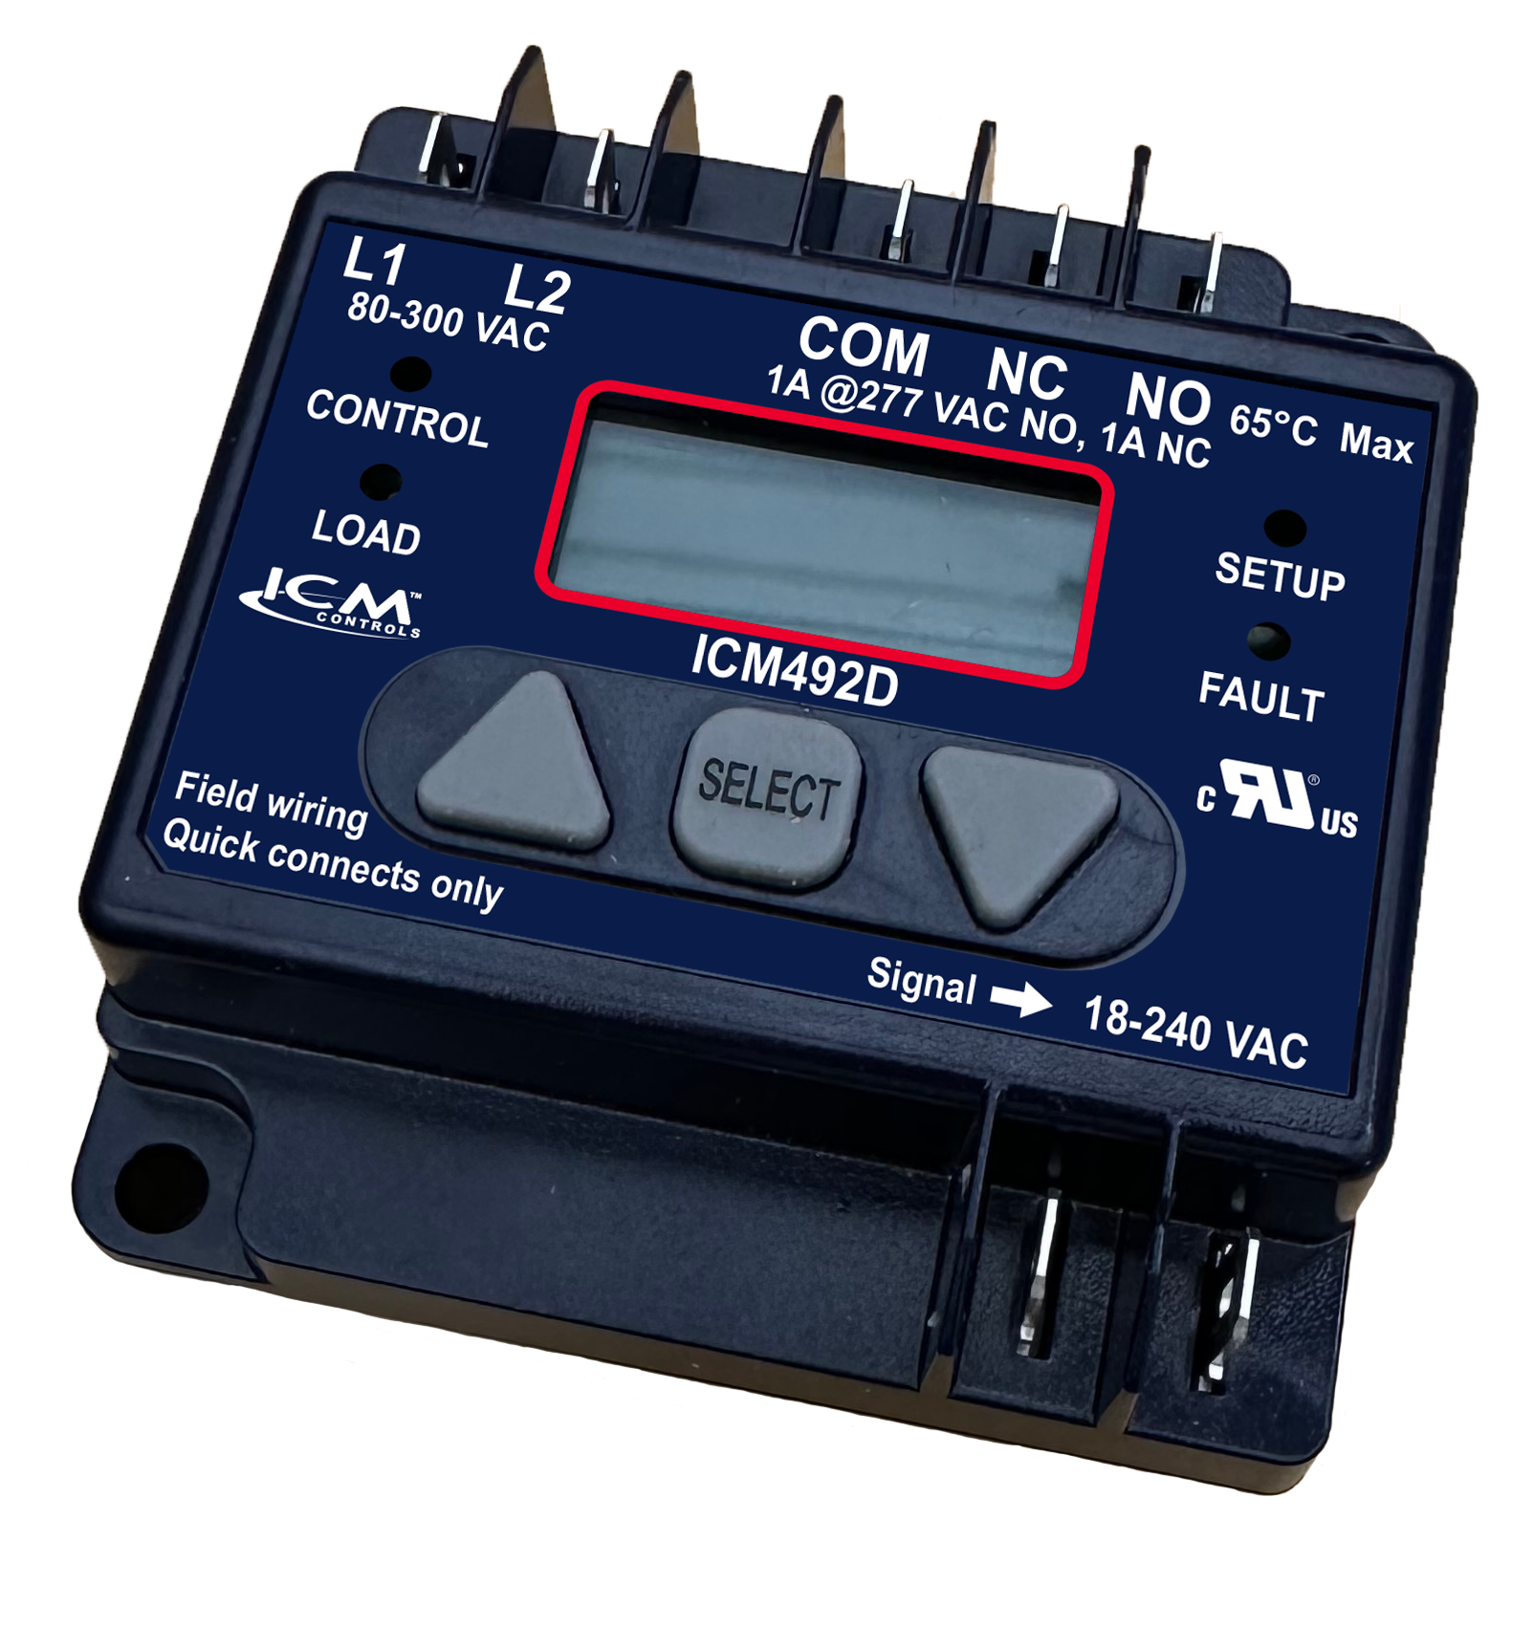

FEATURES:
Easy-view, backlit digital display
Adjustable voltage set point
Calibration feature
Adjustable anti-short cycle time delay
5-fault memory
Heavy duty SPDT relay output
SPECIFICATIONS:
Inputs:
Voltage:18-280 VAC
Frequency: 50/60 Hz
Over/under voltage setting: 5-25%
Outputs:
Relay contact ratings:
N.C. contacts: 2A resistive @ 277 VAC
N.O. contacts: 1A Pilot Duty @ 240 VAC
Replaces:
Wagner / DiversiTech: DSP-1
ICM492D - Single Phase
Voltage Monitor
Why do we need Single Phase Voltage Monitors?
It is becoming more common for service voltage to be dirty or fluctuate during the day
This can cause failure of expensive equipment if the service voltage is outside of the limits of the equipment
The ICM492D locks out in these harmful conditions and protects your single-phase load
Why choose the ICM492D?
The ICM492D is a new compact design with integral anti short cycle delay
New true RMS read with display calibration feature
New tactile buttons for durability
Simple to use configuration menus and minimal connections makes for simple installation and operation
Operation
The ICM492D continuously monitors incoming line voltage for faults and displays RMS voltage on the digital display.
When incoming line voltage is outside of the user selected parameters a fault occurs and the ICM492D will break the relay contacts and indicate a fault condition by flashing FAULT on display.
An ASC time delay prevents system short cycling caused by transient faults and rapid power interruptions
APPLIANCE
ELECTRICAL
HVAC/R
MARINE
POOL & SPA
RV

