Slide 1


Single- Phase Surge Protection Devices

Slide 2

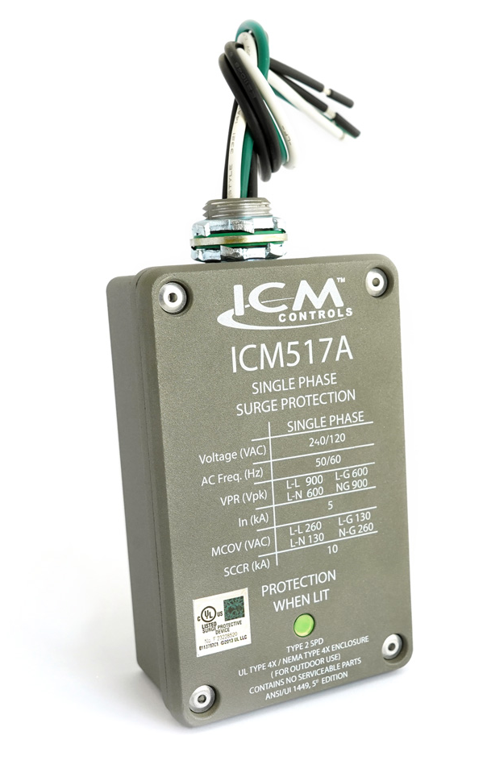

FEATURES:
NEMA Type 4X rated for
indoor/outdoor installation
Withstands effects of prolonged UV exposure better then ABS plastics
Built to withstand the high impact of a
major surge event
Limited lifetime product, up to a 3-year $25,000 connected equipment warranty
Designed and assembled in USA
SPECIFICATIONS:
Service voltage: 120/240 volts, single phase
Maximum surge current: 100,000 amps
Maximum energy dissipation: 1,020 Joules
AC protection modes: L-L, L-N, L-G, N-G
ICM 517A - Single-Phase Surge Protection
Why do we need Surge Protectors?
Single-phase power can have surges caused by lightning strikes, power outages, or an electrical overload
Surges can permanently damage single-phase equipment which can present a major expense to replace
With an ICM517A wired into your system, you can have peace of mind that your equipment is protected
The value of the ICM controls Single Phase Surge Protector
The ICM517A is an upgraded version of the ever-popular ICM517
New robust NEMA 4X rated metal enclosure to contain major surge events better than plastic
Single status LED provides an easy-to-read status of protection
Highly rated at 100,000 Amps max surge protection
Operation:
When a surge occurs, the ICM Surge Protector will absorb the surge up to 100kA for a single event and multiple hits under 100KA
ICM incorporates superior thermally protected metal oxide varistor technology, which allows for safe disabling of the surge elements when a surge exceeds the thermal limits of the device.
REPLACES:
Crosses to comparable Surge Protective Devices from the following companies. Features can vary. ABB, Square D, Eaton, Ditek, Intermatic, Mars, RectorSeal, Supco
APPLIANCE
ELECTRICAL
HVAC/R
MARINE
POOL & SPA
RV

Slide 3
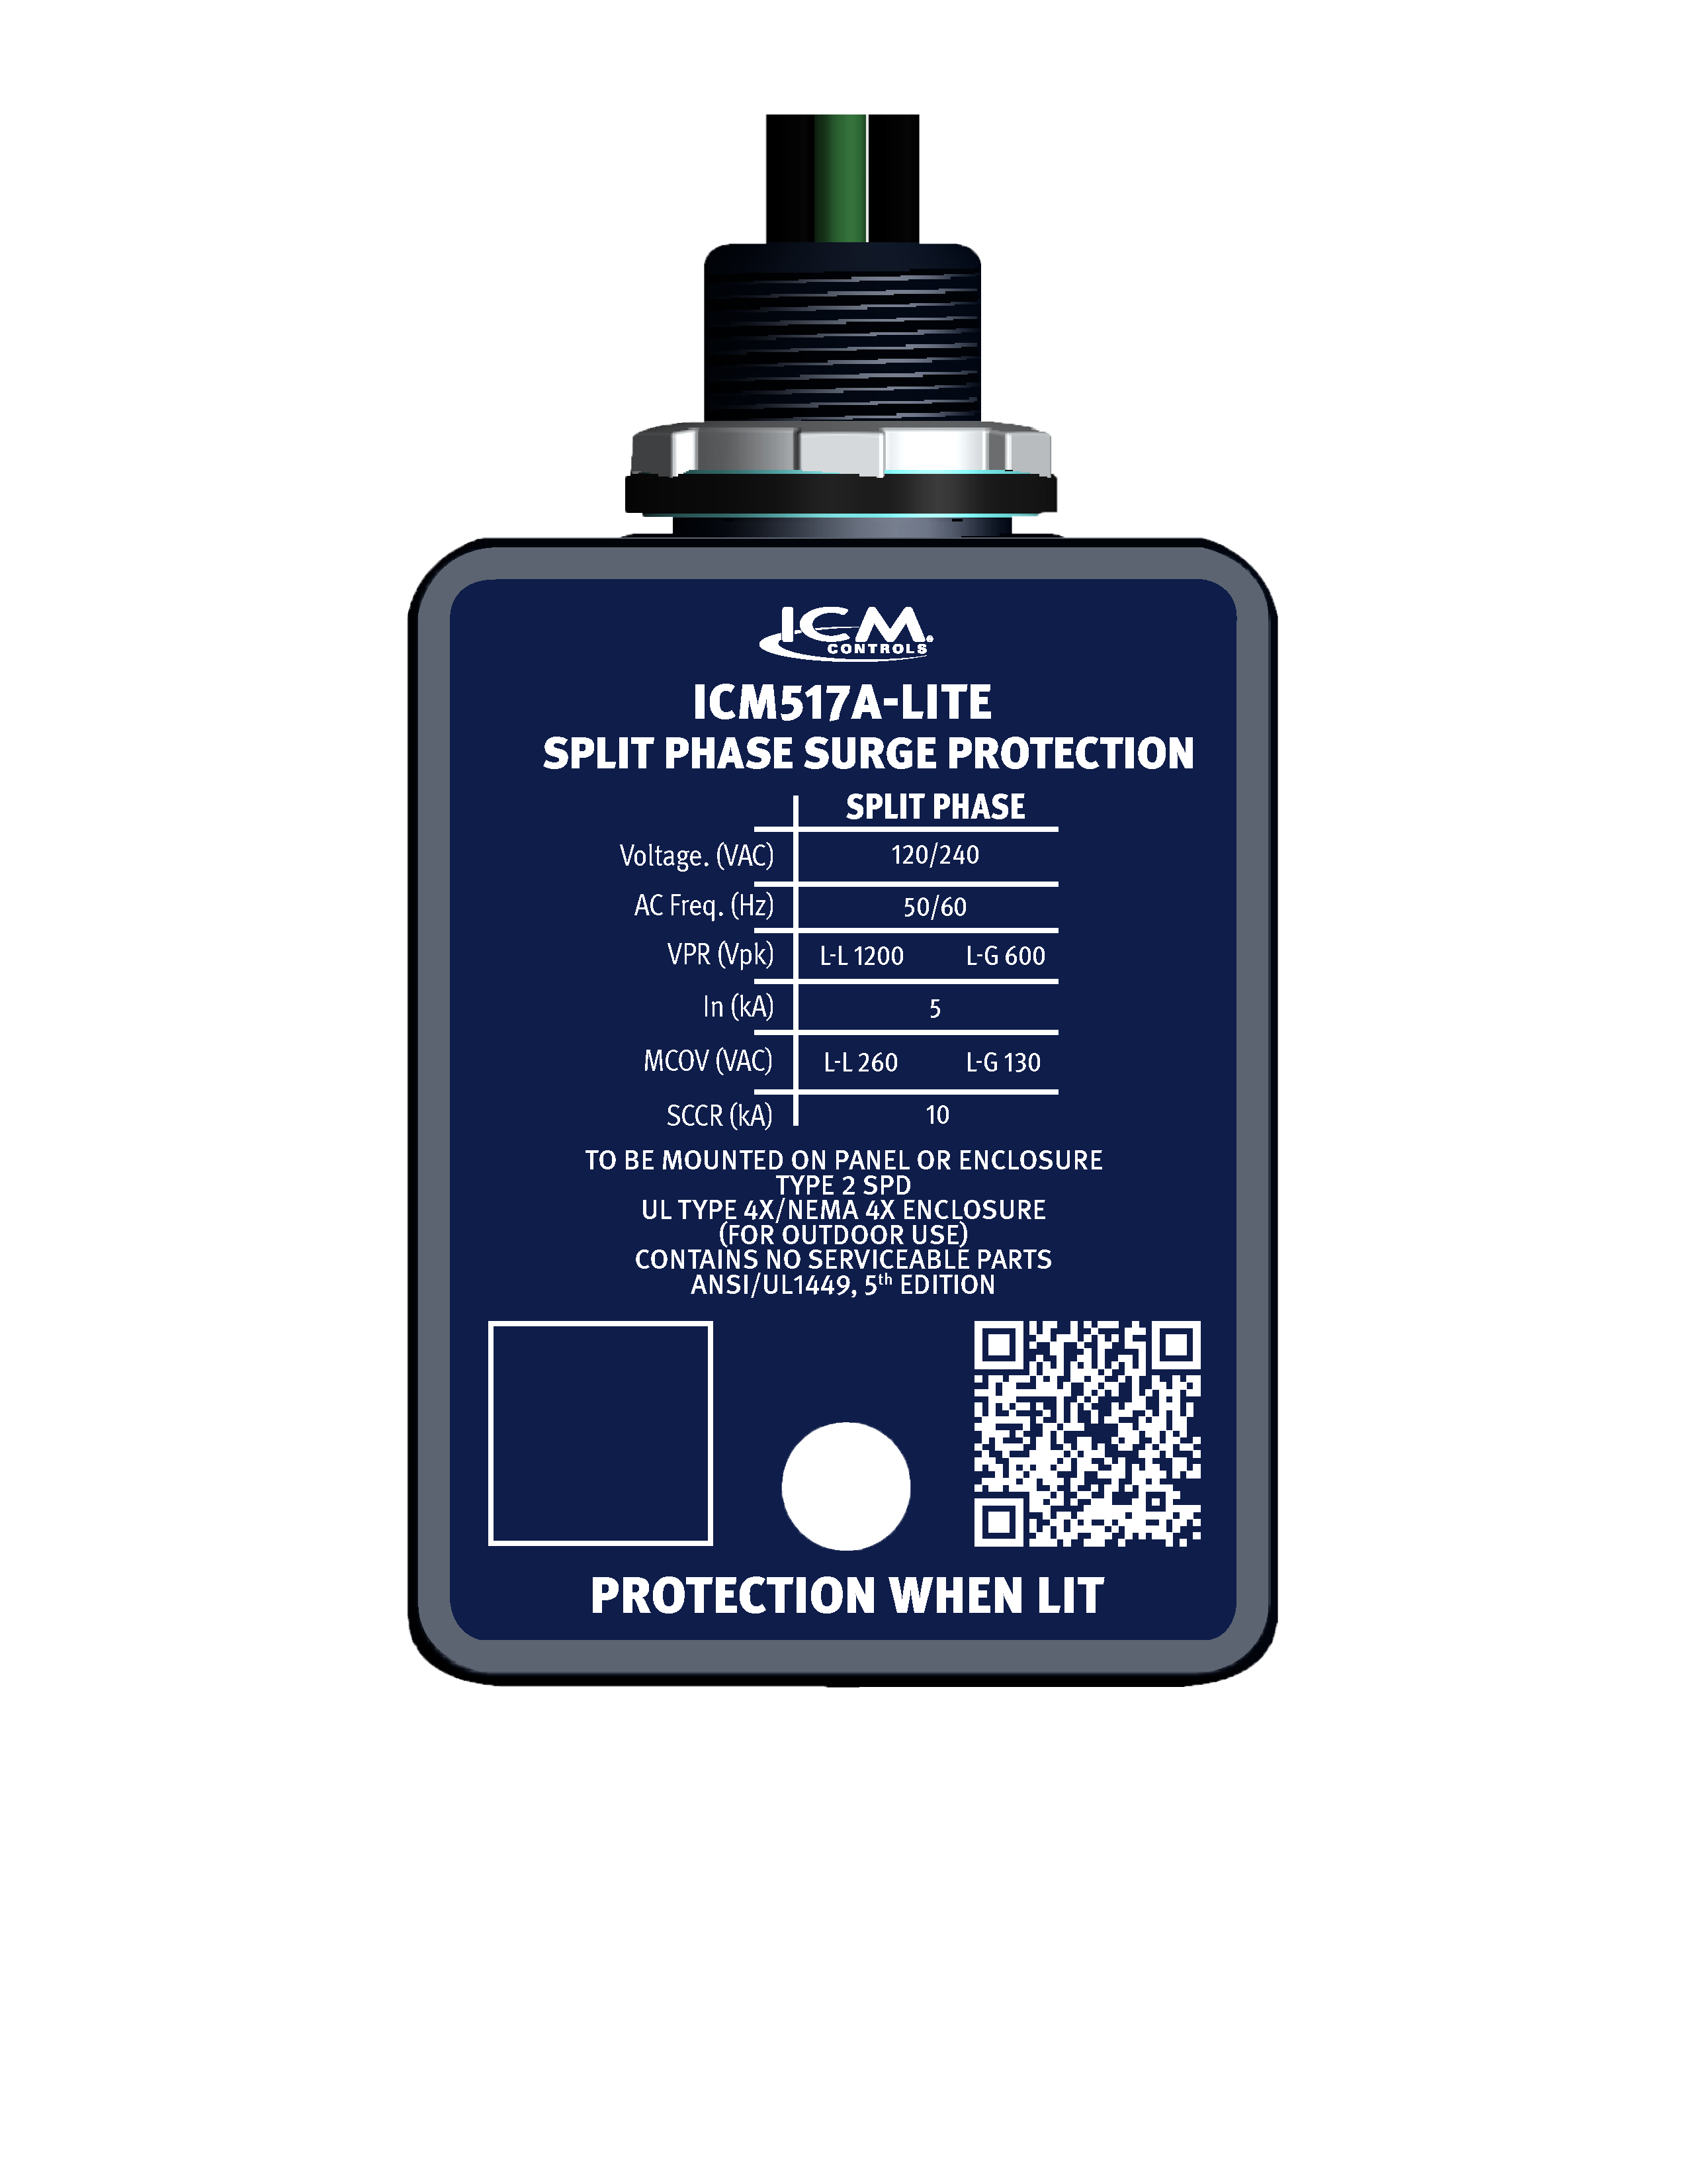
FEATURES:
Superior TMOV technology provides safe and reliable surge protection
Featuring a thinner more compact profile
UL Listed to standard 1449 5th edition
Maximum surge capacity of 60,000 amps
Easy to read status light
Easy 3-wire installation
Designed and assembled in USA
SPECIFICATIONS:
Service voltage: 120/240 volts, single phase
Maximum surge current: 60,000 amps
Maximum energy dissipation: 612 Joules
AC protection modes: L-L, L-G
ICM 517A-LITE – Single-Phase Surge Protection
Why do we need Surge Protectors?
Single-phase power can have surges caused by lightning strikes, power outages, or an electrical overload
The power grid is taxed more than ever by voltage surges, spikes and irregularities caused by increased usage of the grid and changing weather patterns
ICM controls has a low-cost option to these type of issues
The value of the ICM controls Single Phase Surge Protector
ICM provides a USA manufactured option
The ICM517A-Lite is a compact low-cost option to higher cost single phase surge protectors
Provides commercial property owners with peace of mind, contractors with a reliable selling proposition, and wholesalers with a high demand product.
Durable NEMA 4X enclosure for indoor/outdoor installation with easy to see status LED
Reliable surge suppression using TMOV technology which allows for safe disabling of the surge elements when a surge exceeds the thermal limits of the device.
Operation:
When a surge occurs, the ICM517A-Lite absorbs and dissipates the surge up to a maximum surge capacity of 60,000 amps
APPLIANCE
ELECTRICAL
HVAC/R
MARINE
POOL & SPA
RV

Slide 4
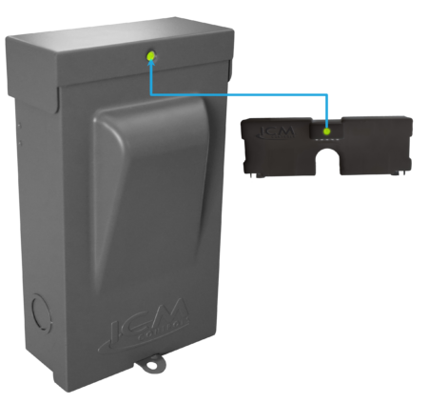
FEATURES:
Maximum Surge Current Rating
of 100kA
Completely factory wired for quick and easy installation
NEMA type 3R rated powder coated metal enclosure for indoor/outdoor use
Fully accessible mounting holes, no disassembling required
SPECIFICATIONS:
Input:
Voltage: Split phase 240 VAC
Frequency: 50/60Hz
Contact ratings:
Voltage: 240 VAC
FLA: 30A/60A (depending on model)
LRA: 360A
REPLACES:
All standard disconnect boxes rated for equal voltage and current configurations
30A – MARS: 83916, RectorSeal: RSH-50 96417
60A – MARS: 83915, RectorSeal: RSH-50 96419
ICM495 – Disconnect with Internal Surge Protection
Why would you need an ICM495?
Disconnect boxes provide safe and easy access to remove power to a circuit when troubleshooting
Oftentimes disconnects do not come with protection devices such as surge protection and they need to be installed separately to properly protect the load
With the ICM495, there is now an all-in-one surge and disconnect solution
Why choose the ICM495?
The ICM495 is a UL Listed Electrical Disconnect with an Internal Surge Protective Device built-in
Highest UL rating for nominal discharge current (In 20kA), for increased longevity & durability of the SPD
Completely assembled and pre-wired for quick and easy installation
Operation
When a surge occurs, the ICM495 will absorb the surge up to the limits of the control
The ICM495 incorporates thermal protection on the surge elements (TMOV’s) which allows for safe disabling of the surge elements when a surge exceeds the thermal limits of the device
The ICM495 has a status light on the control which identifies operational status when illuminated
APPLIANCE
ELECTRICAL
HVAC/R
MARINE
POOL & SPA
RV

