Slide 1


Three-Phase Surge Protection Devices

Slide 2

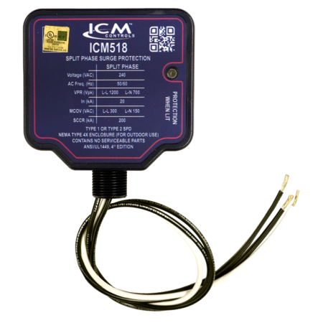

FEATURES:
Easy 3-wire installation
3/4” conduit connection
Green LED indicator tells whether the device is operational
Low cost, high performance
Rugged and reliable
UL Listed Type 1 or Type 2 SPD
SPECIFICATIONS:
Service voltage: Split-phase 240 VAC
Short Circuit Current Rating (SCCR): 200 kA
Maximum Surge Current: 100 kA
Nominal discharge current (In): 20kA
Protection mode: L1-L2, L1-N, L2-N
ICM518 – Three-Phase Surge Protection
Why do we need Surge Protectors?
Three-phase power can have surges caused by lightning strikes, power outages, or an electrical overload
Surges can permanently damage three-phase equipment which can present a major expense to replace
With an ICM518 wired into your system, you can have peace of mind that your equipment is protected
The value of the ICM controls Three-Phase Surge Protector
The ICM518 is a UL Listed Whole-Home Surge Protective Device for 240 VAC three-phase configurations designed to protect a dwellings most valuable assets.
The ICM518 has a NEMA Type 4X waterproof rated enclosure that is suitable for both indoor and outdoor use.
Operation:
When a surge occurs, the ICM Surge Protector will absorb the surge up to the limit of the control
ICM incorporates superior thermally protected metal oxide varistor technology into the three-phase surge suppressors, which allows for safe disabling of the surge elements when a surge exceeds the thermal limits of the device.
REPLACES:
■ ASCO: 420120S ■ Eaton: SP1-240S, SP2-240S ■ ERICO (Critec): TDX50C240 ■ Generac: G0073000 ■ Intermatic: AG2401C3, IG1200RC3, IG1240RC3, IG3240RC3 ■ Leviton: 55240-ASA ■ MARS: 83905 ■ Siemons: TPS3A
APPLIANCE
ELECTRICAL
HVAC/R
MARINE
POOL & SPA
RV

Slide 3
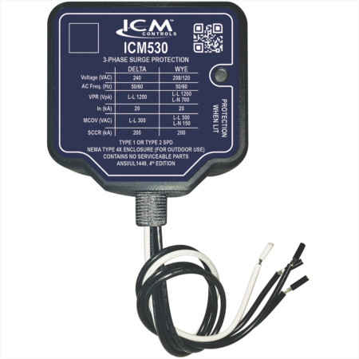
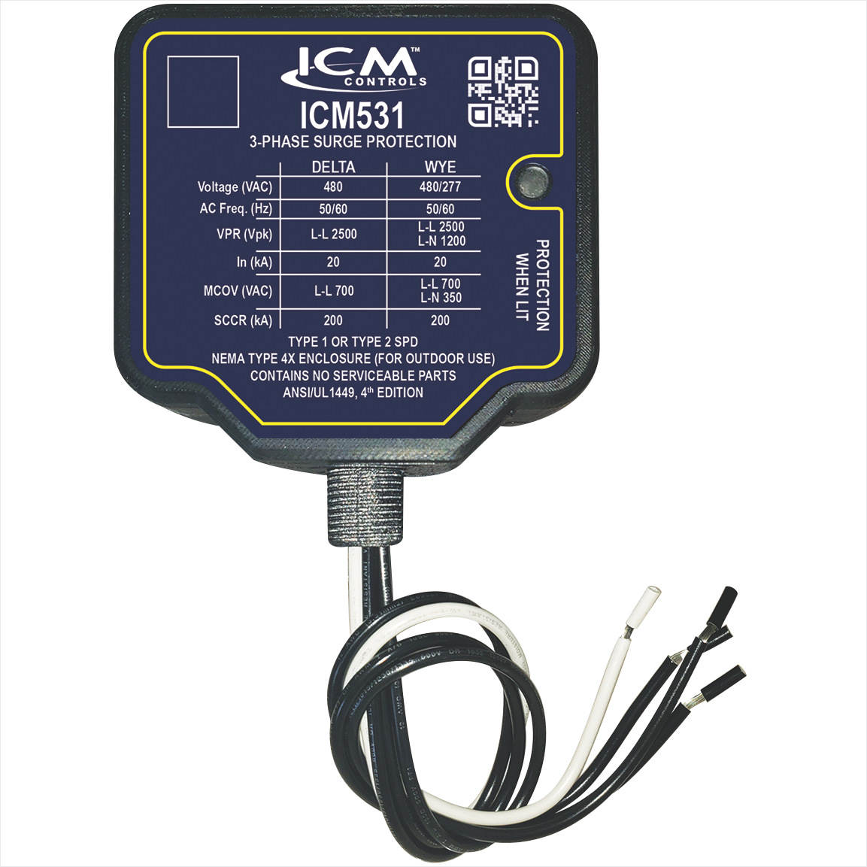
FEATURES:
Delta or Wye configuration
Green LED indicates surge protection present
UL Listed Type 1 or Type 2 SPD
NEMA Type 4X watertight plastic enclosure for outdoor and indoor installation
SPECIFICATIONS:
Short Circuit Current Rating (SCCR): 200 kA
Nominal discharge current (In): 20kA
Surge protection technology: TFMOV
Input power frequency: 50/60 Hz
ICM530 & ICM531 –
Three-Phase Surge Protectors
Why do we need Three Phase Surge Protection?
Frequently, industrial sites have surges caused by lightning strikes, power outages, or an electrical overload
Surges can permanently damage three-phase equipment which can present a major expense to replace
With an ICM surge protector wired into your system, you can have peace of mind that your equipment is protected
The value of the ICM controls Three Phase Surge Protectors
The ICM 3-phase surge protective device can be installed as a Type 1 or Type 2 device for both indoor and outdoor applications
NEMA Type 4X watertight plastic enclosure for outdoor and indoor installation
Easily connects to electrical panel or disconnect for indoor and outdoor applications
Operation
When a surge occurs, the ICM Surge Protector will absorb the surge up to 150kA
ICM incorporates superior thermally protected metal oxide varistor technology into the three-phase surge suppressors, which allows for safe disabling of the surge elements when a surge exceeds the thermal limits of the device.
REPLACES:
ABB: OVRHLDxx-120, ASCO: 420120Y, 420240D, Easton: SP1-208Y, SP1-240D, SP2-208Y, SP2-240D, ERICO (Critec): TDX50C120/208, TDX50C120/240D, Intermatic: AG2083C3, L5F13Y1DG1, Leviton: 55208-ASA, Siemens: TPS3D, TPS3C, Square D: SDSA2040, SDSA2040D
APPLIANCE
ELECTRICAL
HVAC/R
MARINE
POOL & SPA
RV

