Slide 1


Time Delay Relays

Slide 2

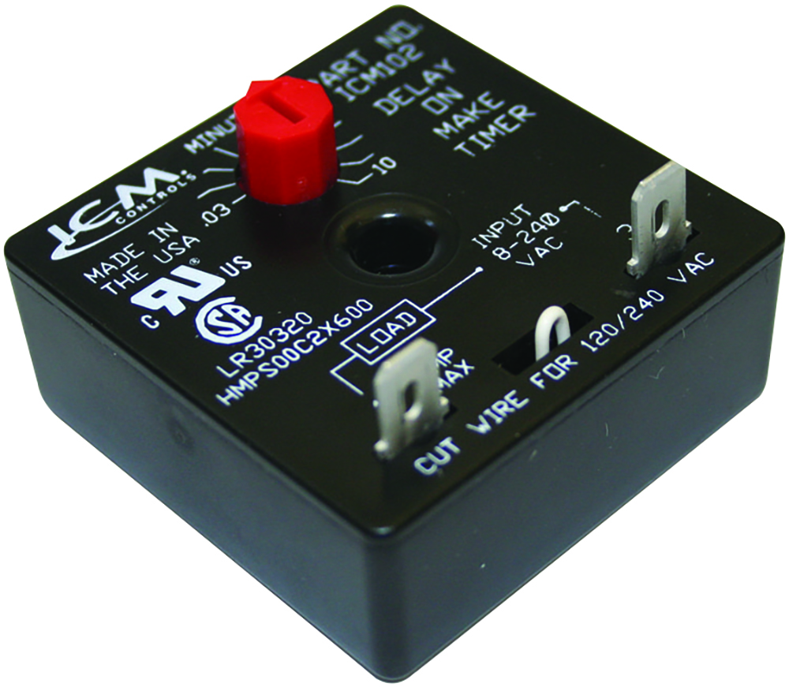
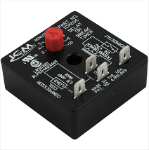
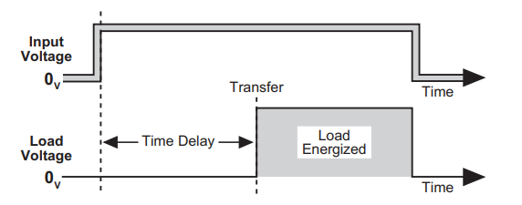

FEATURES:
Universal voltage operation
Knob-adjustable time delays
Works with anticipator-type thermostats
One model replaces many in field
Ideal for compressor staging
Simple 2-wire hookup
SPECIFICATIONS:
Voltage: 18-240 VAC,
Output: Solid State:1.5 amps, 40 mA holding current
Adjustable delay: .03-10 minutes (1.8-600 seconds)
Delay on Make Timers
Why we need Time Delays and their applications?
Used in many applications where the power to a device needs to be delayed for a given period
The HVAC industry for example requires the need to run multiple AC units on a single power source which could create an overload condition.
ICM controls has the solution with our Delay On Make timers which allows you to stagger start multiple loads like a compressor!
The value of ICM controls Delay On Make Timers
High quality circuit board construction and solid-state design means no mechanical relay thus increasing reliability
Ultra low-cost alternative to more expensive devices
Two wire design for ease of installation and wide application range
Universal voltage range makes it an all-In-one solution
Operation
The ICM102 will delay the load from turning on based on the ICM102 dial setting
Setting the delay different for each load allows you to stagger start multiple loads preventing the potential overload condition
REPLACES:
Airotronics, Little Fuse , EAC, and other similar delay on make timers
Timing Diagram
APPLIANCE
ELECTRICAL
HVAC/R
MARINE
POOL & SPA
RV

Slide 3
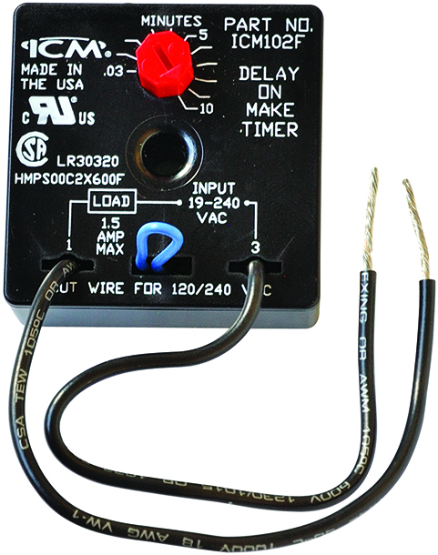
SPECIFICATIONS:
Voltage: 18-240 VAC
1.5amps
15amps inrush
40mA holding current
Frequency: 50/60Hz
Adjustable delay: .03-10min (1.8-600 secs)
Voltage drop: 2.5V @ 1.5amps
Dimensions: 2.00” x 2.00” x 1.25”
ICM102, ICM102F
Delay on Make Timer (ICM102)
With 6” Wire Leads (ICM102F)
Features and Benefits:
Universal voltage operations
Higher 1.5amp power rating
Knob-adjustable time delays
Works with anticipator-type thermostats
One model replaces many in field
Ideal for compressor staging
Simple 2-wire hookup
“F” suffix denotes 6” wire leads
REPLACES:
ICM102
A-1: EAC-701-ADJ
Diversified: AC-800
Gemline: 1C310, 1C213
Mars: 32019, 32391, 32367
Supco: TD69
Wagner/DiversiTech: ADM-1
ICM102F
Supco: TD69W
Wagner/DiversiTech: ADM-2
ICM102F
APPLIANCE
ELECTRICAL
HVAC/R
MARINE
POOL & SPA
RV

Slide 4
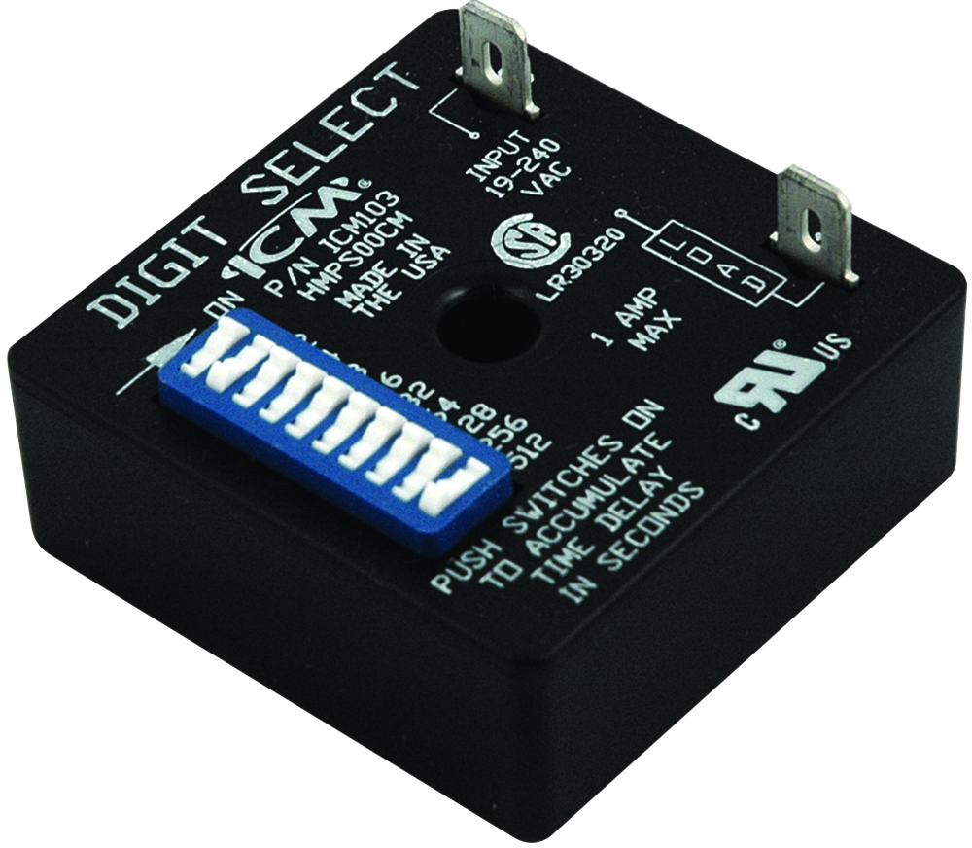
SPECIFICATIONS:
Voltage: 18-240 VAC
1 amps
10 amps inrush
40mA holding current
Frequency: 50/60Hz
Switch-settable delays: Range from 1-1, 023 sec.
Voltage drop: 2.5V @ 1 amps
Dimensions: 2.00” x 2.00” x 1.25”
ICM103
Delay on Make Timer
Features and Benefits:
Highly precise digital timing
Switch-settable time delays
Ideal for ice machine applications
Universal voltage operation
Repeat accuracy .5% over voltage and temperature range
REPLACES:
A-1: 7061
Gemline: 1C213
Ice-O-Matic: TD3001A
Mars: 32394, 32396
Robertshaw: 3310-068
Supco: TMF-19, TMF-80
APPLIANCE
ELECTRICAL
HVAC/R
MARINE
POOL & SPA
RV

Slide 5
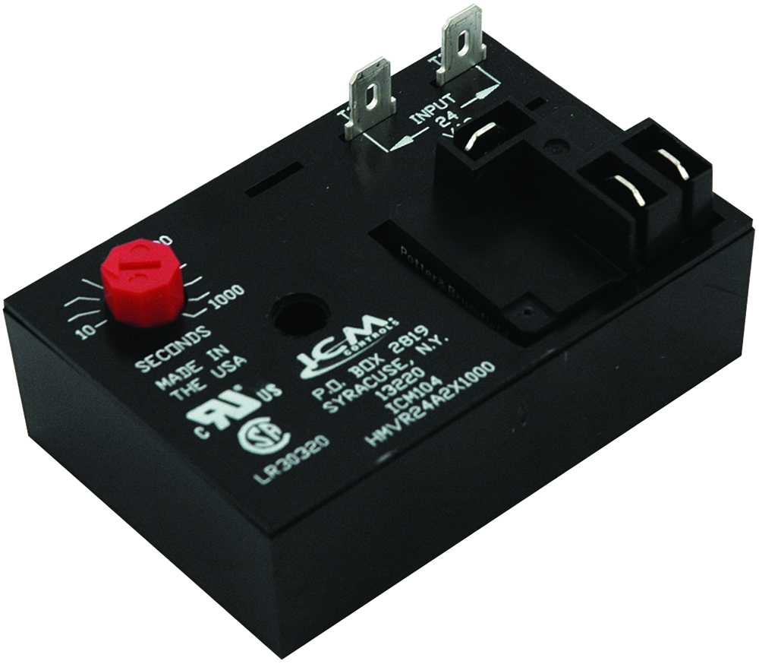
SPECIFICATIONS:
Control Voltage: 18-30 VAC
Frequency: 50/60Hz
Output:
N.O: 20 amps @240 VAC
N.C.: 10 amps @ 240 VAC
Form: SPDT, 1 form C
Knob-adj. time delay: 10-1,000
Dimensions: 2.00” x 3.00” x 1.25”
ICM104
Delay on Make Timer
Features and Benefits:
Highly precise digital circuitry
High power, SPDT relay output
Input to output isolation
Works with anticipator-type thermostats
Repeat accuracy .5% over voltage and temperature range
Rugged, compact package
REPLACES:
Mars: 32394/32398
APPLIANCE
ELECTRICAL
HVAC/R
MARINE
POOL & SPA
RV

Slide 6
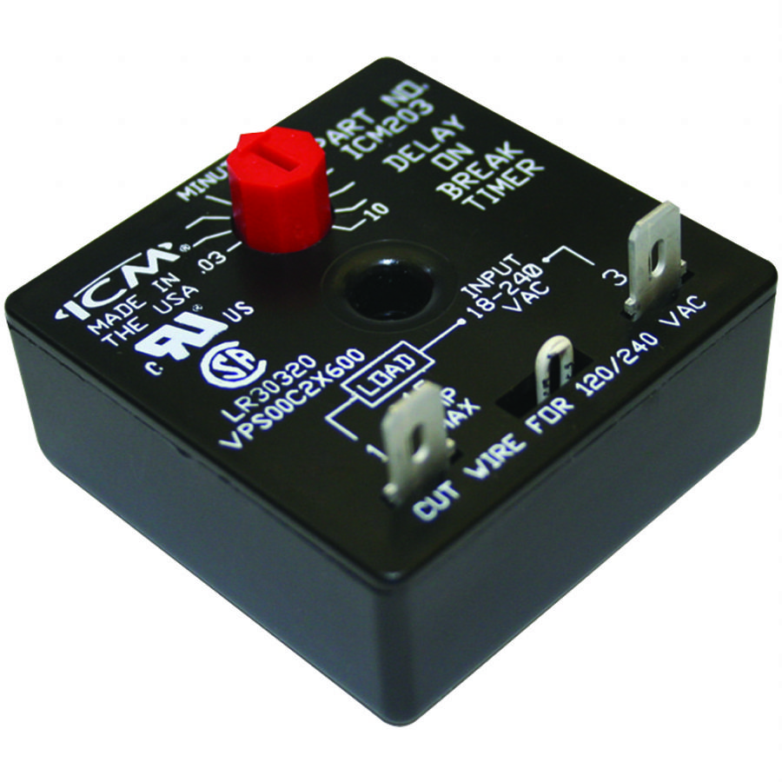
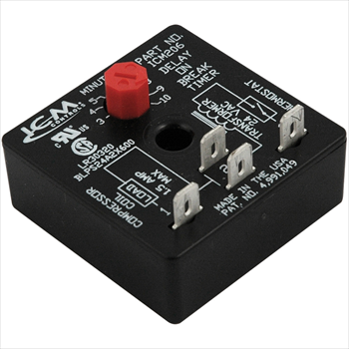
ICM203 SPECIFICATIONS:​​
Voltage: 18-240 VAC, 1.5 amps, 15A inrush, 40 mA holding current
Frequency: 50/60 Hz
Adjustable delay: .03-10 minutes (1.8-600 seconds)
Voltage drop: 4.5 V max @ 1.5 amps
REPLACES:
A-1: EAC-501-ADJ, Diversified: AC-503, MARS: 32001, 32387, 32392, Robertshaw: 3310-072, Supco: TD72, TD73, Wagner/DiversiTech: ADB-1
ICM206 SPECIFICATIONS:​​
Voltage: 18-30 VAC, 1.5A, 15A inrush, 40mA holding current
Frequency: 50/60 Hz
Adjustable delay: 3-10 minutes
REPLACES:
• A-1: EAC-426-ADJ , Supco: TD74
ICM Delay on Break Timers
Why do we need Delay on Break Timers?
Delay on Break timers will help to protect equipment from damage which can be caused by rapid short cycling.
The value of ICM Delay on Break Timers
High quality circuit board construction and solid-state design means increased reliability
Ultra low-cost alternative to more expensive devices
Operation
Upon application of power, the load is energized. When the there is a loss of power, the load is de-energized and the delay period begins.
The load will not start during the delay period. Restart occurs after the delay period has elapsed.
APPLIANCE
ELECTRICAL
HVAC/R
MARINE
POOL & SPA
RV

Slide 7
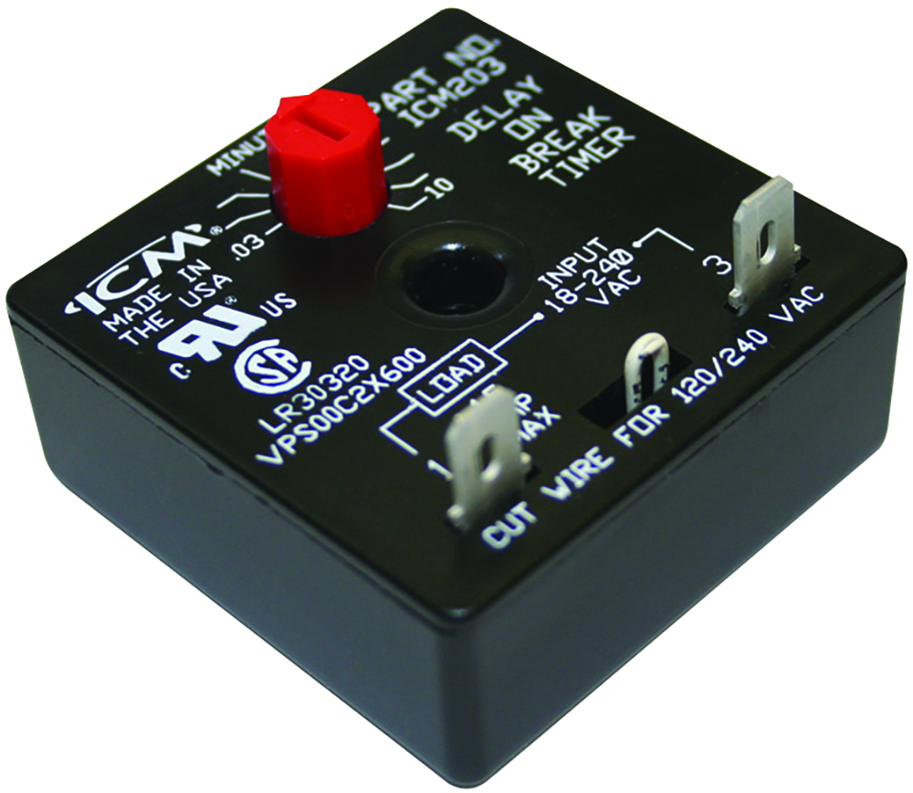
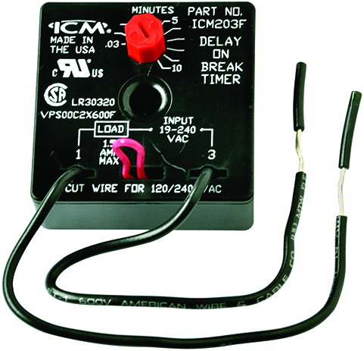
SPECIFICATIONS:
Voltage: 18-240 VAC
1.5 amps
15 am inrush
Frequency: 50/60Hz
Knob-adj. time delay: .03-10 min. (1.8-600 sec.)
Voltage drop: 3.5 V typical, 4.5 V max. @ 1.5 amps
Holding current min.: 40 mA
Dimensions: 2.00” x 2.00” x 1.25”
ICM203, ICM203F
Delay on Break Timer (203)
With 6” Wire Leads (ICM203F)
Features and Benefits:
Universal voltage operation
Higher 1.5 amp power rating
Compressor lockout/ anti-short cycle timer
Helps to protect compressors from damage caused by rapid short cycling
Simple, 2-wire hookup
“F” suffix denotes 6” wire leads
REPLACES:
ICM203
A-1: EAC-501-ADJ
Diversified: AC-503
Mars: 32001, 32387, 32392
Robertshaw: 3310-072
Supco: TD72, TD73
Wagner/DiversiTech: ADB-1
ICM203F
Supco: TD73W
Wagner/DiversiTech: ADB-2
ICM203F
APPLIANCE
ELECTRICAL
HVAC/R
MARINE
POOL & SPA
RV

Slide 8
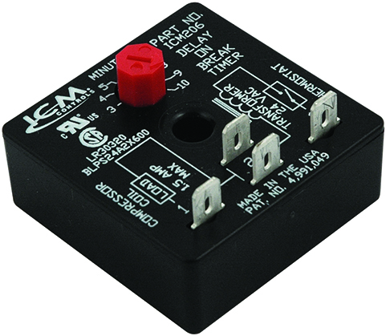
SPECIFICATIONS:
Voltage: 18-240 VAC
1.5 amps
15 am inrush
Frequency: 50/60Hz
Time delays: 3-10 min. adjustable time delay
Holding current min.: 40 mA
Dimensions: 2.00” x 2.00” x 1.25”
ICM206 - Delay on Break Timer
Features and Benefits:
Burnout protection
UL 873 recognition as compressor controller
Helps prevent scroll compressor reversal
Fast response time: 16ms
Compressor lockout/anti-short cycle timer
Eliminates relay chatter due to thermostat bounce or tampering
Works with anticipator-type thermostats
REPLACES:
A-1: EAC-426-ADJ
Supco: TD74
APPLIANCE
ELECTRICAL
HVAC/R
MARINE
POOL & SPA
RV

Slide 9
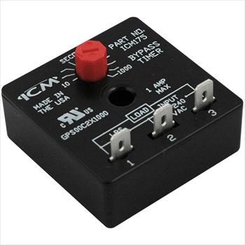
Features:
Designed to bypass a low-pressure switch or other device during startup
Ideal for low ambient startups
Helps to reduce nuisance lockouts
Universal AC voltage operation
ICM175 SPECIFICATIONS:​​
Voltage: 18-240 VAC 40mA min,1A max, 10A inrush
Adjustable delay: 10-1000 seconds
Replaces:
Mars: 32395
Supco: TD32
ICM175 - Bypass Timer
Why we need Bypass timers and their applications?
Bypass timers provide the ability to temporarily bypass a switch function to allow operation under a normally locked out condition when necessary for operation.
Bypass timers allow compressors to start during low ambient conditions when operation would normally be locked out due to low pressures in the system.
The value of ICM controls Bypass timer
Manufactured in the USA to high quality standards
Low-cost option to more expensive custom designs
Universal operating voltage makes it a versatile choice
Key component for “winter start” kits
Operation
With power applied to the input, the load energizes immediately and remains energized for the length of the time delay, regardless of the state of the switch being bypassed. At the end of the time delay, the condition of the load is determined by the state of the switch.
APPLIANCE
ELECTRICAL
HVAC/R
MARINE
POOL & SPA
RV

Slide 10
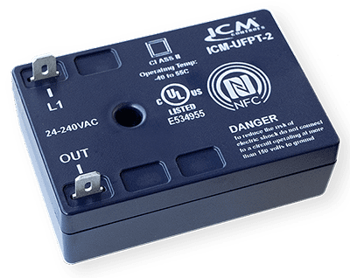
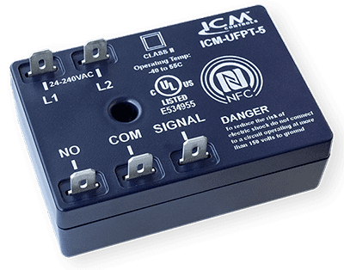
ICM-UFPT-2 SPECIFICATIONS:​​
Voltage: 24-240 VAC
40mA minimum-0.5A max
ICM-UFPT-5 SPECIFICATIONS:​​
Voltage: 24-240 VAC
1A @ 240VAC (pilot duty)
4FLA/4LRA @ 277VAC (AC motor)
5A @ 277VAC (general use)
8.75A @ 240VAC (resistive)
ICM-UFPT Timing Modes:​​
On delay
Interval
Anti-short cycle
Repeat cycle
Off delay (5-wire model only)
Single shot (5-wire model only)
Universal Time Delay Relays
Why we need a universal time delay relay and their applications?
One stop shop for all your timing needs
Replacement option for obsolete legacy timers
Universal application saves cost for the distributor and the technician by reducing the number of timers needed for stock
Great option for unique timing applications
The value of ICM controls universal time delay relays
Universal function replaces over 85 ICM legacy timers and hundreds of competitor models.
The convenience to stock one control for all timer applications.
State of the art NFC technology allows accurate programming of all functionalities using a smart phone.
Installation instructions, wiring diagrams, and timing diagrams are conveniently displayed on the App.
Operation
Uses near field communication and the ICM OMNI app to program 6 different timing functions
APPLIANCE
ELECTRICAL
HVAC/R
MARINE
POOL & SPA
RV

Slide 11
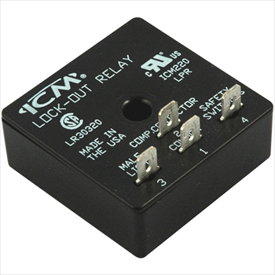
FEATURES:
UL 873 recognized as a
compressor controller
Low-cost lockout relay
Ideal for use with safety/ interlock switches
SPECIFICATIONS:
Voltage: 18-30 VAC
Output : Relay: 2 amps max. @ 30 VAC
ICM220 – Lockout Relay
Why we need Lockout Relays and their applications?
For older systems which do not have controls to monitor safety switches and protect the system.
To protect the compressor or other sensitive equipment from damage caused by rapid short cycling when safety switches open and close.
The value of ICM controls Lockout Relays
Monitors various switch inputs to help protect the compressor.
Helps eliminate nuisance lockouts.
Protects the compressor by locking out operation until power is recycled, and switches are closed.
Replaces impedance relay series 84 and 93
Low-cost alternative to more expensive LPR’s
Operation
Upon application of power with the safety switches closed, the load will energize. If any of the safety switches are open longer than 600ms; the ICM220 will energize the fault output, and lockout compressor operation. Power must be removed for 100ms, and the safety switches must be closed to clear the lockout.
REPLACES:
Impedance Relays: 83 and 93
APPLIANCE
ELECTRICAL
HVAC/R
MARINE
POOL & SPA
RV

