Slide 1


Universal Controls

Slide 2
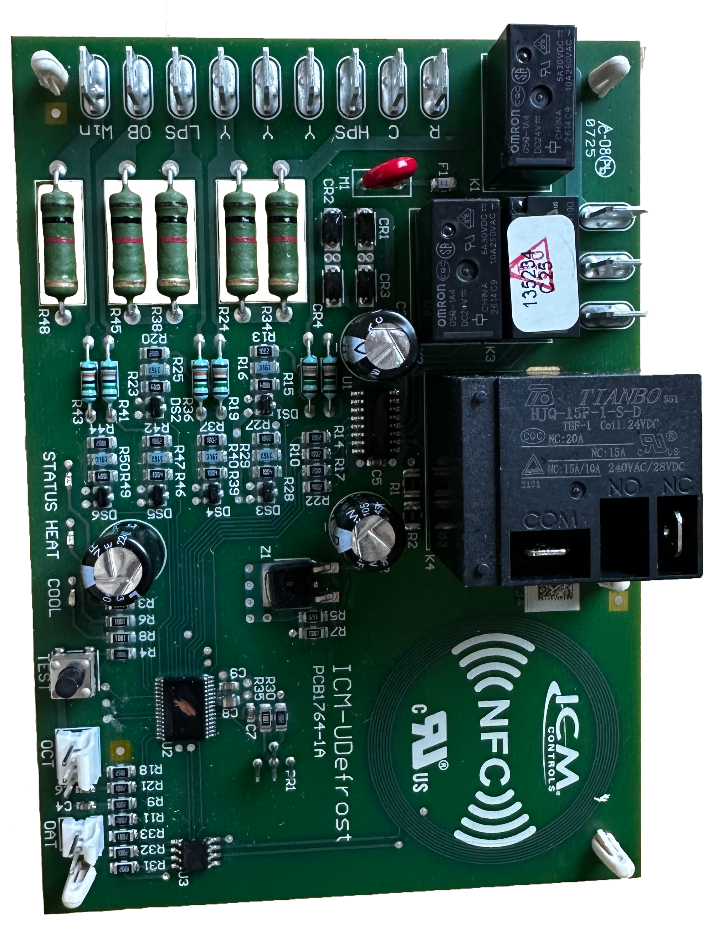


Features:
Universal, time & temperature defrost board for heat pumps
Nine configurable setting with NFC
Field test mode
Brownout protection
LED indicators to aid in troubleshooting
Specifications:
Input:
Power Supply: R,C (24VAC, 50/60Hz)
Thermostat: 24 VAC, 24mA
Field Test Button
Replaces:
The ICM-UDefrost replaces all legacy ICM Controls defrost boards and their associated crosses
ICM-UDefrost- Universal Defrost Control Board
Why we need an ICM-UDefrost and their applications?
With the high cost and limited access to OEM replacement boards, the need for a universal defrost control board with the functions of nearly all time & temperature heat pump defrost controls is a must.
As Heat Pumps have become more efficient, they are being used in much colder climates.
In these colder climates Heat Pumps have the issue of ice building up on the outdoor coil which requires a mechanism for defrost.
The value of ICM-UDefrost, Universal Defrost Control Board:
Manufactured in the USA to high quality standards
Universal to replace almost any traditional Time / Temperature terminate defrost board.
NFC configuration via ICM Omni app allows programming and set up without the need for power or internet connections.
Universal function benefits distributors and contractors by offering a one source solution for their defrost needs
Replaces 200+ competitive part numbers
Operation
The ICM-UDefrost board monitors thermostat calls for Y, O/B and Win inputs. During a heat call, if conditions for defrost are met, the control will perform a time and temperature defrost cycle. During normal operation, the control continuously monitors safeties such as the
low-pressure switch, high-pressure switch, brownout detection, and sensor health while displaying status and fault conditions via onboard LED diagnostics.
APPLIANCE
ELECTRICAL
HVAC/R
MARINE
POOL & SPA
RV

Slide 3
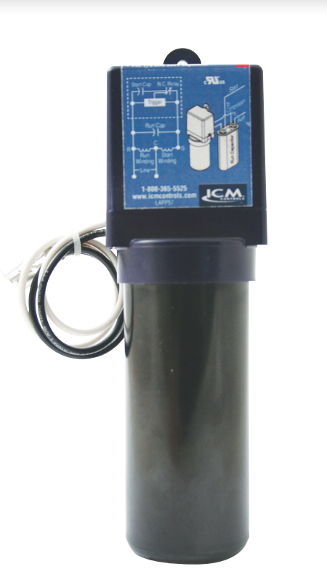
FEATURES:​​
Patented circuitry with differential voltage sensing technology
Self-adjusting to changes in voltages ​
Simple, two-wire installation
​ Multi-voltage operation for 115 or 230 VAC motors ​
SPECIFICATIONS:​​
Input:​​
Line Voltage: 90-240 VAC​​
Recommended range: 1/12 to 5 HP
Capacitor: 145-175 Mfd. 330 V
REPLACES:
5-2-1: CSR-U1, CSR-U2, CSR-U3
DiversiTech: DST-5, DST-6
Kickstart: KS1-KS5 & KS8
Mars: 32708, SS1, SS5, 32703, 32704, 32701, 32702
Supco: SPP5, SPP6, SPP5E, SPP6E, SPP7E, SPP8E, SPP9E, SPP10E, RCO810, RCO410, RCO210
Watsco: WSX1
ICM866U- Hard Start
Why we need Hard Starts and their applications?
To provide older motors the necessary torque to start quickly.
To reduce strain on the system
To prolong the life of older motors which struggle to start on their own
Reduces breaker tripping on long line sets or where there are tight compressors
The value of using ICM Hard Starts.
Precisely engages and disengages the start cap using patented differential voltage sensing circuit
Not affected by ambient temperature
Instant recycling far better than PTCR types
Universal application eliminates guesswork on which hard start you need
No positional requirement
Operation​
ICM866U’s differential voltage sensing employs a patented circuitry which monitors differential compressor auxiliary voltage, determines the state of the motor and precisely engages and disengages the start capacitor. A timed safety circuit is provided in the event the motor fails to start within 2 seconds.​
APPLIANCE
ELECTRICAL
HVAC/R
MARINE
POOL & SPA
RV

Slide 4
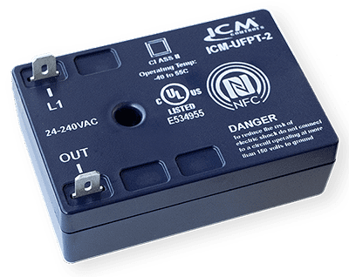
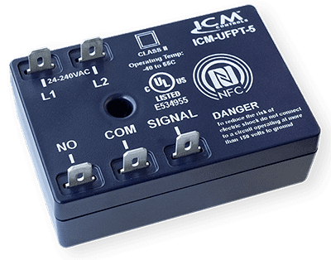
ICM-UFPT-2 SPECIFICATIONS:​​
Voltage: 24-240 VAC
40mA minimum-0.5A max
ICM-UFPT-5 SPECIFICATIONS:​​
Voltage: 24-240 VAC
1A @ 240VAC (pilot duty)
4FLA/4LRA @ 277VAC (AC motor)
5A @ 277VAC (general use)
8.75A @ 240VAC (resistive)
ICM-UFPT Timing Modes:​​
On delay
Interval
Anti-short cycle
Repeat cycle
Off delay (5-wire model only)
Single shot (5-wire model only)
Universal Time Delay Relays
Why we need a universal time delay relay and their applications?
One stop shop for all your timing needs
Replacement option for obsolete legacy timers
Universal application saves cost for the distributor and the technician by reducing the number of timers needed for stock
Great option for unique timing applications
The value of ICM controls universal time delay relays
Universal function replaces over 85 ICM legacy timers and hundreds of competitor models.
The convenience to stock one control for all timer applications.
State-of-the-art NFC technology allows accurate programming of all functionalities using a smart phone.
Installation instructions, wiring diagrams, and timing diagrams are conveniently displayed on the App.
Operation
Uses near field communication and the ICM OMNI app to program 6 different timing functions
APPLIANCE
ELECTRICAL
HVAC/R
MARINE
POOL & SPA
RV

Slide 5
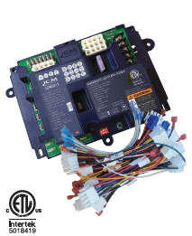
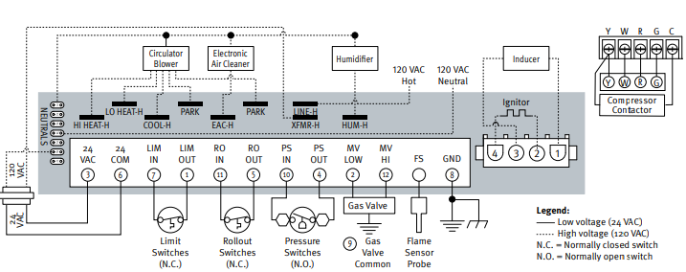
FEATURES:​​
Redundant gas valve safety design​​
Double sided plated through hole board construction​
Fault memory​​
​Agency certified​
Hot surface ignition​
Compatible with over 200 crosses​
SPECIFICATIONS:​​
Input:​​
• Line Voltage: 120 VAC​​
• Control Voltage: 18 – 30 VAC​​
Output:​​
• Type: Relay​
• Blower motor: 9.5 FLA @​ 120VAC
REPLACES:
White Rogers 50M26U-843U and over 200 popular furnace boards including Carrier, Rheem, Nordyne, Goodman, Trane etc.
ICM2812-KIT Universal Hot Surface Ignition Furnace Control board
Why Universal furnace control boards are the way to go?
Reduces truck stock inventory
Eliminates trips back and forth to distributors
Reduces inaccurate crosses by offering a single affordable solution to OEM boards
The value of choosing ICM controls Furnace Boards
Proudly assembled in USA
Meets stringent agency requirements for safety
Durable circuit board design and construction ensures strong connections increasing reliability
Complete with all the required cables to easily fit over 200 furnace boards
U.S. based live technical support with real technicians instead of artificial intelligence
Operation
The board controls all functions of the furnace including timing, trial for ignition, gas valve, system safety switches, flame sensing and provides 100% lockout safety
APPLIANCE
ELECTRICAL
HVAC/R
MARINE
POOL & SPA
RV

Slide 6
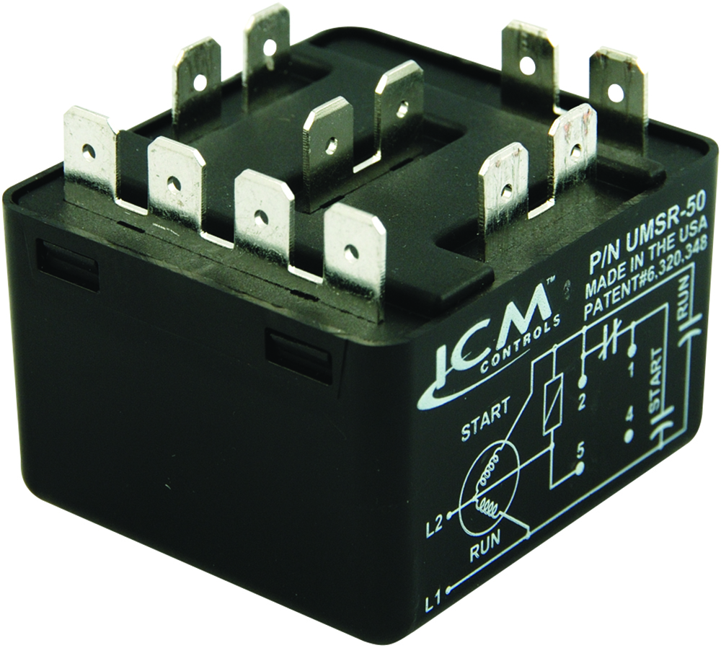
FEATURES:​​
Replacement for all standard potential relays
Patented differential voltage sensing
No user-adjustments required
Non-positional mounting configuration
50A switching capabilities
Universal mounting bracket for easy installation
SPECIFICATIONS:​​
Voltage rating: 110-270VAC, single phase
Max. voltage contact rating: 502 VAC (absolute)
Motor power rating: Up to 10 HP
Operating position: Non-positional
Safety time out: Approximately 1-second per 100 microfarads
Consumption: 5 VA maximum
Contact rating: 50A (break only)
Dimensions: 2.00” x 2.00” x 1.75”
REPLACES:
All standard potential relays
Supco: APR5, SUPR
UMSR-50- Universal Motor Starting Relays
Why we need Motor Starting Relays and their applications?
Capacitor start motors require a potential relay to dropout the start capacitor after the motor has started
There is a need to replace older style potential relays which have a pick-up and dropout rating requiring contractors to stock a large inventory of relays for different motor types
The value of using ICM’s Motor Starting Relay
ICM solved this issue by designing a universal motor starting relay incorporating a patented differential sensing circuit which removed the need for multiple relays
One universal function potential relay reduces truck stock and distributor inventory
Non-positional configuration offers a convenient mounting option
Ideal for A/C, commercial refrigeration, heat pump or any single-phase motor application up to 10 HP.
Operation​
Uses a differential voltage sensing circuit to monitor the back EMF of a motor and precisely disconnect the start circuit including the start capacitor at the exact moment the motor is started.
APPLIANCE
ELECTRICAL
HVAC/R
MARINE
POOL & SPA
RV

Slide 7
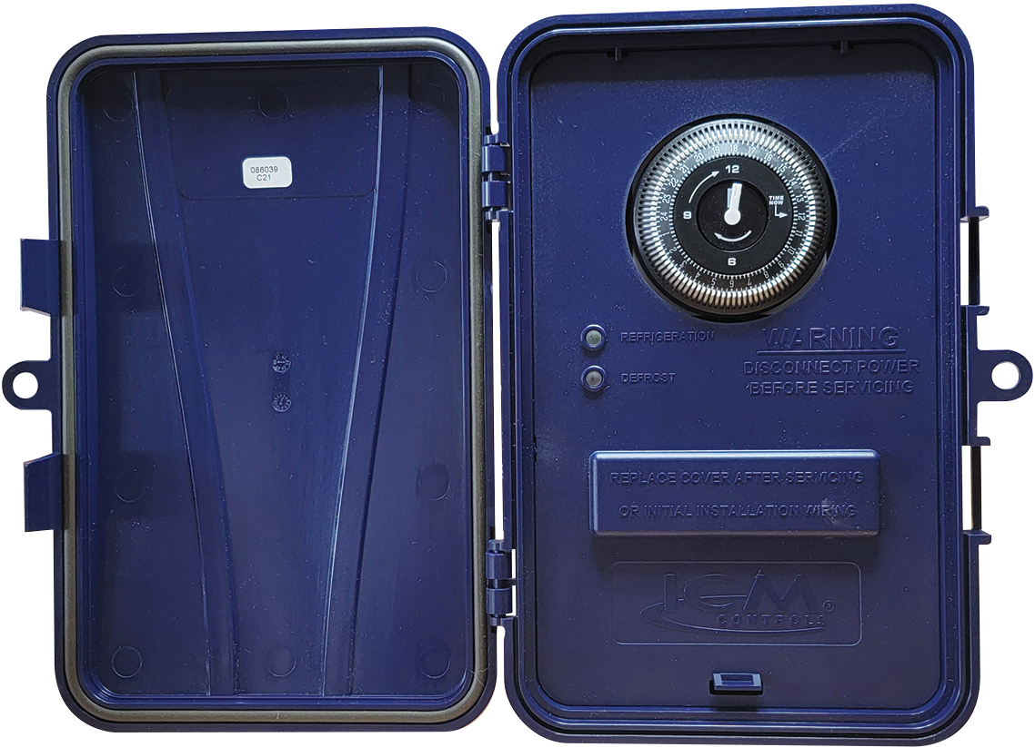
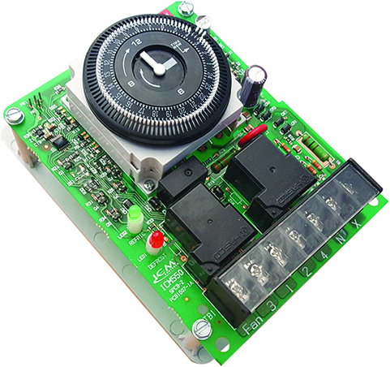
FEATURES:​​
24-hour multi-functional timer
Timed or manual termination
Adjustable 15 minutes to 23 hours 45 minutes defrost cycle
High power relay outputs
100% monitoring of inputs and outputs
Simple to use, drag & drop replacement for popular models
User-friendly time clock
For replacement board only order: ICM550
SPECIFICATIONS:​​
Electrical Rating
Voltage: 120-240VAC
Frequency: 60Hz
OUTPUT:
Type: Relay
Form: SPDT, SPST
Rating:
  [2] & [4]: 30A R, 1HP @ 120VAC, 2HP @240VAC
  [1] & [3]: 40A R, 1HP @120VAC, 2HP @ 240VAC
  [1] & [F]: 30A R, 1HP @ 120VAC, 2HP @240VAC
ICM550/ICM550-ENC: Multi-Functional Timer
Why we need the ICM550 multi-functional timer?
Refrigeration markets require a timer with high power relays to provide defrost operation
Multi-functional timers like the ICM550 can be used to provide cycle timing for many different applications including irrigation for green houses, circulation pump control for pool heaters and a host of other applications which require cycle timing
The value of using ICM’s Multi-functional timer:
Very robust design
User-friendly time click
Heavy duty output relays
Available with NEMA 4X weatherproof enclosure for applications such as water irrigation or pool & spa applications
Drag and drop replacement for popular brands like: Intermatic, Grasslin and Paragon models
Operation​
When mode B is selected and the unit is in the timed cycle (clock dip switches in the on position), the load will be turned on with the back up source. At the end of the timed cycle, the unit will return to normal operation until the next preset interval occurs. Mode A offers opposite operation, where the load is off during the timed cycle.
APPLIANCE
ELECTRICAL
HVAC/R
MARINE
POOL & SPA
RV

Slide 8
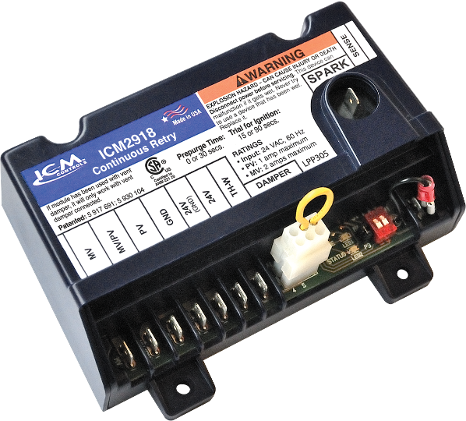
ICM CONTROLS HOT SURFACE IGNITION BOARDS CROSS TO MANY POPULAR ORIGINAL EQUIPMENT BRANDS INCLUDING:
Carrier
White Rodgers
Lennox
Goodman
Trane
UTEC
ICP
Rheem
Nordyne
Texas Instruments
ICM Controls Hot Surface Ignition furnace boards and their cross references to OEM boards can be found on the ICM Controls website at www.icmcontrols.com
ICM2918 Universal Intermittent Pilot Ignition Control
Why use a Universal Pilot Ignition control
Universal function saves the distributor from stocking multiple SKU's
Great for truck stock for contractors
Replaces the very popular Honeywell S8610U universal pilot ignition control.
The value of choosing ICM controls HSI Furnace Boards
Proudly assembled & engineered in USA
Meets stringent agency requirements for safety
Durable circuit board design and construction ensures strong connections and increased reliability
U.S. based technical support with real technicians instead of artificial intelligence
Operation
The ICM2918 Universal Intermittent Pilot Gas spark Ignition Control Module initiates and monitors pilot flame, trial for ignition, vent damper and the gas valve operation while incorporating a flame sensing circuit which will safely go into 100% lockout if flame sense is lost.
APPLIANCE
ELECTRICAL
HVAC/R
MARINE
POOL & SPA
RV

Slide 9
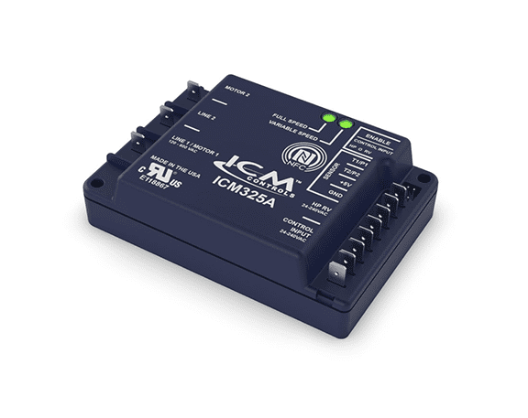
FEATURES:
Near field communication via the ICM Omni App
2 senor inputs
Universal control and input voltage
SPECIFICATIONS:
Input:
• Voltage Range: Universal 120 – 600 VAC
• Control Voltage: 24 – 240 VAC (jumper enabled)
Output:
• Motor 2: 10A maximum
ICM325A – Single-Phase Universal Head Pressure Control
Why we need Head Pressure Controls and their applications ?
Supermarkets, grow houses and computer rooms still require air conditioning and refrigeration during low-ambient conditions.
To prevent the loss of perishable goods and damage to sensitive equipment
Prevents issues like liquid slugging and evaporator freeze-ups.
Helps regulate the system pressure.
The value of the ICM’s Head Pressure Controls
Universal input voltage 120-600VAC
NFC technology allows for easy programming and setup without the need for external power by using the power of your mobile device and the ICM OMNI App!
NFC does not require internet connection and is more reliable than Bluetooth
More reliable and accurate than setting with basic potentiometers
Universal operation reduces truck stock and multiple SKU’s making it a great choice for both stocking distributors and contractor alike
Operation
The ICM325A will control the head pressure on a heat pump or HVAC unit by adjusting the condenser fan speed thus allowing the heat pump or air conditioner to operate in low ambient conditions.
REPLACES:
ACT: FM2000
Hoffman: 800, 800A, 800AA, 814-50, 816-10
Ranco: E31Series
Johnson Controls: P66AAB/P66AAD
ICM: All Single-Phase Head Pressure Controls Models; ICM325H, ICM325HNV, ICM326HN, ICM327HN, ICM333
APPLIANCE
ELECTRICAL
HVAC/R
MARINE
POOL & SPA
RV

